Slide 1
Notes:
Hello everyone, my name is Daniel Fleming and I am the geriatric physical therapy resident and Ashley Vincent the Occupational Therapy Mental Health and Wellness Fellow. We are here today to present on how we as the health care team can work to improve the function of elderly patients within the acute care setting.

Slide 2
Objectives
Define function and disability within the context of the ICF model.
Identify complications of hospitalization and resulting impact on function.
Discuss benefits of optimizing function in acute care setting.
Describe roles and responsibilities of OT and PT in optimizing function of patients in the hospital setting.
Discuss interprofessional strategies to optimize patient’s function in acute care setting.
Apply interprofessional strategies to promote function in a case scenario.
Notes:
Ashley

Slide 3
Pre-Test Questions
1. Who on the medical team is responsible for ensuring the improvement of function of elderly patients within the acute care setting?
  a. Physician b. PT c. OT d. nursing e. all of the above
2. _________ is an umbrella term for impairments, activity limitations and participation restrictions. It denotes negative aspects of the interaction between a person’s health condition(s) and the individual’s contextual factors (environmental and personal factors)
3. Why is it important to promote function?
a. Improves Quality of Care b. Gives patients something to do c. To add stress to the care team
Notes:
Dan

Slide 4
Roles in Acute Care Setting
Physical Therapy
  Comprehensive evaluation to identify impairments
  Individualize treatment plans
  Patient, family, caregiver education
  Recommendations for safe mobility in hospital
  Facilitate early mobilization in hospital.
  Discharge recommendations
  Anticipate needs of discharge.
Occupational Therapy
  Identify patients' meaningful occupations / activities / roles
  Restore skills and/or modify the environment or task to improve function and independence
  Special focus on mental health, physical & cognitive factors
  Progression towards performance-based goals
  Discharge planning
University of Rochester Medical Center
(American Occupational Therapy Association, 2020)
Notes:
Dan + Ashley

Slide 5
Areas Addressed by OT
ADL | IADL | Health Management
Bathing Toileting Dressing Eating/Swallowing Feeding (food to mouth) Functional Mobility Grooming Sexual Activity | Care of Others Care of pets and animals Child rearing Driving and Community Mobility Financial Management Home Establishment and Management Meal preparation and Cleanup Religious and Spiritual Expression Safety and emergency maintenance Shopping | Social and emotional health promotion/maintenance Symptom and condition management Communication with the health care system Medication management Physical activity Nutrition management Personal Care Device Management
(AOTA, 2020)
Notes:
Ashley

Slide 6
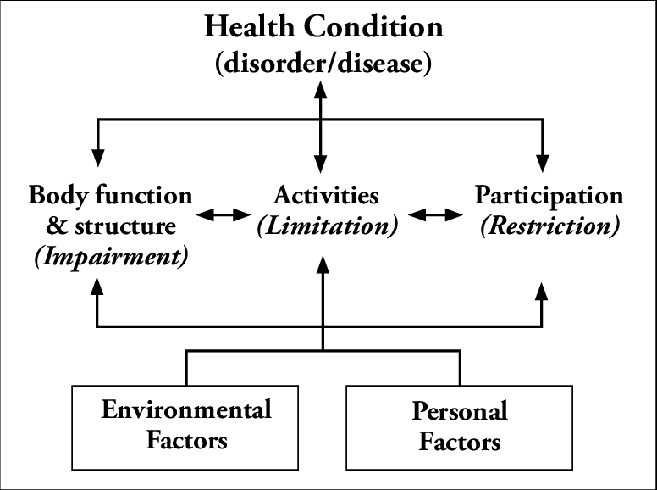
International Classification of Function (ICF) Model
(World Health Organization (WHO), 2002)
Notes:
OTs and PTs use the International Classification of Functioning, Disability, and Health or the ICF model to conceptualize and analyze the dynamic interaction of components that makeup disability and functioning. This model was created in 2002 by the WHO to provide a scientific basis for health status and conditions for interdisciplinary use from healthcare to research to education to policy. Its creation is a global effort to further understand and define functioning and disability by providing a common language about health and health related issues, a scientific bases for studying and understanding disability and function, a way to compare data about function and disability across the world, and to create a systematic coding scheme for health information systems. The ICF model applies to everyone regardless of health condition and does not treat disability as a separate category, places all diseases on the same level, attempts to use a neutral language to describe disability, and recognizes the role the environment can play within disability or function.

Slide 7
What is Function?
Function
  An umbrella term for body function, body structures, activities and participation. It denotes the positive or neutral aspects of the interaction between a person’s health condition(s) and that individual’s contextual factors (environmental and personal factors)
Disability
  An umbrella term for impairments, activity limitations and participation restrictions. It denotes negative aspects of the interaction between a person’s health condition(s) and the individual’s contextual factors (environmental and personal factors)
(Liu et al. 2019)
(WHO, 2002)
Notes:
The ICF classifies disability and function as umbrella terms used to describe the interactions amongst the components of the ICF model which include personal factors, personal factors, body structures and functions, activities, and participation.
Functioning- denotes a neutral or positive interaction between all the components of the ICF model and the health condition. Body structures includes things like muscles, tendons, ligaments, etc and there resulting body function which is for voluntary movement of body. It is important to understand activity vs. participation. Activity is the execution of a task for example walking but participation is involvement in a life situation like weekly neighborhood walks with friends.
Disability- denotes a negative interaction between the health condition and the other components of the ICF. Problems in structure and function are described as impairments like a muscle strain or a ligament sprain, causing difficulty in activity like walking which we would define as limitations and resulting in ultimately inability to participate in life activities which we would call a restriction like walking to a friend’s house.
The personal and environmental components of the ICF also play a significant role in a person’s disability and function within the ICF model. Environment factors can either be facilitators or barriers and include the physical, social, and attitudinal environment in which people conduct their lives. Examples include number of steps into house, number of floors to house, or access to transportation just to name a few. Personal factors on the other hand are factors intrinsic to person such as race, age, gender, coping style. These are not specifically coded in ICF at this point, but they can have a significant effect on a person’s health status.
The ICF has been validated for use in clinical setting is currently being utilized as a clinical tool to predict the length of stay and treatment cost for each patient.

Slide 8
Case Study
Mr. Jones is a 76-year-old black, male with history significant of chronic PTSD, diabetes, obesity, CHF, and depression. He recently sustained a fall and broke his R hip, requiring THA, which has shown signs of infection.
What are some factors about Mr. Jones we could consider through
the ICF Framework?
Notes:
Here is a patient that I want you to think about as we present. Try to consider about what might be important to focus on or consider about his function.

Slide 9
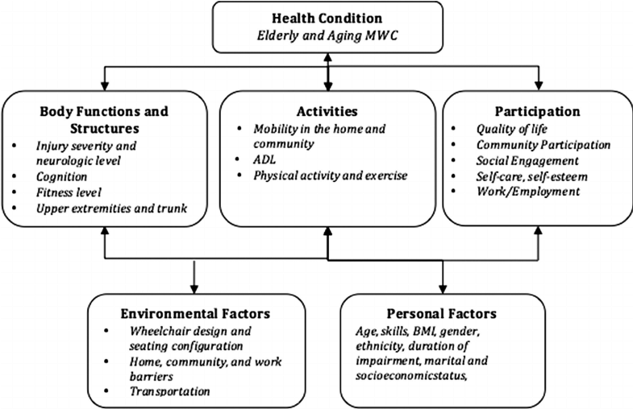
(Williams, 2015)
Notes:
How to consider his case within the context of the ICF

Slide 10
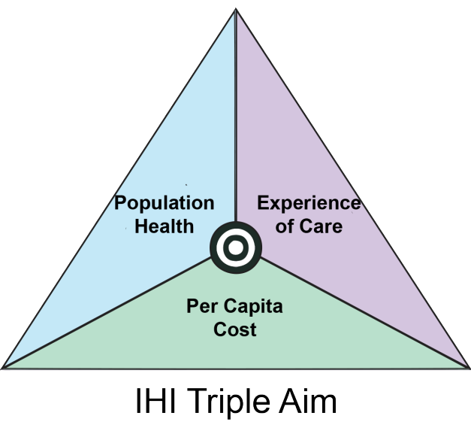
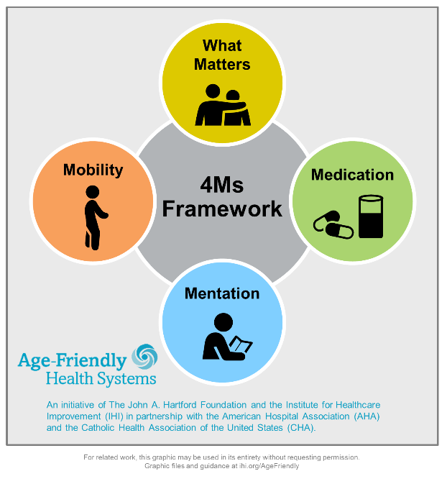
Why Function Matters in the Hospital
Part of Healthcare Quality Initiatives
(Berwick et al., 2008; Institute for Healthcare Improvement, 2020)
Notes:
Ashley

Slide 11
Why Function Matters in the Hospital?
To Hospitals:
Quality outcomes:
Increased length of stay
Hospital readmission
Discharge recommendations
To Patients:
Independence, Well Being and Freedom
  Self-identity & Self-efficacy
Pros and Cons to Assisted Mobility
  Alternatives to mobility limitations
Adaptability
  Decline is nonlinear
(Creditor, 1993; Goins et al., 2014)
Notes:
Ashley

Slide 12
Framing the Problem for Functional Decline
Immobility
  80% of elder adults only spend 43 min day walking despite being ambulatory upon admission
Falls
  30-50% result in physical injury with 1-3% resulting in fractures ’
Discharge to SNF
  3.8% died at initial stay at SNF
  28.6% required readmission
(Morris & O’Riordan, 2017)
(Gillis & MacDonald, 2005; Smart et al 2018)
(Hakkarien et al. 2016)

Slide 13
(Creditor 1993)
Notes:
In this slide, I am going to discuss the affects that hospitalization has on an elderly patient’s function. At the top we can see normal aging and this is what elderly patients are usually presenting to hospital admission with. While normal aging usually results in a loss of function such as sarcopenia or decrease in muscle strength, bone density, skin integrity, etc. It is the further effects of hospitalization that can further degrade function. High bed rails can lead to decreased mobility, lack of access to fluids or barriers to mobility can decrease plasma volume, sensory deprivation from isolation or removal of glasses or hearing aids, etc can increase the risk of patients developing more complications, increase their level of disability and dependence. These downstream effects can result in a discharge location that signifies a greater level of dependence like a nursing home, which is why it is so important we as a medical team intervene to prevent these hazards and promote function.

Slide 14
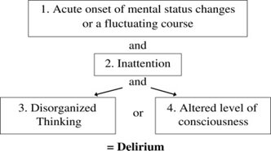

Delirium
An acute medical condition characterized by inattention with additional changes in global cognitive function and/or arousal levels.
Three Clinical Presentations:
Hyperactive
Hypoactive
Mixed
(American Psychiatric Association, 2013; Fong, Tulabaev & Inouye, 2009; Pisani, M.A., Kong, Kasl, Murphy, Araujo, Van Ness, 2009)
Notes:
Ashley

Slide 15
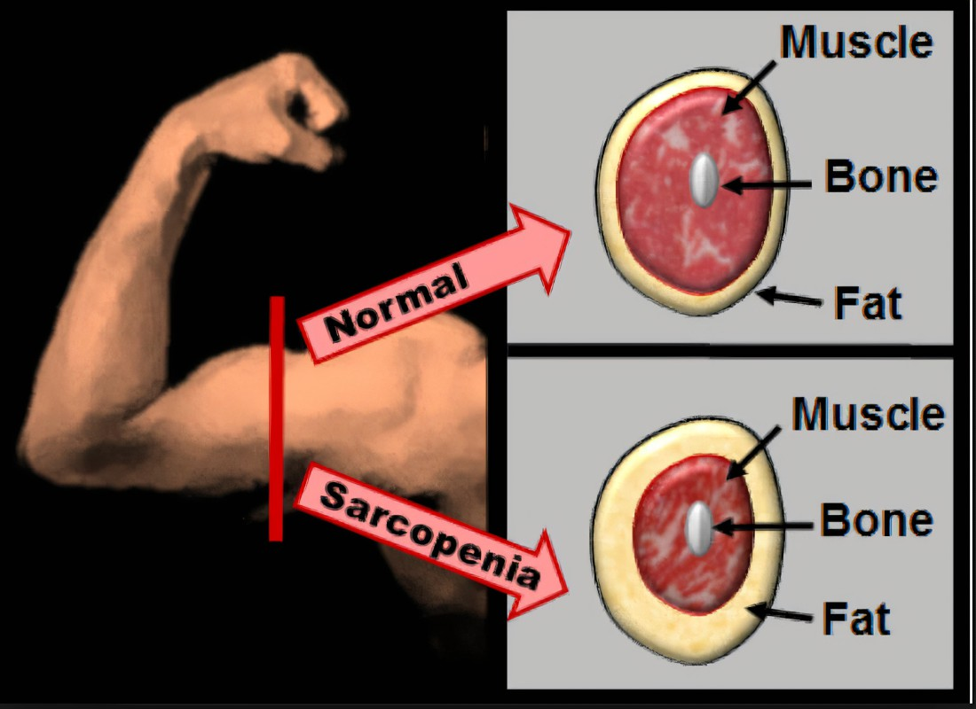
Deconditioning in the Hospitalized Elderly
(Gillis & MacDonald, 2005)
Notes:
Deconditioning is a complex process of physiological change following a period of inactivity, bedrest, or sedentary lifestyle, and it is commonly associated with hospitalization in the elderly. The resulting functional losses that occur from deconditioning include mental status and degree of incontinence and ability to accomplish ADLs. It’s affect on MSK system include sarcopenia or diminished muscle mass, a decrease in muscle strength by 2 to 5% per day, muscle shortening, and significant loss of leg strength. The resulting functional deficits that result from sarcopenia include falls, functional decline, and increased frailty and mobility.

Slide 16
Process Framework
Admission/Referral
Gather history
Intervention
Clnical Observation/Assessment
Notes:
Ashley

Slide 17
Case Study
Mr. Jones is a 76-year-old black, male with history of chronic PTSD, diabetes, obesity, CHF, and depression. He recently sustained a fall and broke his R hip, requiring THA, which has shown signs of infection.
Notes:
Ashley-Here is a patient that I want you to think about as we present. Try to consider about what might be important to focus on or consider about his function.

Slide 18
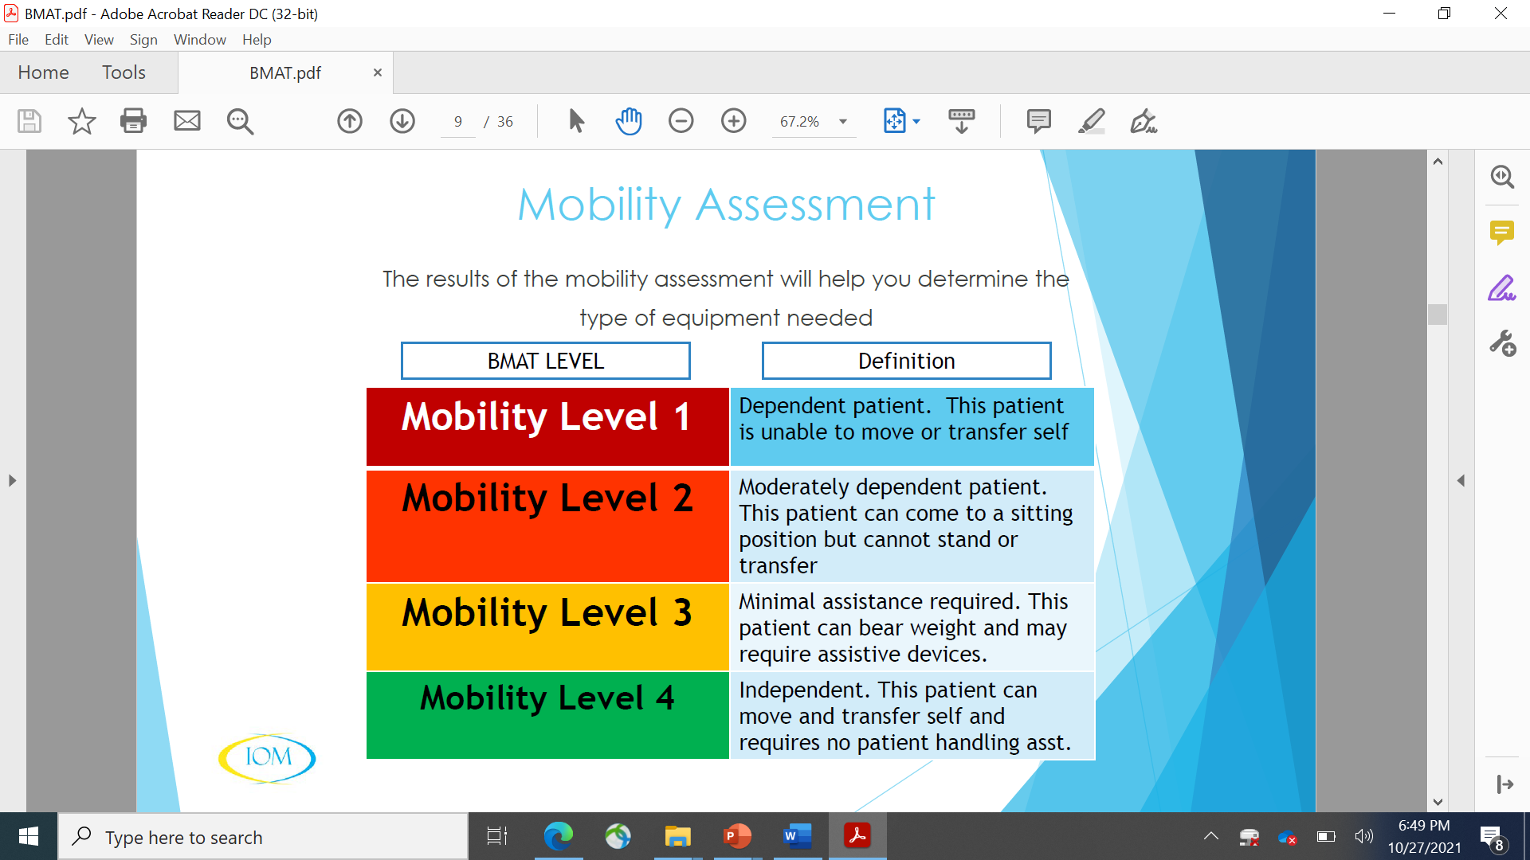
Mobility: Bedside Mobility Assessment Tool (BMAT)
(DukeHealth 2019)
Notes:
DAN-Here is the Beside Mobility Assessment Tool (BMAT), and it serves as a great example of how we use assessments to measure function, specifically mobility. As therapists we use look these assessments while charting in order to get a better idea about a patient’s mobility status before seeing them. Now let’s talk about the assessments that we as PTs and OTs use to measure function. We will discuss this by giving you a overview of what we do in the geriatric assessment.

Slide 19

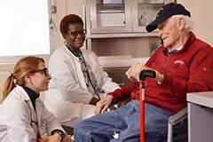

Evaluation: Patient History
  Chart Review
    Medical Condition
    H&P Note
    Most Recent Medical Note
    Previous OT/PT notes
    Lab Values
    Vitals
    Precautions
  Patient Interview/Subjective
    Number of Falls in past 6 months
    Home Setup (environmental supports/barriers)
    DME & Assistive Equipment
    Prior Level of Function
    Social Support
    PATIENT GOALS
Notes:
Dan Every evaluation of a patient starts with a thorough chart review where we look at why the pt is being admitted, their past medical history and past medical history with therapy (OT and PT). Basically, we are trying to get as clear of an idea as possible about what patient is like before we even meet them. To determine whether patient is appropriate to see we look at lab values, the physician’s activity orders, and vitals. When we first meet patient, we take a patient history by asking a series of questions listed above. As I described earlier, with the ICF, through questions like home setup, number of falls, and social support, we as are trying to get as much information about the components of the ICF like environmental, participation, and personal factors that inform what we will measure and how we will intervene.

Slide 20
Case Study: Mr. Jones
History / Environment (person and environment factors)
  Electrician, 23 years. Retired 6 years ago. Spends most of day in bed or on couch, inside, watching TV or calling friends.
  Home distant from social and community supports.
  1 story home with 4 steps to enter, unilateral handrail.
  Adult children and friends live at least 20 minutes away.
  Veteran attends biweekly Veteran meetup.
  Wife willing and able to complete community-based tasks and to drive him to social engagements. Unable to physically support mobility.
Sensation/Physical Abilities
  Bilateral peripheral LE neuropathy. Strength and ROM WNL.
  Wears glasses. Hearing functional
Orientation and Cognition
  Difficulties with short term memory, poor decision-making, and safety awareness.
Mental Health Factors/Impact
  Spends most of day in bed or on couch, inside. Social isolation. Anhedonia.
Notes:
Ashley

Slide 21
Evaluation: Assessment
  Systems Screen
    Pain
    Orthostatic Vitals
    ROM & Strength
    Sensation & Reflexes
    Coordination
  Mobility Screen
  Determine level of assistance.
    Bed Mobility
    Transfers
    Gait
    Stairs
  Performance-based Assessments
  Personal Factors
    Roles
    Habits & Routines
  Orientation and Cognition
  Mental Health Factors & Impact
Notes:
After subjective, we progress further through evaluation, by completing objective measures like a system screen of msk and neuro, mobility screen, performance based outcome measures, and personal factors like cognition, orientation, and mental health factors and impact.
We look for a holistic picture of our patients, from history, what’s important to them, past medical experiences, and identifying barriers and facilitators to participation in functional activity. Depending on the patient, we like to get a good idea of their physical and cognitive abilities as well as taking into consideration what motivates them and any other factors which may limit or enhance their ability to do what’s important to them (from ADLs to health management to IADLs).

Slide 22
OT Assessments
Functional | IADL / Health Management
- Functional Independence Measure (FIM) - Assessment of Motor and Process Skills (AMPS) - Performance Assessment of Self-Care Skills (PASS) | - Weekly Calendar Planning Activity - Executive Function Performance Test - Texas Functional Living Scales - PASS
Participation | Cognition
- Activity Card Sort - Kohlman Evaluation of Living Scales - Occupational Self-Assessment - Role Checklist - Falls Efficacy Scale – International (FES-I) - Patient's concern about falls within the home and community | - Montreal Cognitive Assessment (MoCA) - Allen Cognitive Levels Screen (ACLS) - St. Louis University Mental Status Exam (SLUMS
Notes:
Ashle

Slide 23
PT Geriatric Outcome Measures
Assess patient’s function and predictor of falls risk
Assess effectiveness of intervention and patient progress
  Gait Speed
    (Discharge location/Level of assistance with ADLs and IADLs)
  Berg Balance Scale
  (Balance)
  Timed Up and Go (TUG)
    (Predictor of Falls)
  30 Second Chair Stand Test
  (Lower Extremity Endurance)
  5 Times Sit to Stand Test
  (Lower Extremity Strength)
  2 Minute or 6 Minute Walk Test (Endurance)
APTA Geriatrics
Notes:
These are some tests we use to determine a patient’s function. These test give us an idea at where patients are with their function compared with other individuals with their gender and age range, and it also helps us to make goals and work towards those goals, and see how much progress we made. These tests are also incredibly important for being able to predict whether patient is at falls risk.

Slide 24
ADL Assessment
(FIM Scoring)
7: Complete independence - Fully independent
6: Modified independence - Requiring the use of a device and/or extended amount of time, but no physical help needed
5: Supervision - Requiring only standby assistance or verbal prompting or help with setup
4: Minimal assistance - Requiring incidental hands-on help only (Veteran performs > 75% of the task)
3: Moderate assistance - Veteran performs 50-75% of the task and needs assistance for 25-50% of the task
2: Maximal assistance - Veteran provides less than half of the effort (25-49%)
1: Total assistance - Veteran contributes < 25% of the effort or is unable to do the task
0: Activity does not occur
Eating
Grooming
Bathing
Dressing Upper/Lower
Toileting
Transfers
Walk/Wheelchair
Stairs
(Uniform Data System for Medical Rehabilitation, 2012)
Notes:
This is one you’ve likely seen a lot. So, what does it mean? FIM scores are indicative of a patient’s current ability to perform a task. We give a rating from 7-0 depending on how much effort the patient can provide (7 being completely independent and 1 being that the patient needs total assistance. These scores communicate where the patient is at at the time of assessment, so, during each interaction with the patient where these activities occur, the patient should be performing at this level of independence at least to promote their independence and sustained functionality with these tasks.

Slide 25
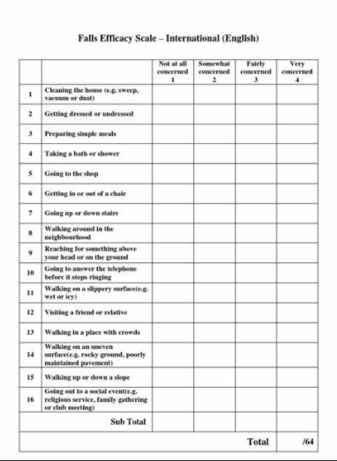

Falls Efficacy Scale – International (FES-I)
Mr. Jones:
FES-I Score – 52/64
Concern for falls:
Fairly High
Client Self-Report Measure
Assesses patient's concerns about falling during household/community activities
Predictive of reduced participation and reduced mobility
1
4
15
32
(Jefferis et al., 2014; Salbach et al., 2014; Tinetti et al., 1990; Yardley et al, 2005; Young and Williams, 2015)
Notes:
An example of a participation-based assessment, something to consider as it notes patient’s fears of falling and is predictive of reduced participation and potential for falls in the future.

Slide 26
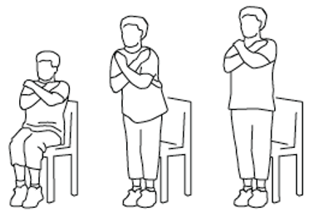
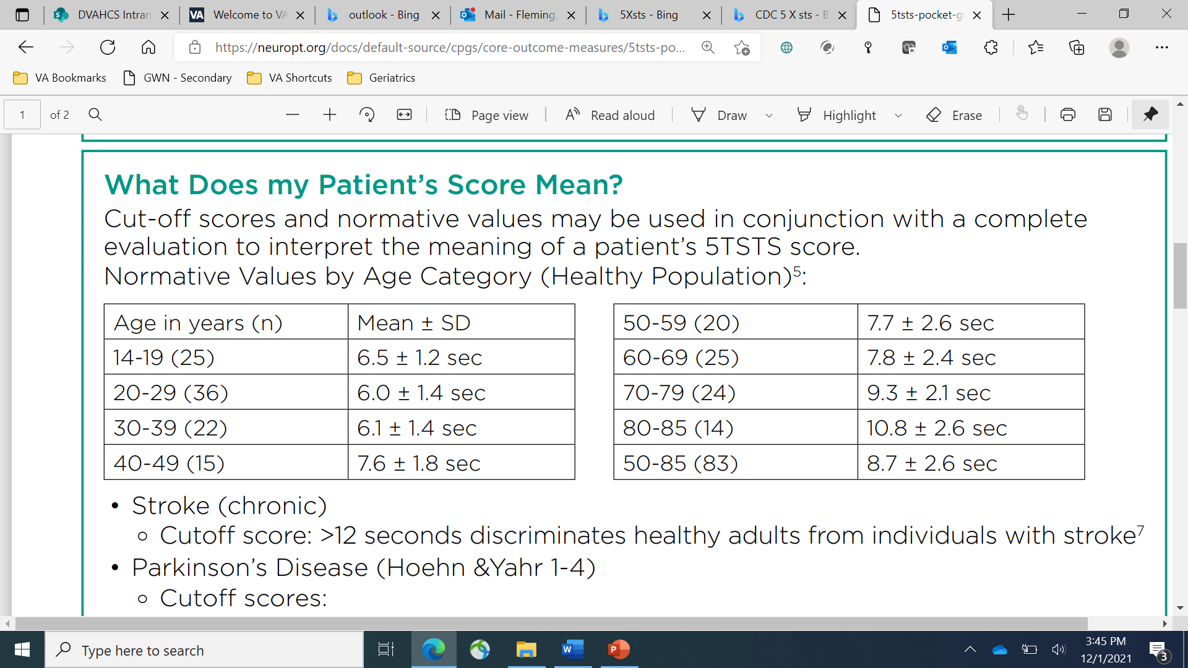
5 x Sit to Stand
Mr. Jones scored a 0 was not able to complete any chair stands without UE support.
(Buatois 2010)
Notes:
We are going to do the 5xSTS or our performance measure test for LE strength. Use your own discretion when deciding to participate, and try to find a chair that is secure against ground.
1. Sit in the middle of the chair.
2. Place your hands on the opposite shoulder crossed, at the wrists.
3. Keep your feet flat on the floor.
4. Keep your back straight, and keep your arms against your chest.
5. On “Go,” rise to a full standing position, then sit back down again.
6. Repeat this 5 times as you safely can and see how long it takes you to perform it. I will show you a clock so that you can track time.
Ready, go... stop.
Compare how you fared with your age related peers. Are any of you are at increased risk for falls.

Slide 27
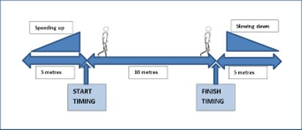
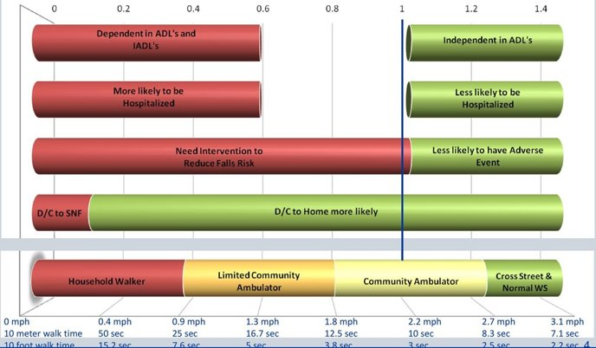
10 Meter Walk Test
Mr. Jones:
0.1 m/sec
Notes:
Here is a very common test we do where a pt simpley walks 10 meters in a straight line where and we measure the time it takes them to complete the task.
Through research, the gait speed times have been shown to be predictive of certain functional outcomes that are reported in chart on this slide. These cutoffs are highly reliable and validated to point where gait speed is known as the sixth vital sign, because it helps us predict a lot about a patient’s function like mortality/morbidity, discharge location from acute care, and ability to safely cross the street just to name a few.

Slide 28
Case Study: Mr. Jones (FIM Scores)
Eating: 7 – Independent
Grooming: 7 Independent with facial grooming + hand/face washing
Bathing/Showering: 3 – 50-75% assist needed to wash bl LEs
Dressing (Upper Body): 7 - Independent
Dressing (Lower Body): 3 – <50% assist needed; extra time, seated, difficulty donning sock on R LE 2/2 THA precautions
Toileting: 4 – Independent with perineal hygiene, needs assist with clothing management
Bladder: 6 – Issues of urinary urgency, wears pads to support
Bowel: 7 –Independent
Transfer (Bed/Chair/Toilet): 4 – MinAx1 for sit > stand, CGA for stand > sit
Transfer (Toilet): 4 – MinAx1 for sit > stand, CGA and grab bar assist for stand > sit
Walk: 2 – CGA ambulation with RW, greater than 50ft, less than 150ft
Stairs: 0 – Activity not assessed
Notes:
Ashley This helps to inform us of patient's current need for assist, determine goals, and caregiver education. Along with other factors (cognitive, motivation, pain tolerance), this can inform healthcare staff of max levels of assist to provide patients to encourage maintained functionality and mobility

Slide 29
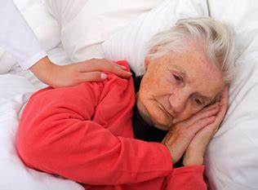
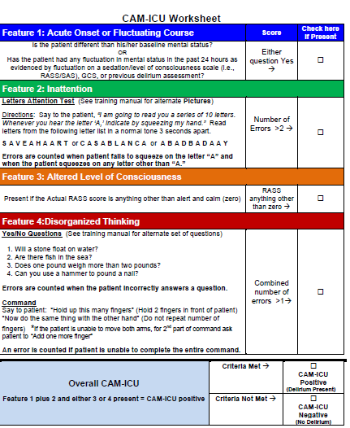
Assessing Delirium
Mr. Jones:
Positive for acute onset & disorganized thinking
Delirium not present at time of assessment.
Early detection allows for recognition and treatment of underlying cause(s)
2 Versions:
- CAM-ICU – 10 item screen for intubated/non-verbal pts
- CAM-3D – 3-minute diagnostic screen
Needs negative screen for at 24 hours to be considered clear from delirium.
(Fong, Tulabaev & Inouye, 2009; Palihnich, Inouye & Marcantonio, 2014)
Notes:
Ashley : What factors may contribte to patient development of delirium? Is he at risk?

Slide 30
Discharge Recommendations
Mr. Jones:
Pt. Anticipated discharge to skilled nursing facility
Discharge Rehab Locations
  Acute Care (PT in hospital)
  Home
  Acute Inpatient Rehab
  Subacute Rehab or Skilled Nursing Facility
  Long term Care Facility/Nursing Home
  Assisted Living-Medical Foster Home
Anticipated Level of Support
  Family Support
  Home Health Support
  Outpatient Rehab Necessary
(SNF, SAR, NH, ALF, and More Discharge Options: Interprofessional Education Series, 2020)
Notes:
One of the most important roles that OTs and PTs play in the medical care team is discharge recommendations. These recommendations are made after evaluation a patient, and the patient is then discharged from acute care setting to one of these locations once they are medically stable. The locations are as follows: Home : Home with Home Health Physical Therapy or without therapy if pt is at baseline, home with outpatient PT if they have transportation and are not physically home bound. Or even sometime patients can get an aid for additional support. Acute Inpatient Rehab: If patient has rehab potential and needs 3 specialties, and can tolerate up to 3 hrs of therapy. Happens during partial hospitalization or residential which requires transportation to facility. Intense rehab. Subacute Rehab or Skilled Nursing Facility (used interchangeably)-patient stays at facility and receives additional PT and OT therapy at facility. Not as intense as acute inpatient rehab Long term Care Facility or Nursing Home – need 24/7 support. Assisted Living Facility – Need support but not as much as in nursing home. Assistance wit meals,etc

Slide 31

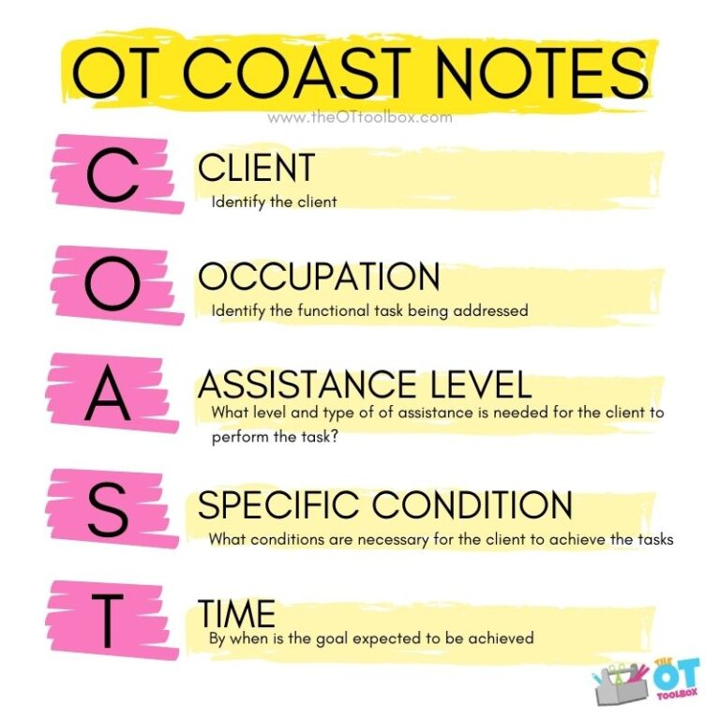
Goal Setting & Action Planning
Time Frame for acute care is usually 1 to 2 weeks
  Examples goals for Mr. Jones:
    Pt will ambulate >=50 ft with mod I with use of LRAD.
    Pt will demonstrate mod-I LBD with use of AE.
    Pt will independently use toilet while adhering to THA precautions within 2 weeks of surgery.
(OTToolbox.com)
Notes:
Talk about ambulation goal and also connect with outcome measures where you can make goals like a point increase
Goals are function-based! May have to do with balance, ambulation, level of independence with ADL task. Take a look at the goals we’ve developed for our case study. It is important for patient-recovery for interdisciplinary carry over!
uAction Planning
u To assist Veteran in thought organization and
identify functional and feasible action steps to achieve goals (in acute hospital settings, this may look like re-engaging in IADLs).
u Promoting routinized referral to goals and action steps to promote patient accountability.

Slide 32
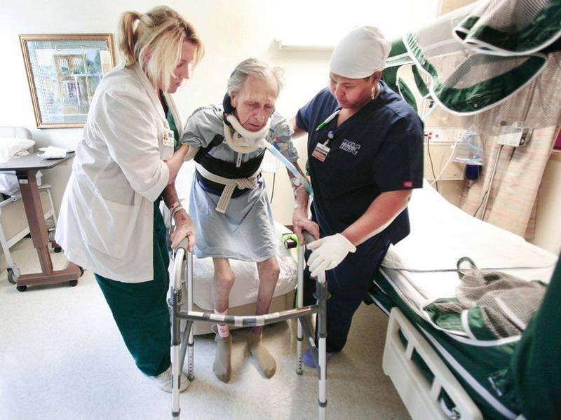
OT/PT Interventions
Education / Training
Caregiver Education
Positioning / Splinting
Therapeutic exercise and activities
Mobility, Balance and ambulation
Assistive Device Recommendations
Wheelchairs, Walkers, Canes
Bathroom equipment
Splinting
Power Mobility
ADL Aids
  Dressing, Feeding, Grooming, etc.
Low Vision
(AOTA, 2020; Dovern et al, 2012)
Notes:
-OT Intervention Examples (Ashley)
-PT Acute Intervention Examples (Dan)- Eval will guide the interventions, and focus should be on pt function like having them be able to transfer from bed to chair or ambulate a certain distance so they can regain functional independence. Even non movement interventions like the positioning of the patient are very important in order to prevent bed sores and contractures is also an example of an intervention that both OTs, PTs, and nurses can utilize to promote function.
-Adaptive Equipment (Dan + Ashley)- Therapists can also use equipment to help patients be able to function from walkers to wheelchairs. What a patient cannot do we attempt to make up for with technology.

Slide 33
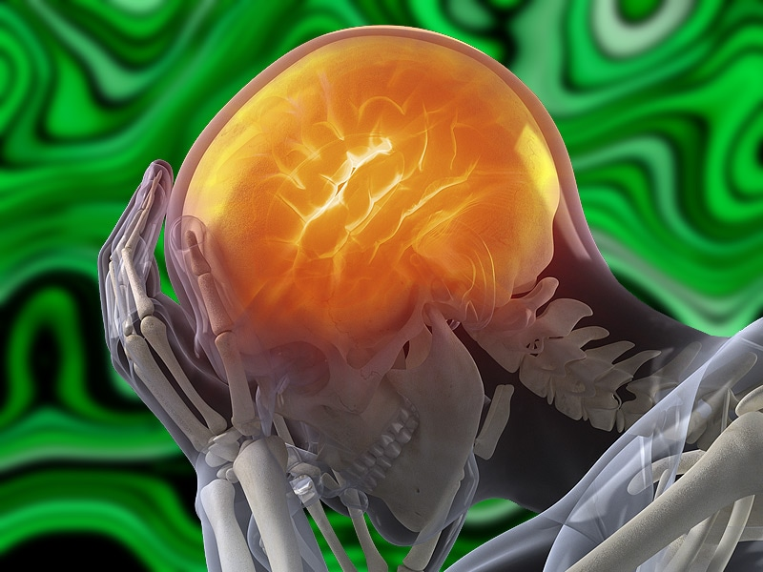
Preventing Delirium
How?
  Viewing cognition as a vital sign!
  Early / Maintaining Mobility
  Sustaining function
  Environmental
Why?
Risk of death | Risk of discharge to SNF
Number of days in ICU | Risk of long-term cognitive decline / dementia.
Number of days on ventilator | Number of days a person has delirium is important.
(Ely & Pun, 2002; Fong, Tulabaev & Inouye, 2009)
Notes:
Ashley

Slide 34
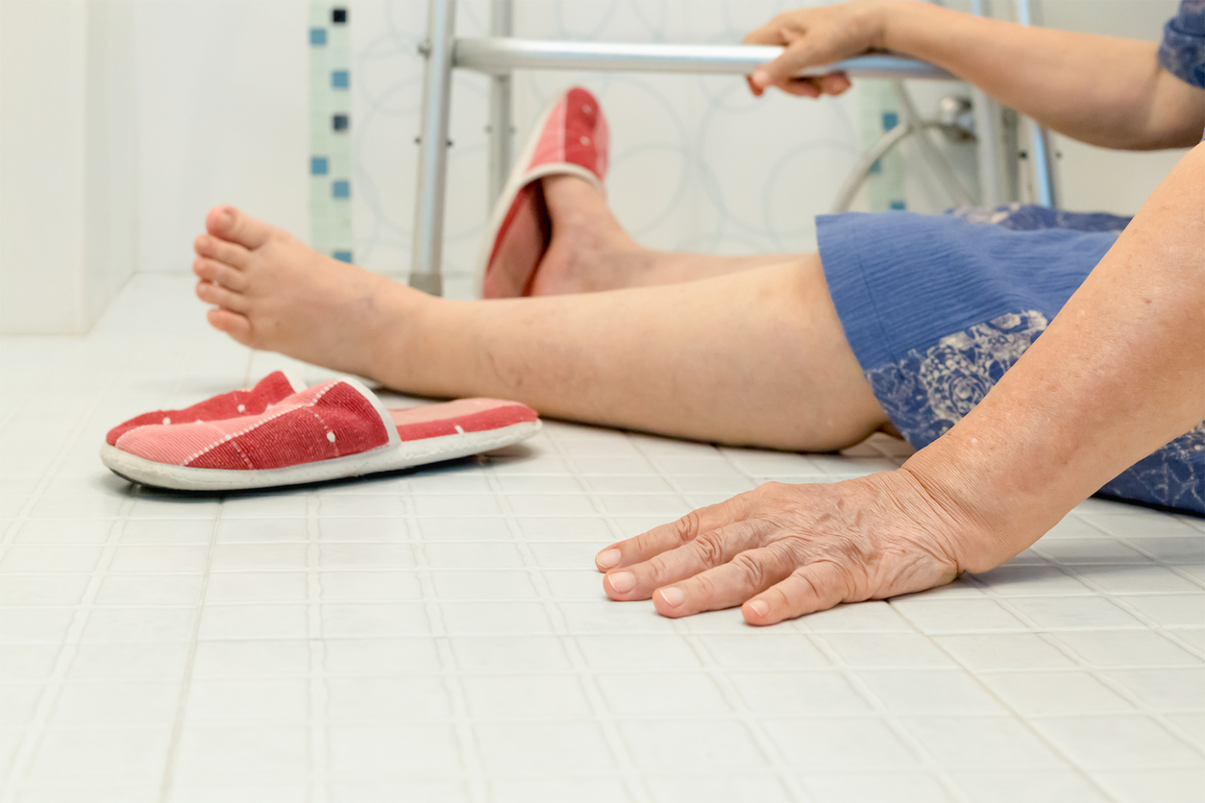
Fall Prevention in Hospital
Statistics
  Physical Injury
  Psychological Sequalae
Intervention
    Physician's review of polypharmacy
    Safety Huddles
    Intentional Rounding
    Environmental Modification
(WHO 2021)
(Morris & O’Riordan, 2017)
Notes:
As I mentioned before in the slide with statistics, falls are one of the biggest concerns for therapists. 30-50% of falls results in physical injuries with 1-3% of that percentage resulting in fractures. There is also a resulting psychological sequalae that results from falls which includes loss of Confidence in Balance, delay in functional recovery, and Increased length of Hospital Stay. Interventions to prevent falls within hospital include a coordinated, interdisciplinary approach can reduce inpatient falls by 20-30%. These interventions require a team-based approach with physicians and pharmacists reviewing medications that put pt’s at a higher falls risk, teams members meeting for safety huddles in which they discuss the current status of the patient and opportunities to improve patient care and safety, and intentional rounding in which handoff includes discussion of patients that are at high risk and the interventions underway that are being used to manage these patients. Other strategies include environmental modifications or the removal of clutter in a patient’s walkway, keeping mobility aids close to the patient, and making patients, caregivers, or staff aware of spectacles, earing aids, or appropriate footwear the pt could wear to increase safety.
Falls (who.int)

Slide 35
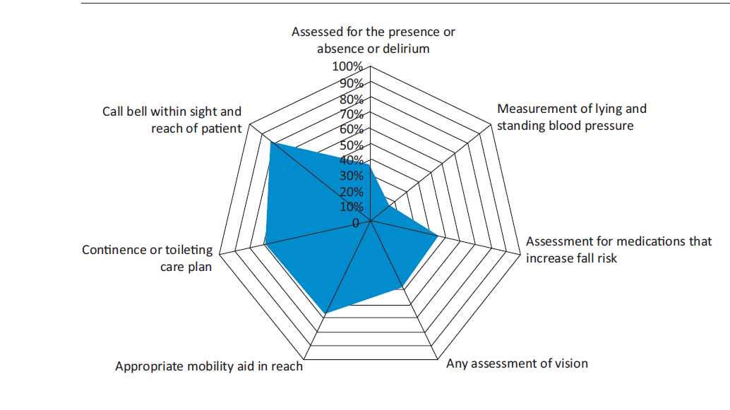
Fall Prevention
Figure 1: Overview of Fall Data from Audit done by NHS in U.K
  Demonstrate disparities between written policy and practical implementation. Measuring when fall risk was identified and addressed with intervention.
Notes:
Demonstrate disparities between written policy and practical implementation
Measuring when fall risk was identified and addressed with intervention
Nurses, OTs, PTs or any other professional directly interfacing with patient
Call bell within sight and reach of patient
Appropriate mobility aid in reach
Continence or toileting care plan in place
Physicians
Review of medications that increase incidence of falls (Beer’s Criteria)
Prevention and management of delirium
Safety Huddles
Short multidisciplinary team briefings that describe patient’s and identify improvements with safety measures
Associated with reduction of falls in some hospitals
Intentional Rounding
Hand off and discussion of high-risk patients and interventions that are already underway

Slide 36
Case Study: Intervention
What type of functional interventions might be appropriate for Mr. Jones?
Notes:
Ashley

Slide 37
Interdisciplinary Strategies
Everyday Prevention of Hospital-borne Disability
Prevention of Pain, Agitation, Delirium,
Immobility and Sleep Disruption (PADIS)
Acute Care for Elders (ACE) Unit
Improved Communication
Promoting Health and Cognition
4Ms Framework
Notes:
Ashley

Slide 38
Everyday Prevention of Hospital-borne Disability
Problem: Hospitalized older adults spend 80% of their time lying in bed and less than 43 min day walking, despite being ambulatory upon admission
Sitting up in bedside chair for all meals (if possible)
Help patients who are not incontinent to bathroom
Use of recommended mobility devices
Provide only the required assistance, allow patients to remain as independent as possible in care
Model of Care: Nursing Education & Family Support
Exercise Programs
(Brown et al., 2009)
Notes:
Ashley

Slide 39
Interdisciplinary Approach: PADIS
Prevention and Management of Pain, Agitation (Sedation), Delirium, Immobility & Sleep (Disruption) + Rehabilitation and Sleep
Integration of non-pharmacological approaches
Approaches to prevent delirium
Cognition as a vital sign Early Mobility Photos/familiar objects from home Glasses/hearing aids Sleep/wake cycle Frequent patient assessment (CAM, check in with family | Pain management strategies Frequent Re-orientation (clocks, calendars) Calm, patient-centered environment Soft voices Appropriate Lighting (soft, non-glare) Unhurried approach Music
(Devlin et al. 2018; Ely & Pun, 2002; Fong, Tulabaev & Inouye, 2009)
Notes:
Ashley

Slide 40
Interdisciplinary Approach: Promoting Health/ Cognition
Consistency with language and approach
  Simplifying communication, if necessary
Caregiver education and buy-in
  Task Forces / Champions
Environmental Supports
  Person-centered Approach
  Promoting Orientation
  Environmental modifications
Maintaining structures and routine
  Sleep / wake cycles
  Mobility
  Participation and Engagement
(Dzierzewski et al., 2014; Mudge, McRae, & Cruickshank, 2013)
Notes:
Ashley

Slide 41
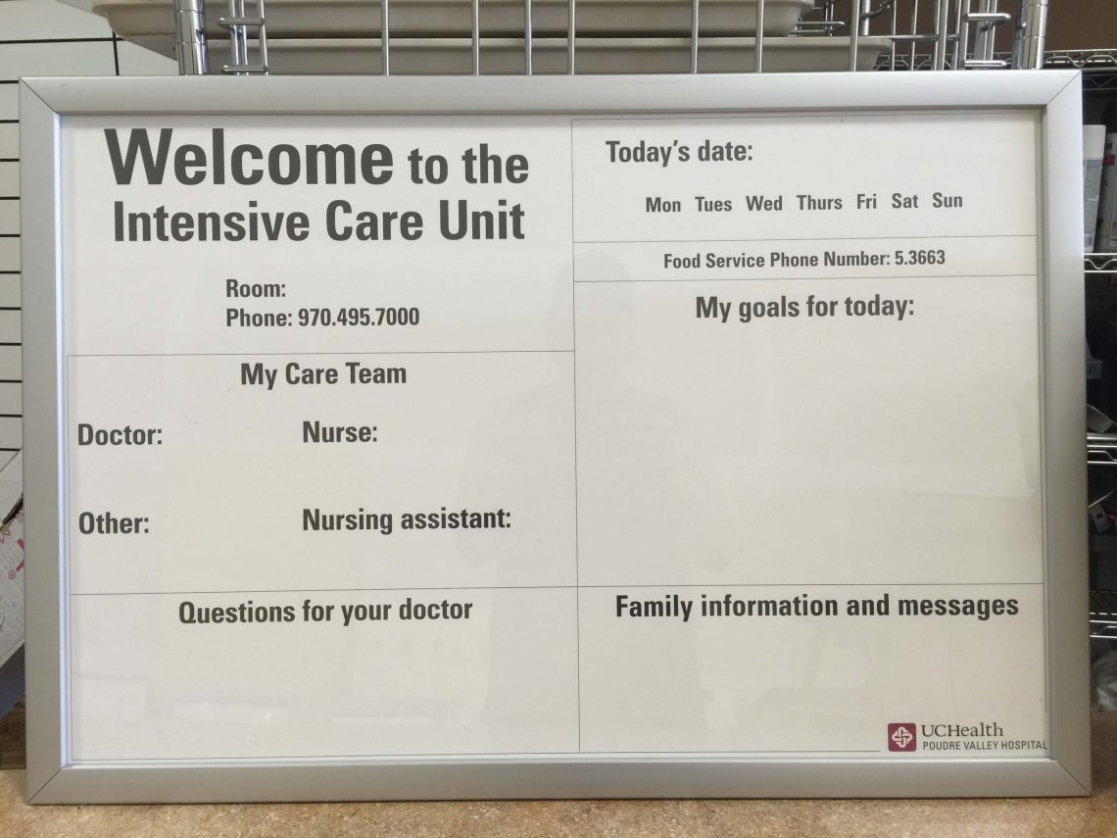
Interdisciplinary Approach: Communication Methods
Posted within patient's room or nurses' station
(accessible for all providers)
Increased communication around treatment:
  Before:
    Medications received
    Events/changes in mood or status
    Vitals
    Upcoming procedures
(UC Health)
  After:​
    Response to exercise​
    Activity Recommendations /
    Fall Risk​
    Adverse events during treatment​
    Changes in abilities observed
Notes:
Ashley – potentially both of us

Slide 42
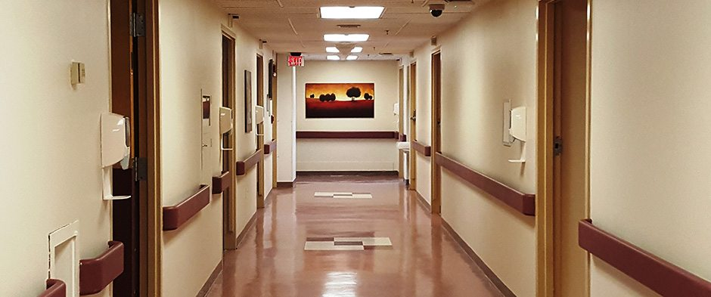
Interdisciplinary Approach: ACE Unit
The Acute Care for Elders (ACE) Unit
  Physical Environment that promotes functional independent and safety
  Patient centered care delivered by bedside nurses in collaboration with interdisciplinary providers
  Comprehensive discharge planning done early and in coordination with interdisciplinary team
  Medical review to ensure quality of medication prescribing and clinical management
Outcomes
(Gillis & MacDonald, 2005; Smart et al 2018)
(Palmer, 2018)
Notes:
Dan

Slide 43
Case Study Questions
Based on the patient's presentation and new information provided what might one functional priority be for him and why?
Which interprofessional strategy could you apply to your work with a patient like Mr. Jones? Why?
Notes:
Ashley

Slide 44
Case Study: Wrap Up
Mr. Jones had a successful recovery after his surgery, because of an interdisciplinary, team-based approach that promoted function through early mobilization, environmental modification, prevention of delirium and falls, and education about compensatory strategies for self-care. The key factors that made this a successful effort were:
  A comprehensive geriatric evaluation
  Use of validated outcome measures
  Patient-centered goal setting
  Implementation of interdisciplinary strategies to promote function
Notes:
Ashley Mr. Jones had a successful recovery after his surgery, because of an interdisciplinary, team-based approach that promoted function through early mobilization, environmental modification, prevention of delirium, and education about compensatory strategies for self-care. The key factors that made this a successful effort were:
A comprehensive geriatric evaluation
Use of validated outcome measures
Patient centered goal setting
Implementation of interdisciplinary strategies to promote function
After surgery, Mr. Jones remained bedbound, and using interdisciplinary strategies promoting early mobility, environmental modifications and independence, delirium was avoided, and patient was able to increase/maintain participation in daily functional activities with extra time and compensatory strategies as discussed with OT and PT.
Promoting sleep-wake cycle
Getting up out of bed.
With increased communication before and after intervention, the medical and rehabilitation team were able to have good over to facilitate patient's goals and recovery.
Patient-guide care promoted Mr. Jones's self-efficacy in his care and increased his ability to self-advocate and implement learned strategies for self-care while healing.

Slide 45
Post Test Questions
1. Who on the medical team is responsible for ensuring the improvement of function of elderly patients within the acute care setting?
  a. Physician b. PT c. OT d. nursing e. all of the above
2. _________ is an umbrella term for impairments, activity limitations and participation restrictions. It denotes negative aspects of the interaction between a person’s health condition(s) and the individual’s contextual factors (environmental and personal factors)
Disability
3. Why is it important to promote function?
  a. Improves Quality of Care b. Gives patients something to do c. To add stress to the care team

Slide 46
QUESTIONS?
Notes:
Both of us

Slide 47
Resources
American Occupational Therapy Association. (2020). Occupational therapy practice framework: Domain and process (4th edition). American Journal of Occupational Therapy, 74(Supplement_2). https://doi.org/10.5014/ajot.2020.74s2001
American Psychiatric Association. (2013). Delirium. In Diagnostic and statistical manual of mental disorders (5th Edition) (pp. 596–601). American Psychiatric Publishing.
ASSESSMENT Patient Date Time 30-Second Chair Stand. (n.d.). https://www.cdc.gov/steadi/pdf/STEADI-Assessment-30Sec-508.pdf
Buatois, S., Perret-Guillaume, C., Gueguen, R., Miget, P., Vançon, G., Perrin, P., & Benetos, A. (2010). A Simple Clinical Scale to Stratify Risk of Recurrent Falls in Community-Dwelling Adults Aged 65 Years and Older. Physical Therapy, 90(4), 550–560. https://doi.org/10.2522/ptj.20090158
Berwick, D. M., Nolan, T. W., & Whittington, J. (2008). The triple aim: care, health, and cost. Health Affairs (Project Hope), 27(3), 759–769. https://doi.org/10.1377/hlthaff.27.3.759
Brown CJ, Redden DT, Flood KL, Allman RM. The underrecognized epidemic of low mobility during hospitalization of older adults. J Am GeriatrSoc. 2009;57(9):1660–1665. doi:10.1111/j.1532-5415.2009.02393.x
Bryant, E. A., Tulebaev, S., Castillo-Angeles, M., Moberg, E., Senglaub, S. S., O’Mara, L., McDonald, M., Salim, A., & Cooper, Z. (2019). Frailty Identification and Care Pathway: An Interdisciplinary Approach to Care for Older Trauma Patients. Journal of the American College of Surgeons, 228(6), 852-859.e1. https://doi.org/10.1016/j.jamcollsurg.2019.02.052
CDC. (2020, September 15). Disability and Health Overview | CDC. Centers for Disease Control and Prevention. https://www.cdc.gov/ncbddd/disabilityandhealth/disability.html#:~:text=According%20to%20the%20World%20Health%20Organization%2C%20disability%20has
Devlin, J. W., Skrobik, Y., Gélinas, C., Needham, D. M., Slooter, A. J. C., Pandharipande, P. P., Watson, P. L., Weinhouse, G. L., Nunnally, M. E., Rochwerg, B., Balas, M. C., van den Boogaard, M., Bosma, K. J., Brummel, N. E., Chanques, G., Denehy, L., Drouot, X., Fraser, G. L., Harris, J. E., & Joffe, A. M. (2018). Clinical practice guidelines for the prevention and management of pain, agitation/sedation, delirium, immobility, and sleep disruption in adult patients in the ICU. Critical Care Medicine, 46(9), e825–e873. https://doi.org/10.1097/ccm.0000000000003299
Dovern A, Fink G.R., Weiss P.H. (2012). Diagnosis and treatment of upper limb apraxia. J Neurol. 259(7):1269–1283. doi:10.1007/s00415-011-6336-y

Slide 48
Resources
Duke MOVES BMAT (Bedside Mobility Assessment Tool) | Duke Occupational & Environmental Safety Office. (2019). Duke.edu. https://www.safety.duke.edu/ergonomics/sphm/bmat-bedside-mobility-assessment-tool
Dzierzewski, J. M., Fung, C. H., Jouldjian, S., Alessi, C. A., Irwin, M. R., & Martin, J. L. (2014). Decrease in Daytime Sleeping Is Associated with Improvement in Cognition After Hospital Discharge in Older Adults. Journal of the American Geriatrics Society, 62(1), 47–53. https://doi.org/10.1111/jgs.12622
Ely EW, & Pun BT. (2002) The Confusion Assessment Method for the ICU Training Manual. Nashville, TN: Vanderbilt University, 2010. Retrieved from: http://www.icudelirium.org/docs/CAM_ICU_training.pdf
Fong T.G., Tulebaev S.R., Inouye S.K. (2009). Delirium in elderly adults: diagnosis, prevention and treatment. Nat Rev Neurol. 5(4):210–220. doi:10.1038/nrneurol.2009.24
Gillis, A., & MacDonald, B. (2005). Deconditioning in the hospitalized elderly. The Canadian Nurse, 101(6), 16–20. https://pubmed.ncbi.nlm.nih.gov/16121472/#:~:text=Deconditioning%20is%20a%20complex%20process%20of%20physiological%20change
Goins, R. T., Jones, J., Schure, M., Rosenberg, D. E., Phelan, E. A., Dodson, S., & Jones, D. L. (2014). Older Adults’ Perceptions of Mobility: A Metasynthesis of Qualitative Studies. The Gerontologist, 55(6), 929–942. https://doi.org/10.1093/geront/gnu014
Hakkarainen, T. W., Arbabi, S., Willis, M. M., Davidson, G. H., & Flum, D. R. (2016). Outcomes of Patients Discharged to Skilled Nursing Facilities After Acute Care Hospitalizations. Annals of Surgery, 263(2), 280–285. https://doi.org/10.1097/sla.0000000000001367
Inpatient Physical Therapy Services - Physical Therapy - Physical Medicine & Rehabilitation - University of Rochester Medical Center. (n.d.). Www.urmc.rochester.edu. https://www.urmc.rochester.edu/physical-medicine-rehabilitation/physical-therapy/inpatient-therapy-services.aspx
Institute For Healthcare Improvement. (2019). SBAR Tool: Situation-Background-Assessment-Recommendation. Ihi.org. http://www.ihi.org/resources/Pages/Tools/SBARToolkit.aspx
Institute for Healthcare Improvement. (2020). Age-Friendly Health Systems: Guide to Using the 4Ms in the Care of Older Adults. http://www.ihi.org/Engage/Initiatives/Age-Friendly-Health-Systems/Documents/IHIAgeFriendlyHealthSystems_GuidetoUsing4MsCare.pdf

Slide 49
Resources
International Classification of Functioning, Disability, and Health (ICF). (n.d.). American Speech-Language-Hearing Association. Retrieved November 10, 2021, from https://www.asha.org/slp/icf/#:~:text=Personal%20Factors%E2%80%94%20include%20race%2C%20gender%2C%20age%2C%20educational%20level%2CKillewich, L. A. (2006). Strategies to Minimize Postoperative Deconditioning in Elderly Surgical Patients. Journal of the American College of Surgeons, 203(5), 735–745. https://doi.org/10.1016/j.jamcollsurg.2006.07.012
Jefferis, B. J., Iliffe, S., Kendrick, D., Kerse, N., Trost, S., Lennon, L. T., Ash, S., Sartini, C., Morris, R. W., Wannamethee, S. G., & Whincup, P. H. (2014). How are falls and fear of falling associated with objectively measured physical activity in a cohort of community-dwelling older men? BMC Geriatrics, 14(1). https://doi.org/10.1186/1471-2318-14-114
Morris, R., & O’Riordan, S. (2017). Prevention of falls in hospital. Clinical Medicine, 17(4), 360–362. https://doi.org/10.7861/clinmedicine.17-4-360
Mudge, A. M., McRae, P., & Cruickshank, M. (2013). Eat Walk Engage. American Journal of Medical Quality, 30(1), 5–13. https://doi.org/10.1177/1062860613510965
Outcome Measure Toolkit for Geriatric Fall/Balance Assessment. (n.d.). https://geriatricspt.org/special-interest-groups/balance-falls/Outcome-Measure-Toolkit/Outcome%20Measures%20Toolkit%202020.pdf
PalihnichK, Inouye SK, Marcantonio ER. The 3D CAM Training Manual for Research. 2014; Boston: Hospital Elder Life Program
Palmer, R. (2018). The Acute Care for Elders Unit Model of Care. Geriatrics, 3(3), 59. https://doi.org/10.3390/geriatrics3030059
Perez, A. (n.d.). BMAT-Bedside Mobility Assessment Tool. https://www.uclahealth.org/nursing/workfiles/ContinuingEducation2015/TeachBack/UmoveBMAT-TrainingPresentation.pdf
Pisani, M. A., Kong, S. Y. J., Kasl, S. V., Murphy, T. E., Araujo, K. L. B., & Van Ness, P. H. (2009). Days of Delirium Are Associated with 1-Year Mortality in an Older Intensive Care Unit Population. American Journal of Respiratory and Critical Care Medicine, 180(11), 1092–1097. https://doi.org/10.1164/rccm.200904-0537oc
Pojedinec, & G, W. (2014). Confusion Assessment Method for the ICU (CAM-ICU) The Complete Training Manual. http://www.icudelirium.org/docs/CAM_ICU_training.pdf
Smart, D. A., Dermody, G., Coronado, M. E., & Wilson, M. (2018). Mobility Programs for the Hospitalized Older Adult: A Scoping Review. Gerontology and Geriatric Medicine, 4, 233372141880814. https://doi.org/10.1177/2333721418808146

Slide 50
Resources (cont.)
SNF, SAR, NH, ALF, and More Discharge Options: Interprofessional Education Series. (2020, June 10). Core IM Podcast. https://www.coreimpodcast.com/2020/06/10/snf-sar-nh-alf-and-more-discharge-options-interprofessional-education-series/#:~:text=SAR%20%28subacute%20rehab%29%20and%20SNF%20%28skilled%20nursing%20facility%29
Uniform Data System for Medical Rehabilitation (2012). The FIM® Instrument: Its Background, Structure, and Usefulness. Buffalo: UDSMR.
Williams. (2015, September 14). Figure 1. ICF model as applied to elderly and aging MWC users. ICF... ResearchGate; ResearchGate. https://www.researchgate.net/figure/ICF-model-as-applied-to-elderly-and-aging-MWC-users-ICF-indicates-International-Classifi_fig1_271726655
World Health Organization. (2002). Towards a Common Language for Functioning, Disability and Health ICF Towards a Common Language for Functioning, Disability and Health: ICF The International Classification of Functioning, Disability and Health. https://www.who.int/classifications/icf/icfbeginnersguide.pdf
World Health Organization. (2021, April 26). Falls. Who.int; World Health Organization: WHO. https://www.who.int/news-room/fact-sheets/detail/falls
Yardley, L., Beyer, N., Hauer, K., Kempen, G., Piot-Ziegler, C., & Todd, C. (2005). Development and initial validation of the Falls Efficacy Scale-International (FES-I). Age and Ageing, 34(6), 614–619. https://doi.org/10.1093/ageing/afi196
Young, W. R., & Mark Williams, A. (2015). How fear of falling can increase fall-risk in older adults: Applying psychological theory to practical observations. Gait & Posture, 41(1), 7–12. https://doi.org/10.1016/j.gaitpost.2014.09.006

