Slide 1
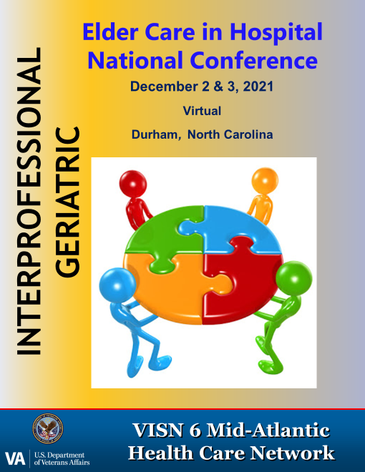
Addressing Pain In Older Populations
Jody Cherniak MSN, MBA-HCM, VHA-CM, RN, GRN
Durham VA Healthcare System Nursing Professional Development Practitioner

Slide 2
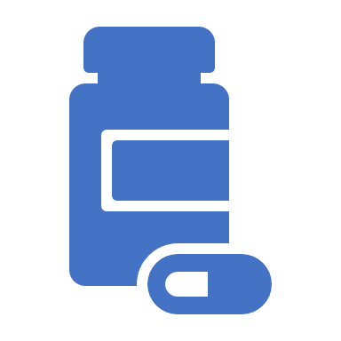
Objectives
Describe challenges in caring for older adults
Identify complications associated with pain management strategies
Compare pharmacologic medications versus non-pharmacologic options for pain management
Examine older adult knowledge deficit considerations

Slide 3
Pain and Aging
48 million >65 years (double by 2045)
93% use OTC for minor ailments before seeking HCP
>65 use more medications than any other demographic and 30% of OTC use
61.5% of ED visits associated with ADR
76% = or > 2 prescription medications
37% = or > 5 prescription medications
The Gerontological Society of America, 2018. Policy to Practice: An Interdisciplinary Look at Labeling Changes to OTC Analgesics and Implications for Patient Care.

Slide 4
Age-related considerations for Older Patients
> 50% have pain
Greater risk of self-treated pain
Poly-pharmacy
ADR, complications
Fall risk/mobility
Dementia
GI, renal, cardiovascular and arthritis comorbidities

Slide 5
Effect of age-related physiologic changes on pain and pharmacokinetics
Pain Modulation and Perceptual system
Structural, functional, and biochemical changes may raise pain threshold
GI and immune function
Alterations contribute to neuroinflammation
Drug distribution and metabolism
Decreased body water reduces distribution of water soluble drugs
Increased body fat causes accumulation of and longer half-life of drugs
Favors sensitization of pain with diminished pain inhibition
Altered functioning of key pain processing centers of brain
Increased risk of ADR
Reduced liver and renal function reduces metabolism or excretion
Slowed motility, blood flow and transport may affect drug uptake

Slide 6
Cognitive Impairment
Impaired patients report less intense pain and small number of pain complaints than mildly impaired patients
CI patients less likely to ask for and receive analgesics
Providers underestimate pain in CI patients
Using a behavior observational assessment tool to screen for pain if patient is CI or doesn’t respond to questions about pain.
CI patient will report pain, if present, when asked
Helfand, M. Pain Med 2009;. 10(7): 1183-99;
Fuffum, MD. J Rehab research & Develop 2007; 44(2), 315-330

Slide 7
Assessment Steps
Pain Screening
Use of pain assessment tools
Diagnosis of underlying conditions
Impact of pain on other functional domains
Evaluation of current medication use including prescription and OTC medications
Assessment of patient knowledge
Notes:
Use multidisciplinary approach, use multimodal approach

Slide 8
Pain Screening
History and physical examination
Hx of HF, HTN, Renal Disease, Stroke,
PQRST, sleep, mood
Screen for cognitive impairment
Screen for depression
Review of patient ADLs
Assessment of gait and balance
Screen for sensory depression: visual, auditory
Alcohol or controlled substance use
Successful pain management strategies used

Slide 9
Pain Assessment Tools
Self report
DVPRS
PAINAD - Pain Assessment in Advanced Dementia
PACSLAC- Pain Assessment Checklist for Seniors with Advanced Dementia
PAD
Observed pain indicators

Slide 10
Step-wise Approach
1st
Attempt to obtain the patient’s self-report
Gold Standard: yes or no
2nd
Look for behavioral changes
Use standardized and valid behavioral pain scale
3rd
The family can help to identify pain behaviors
Assume pain is present- attempt interventions
Herr K. Pain Management Nurse, 2011: 12 (4), 230-250

Slide 11
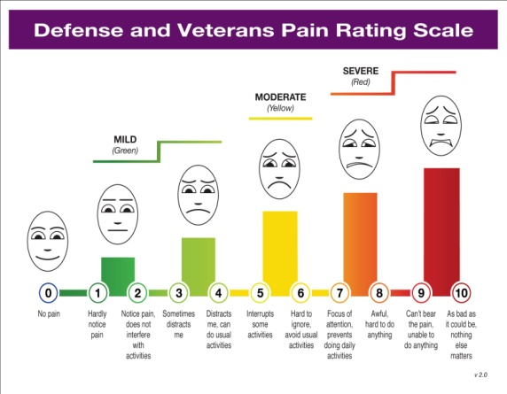
DVPRS
Validated measure of pain intensity and functional impact of pain (sleep/stress/mood/activity)
Improved objective components to provide greater insight into treatment needs and effectiveness
Adaptable to multiple clinical settings
Consistent with current validated pain assessments
Consistent with newer Joint Commission requirements to assess both pain intensity and functional impact
https://vimeo.com/174237044

Slide 12
Supplemental Questions

Slide 13
PAINAD Scale

Slide 14
PACSLAC
https://geriatricpain.org/sites/geriatricpain.org/files/wysiwyg_uploads/pacslac_checklist_with_sm_logo_0.pdf

Slide 15
Pain Management Recommendations
Interdisciplinary approach with multi-modalities
Consider disease modifying interventions
Patient centered goals and evidence- based interventions
Evaluate current medications
Evaluate risk of ADRs- GI, cardiovascular, and renal
Evaluate patient knowledge

Slide 16
Agency for Healthcare Research and Quality (AHRQ)- Goal for Chronic Pain Management
Optimize pain control, know limitations
Enhance functional abilities and physical/psychological well-being
Enhance the quality of life of patients
Minimize adverse outcomes
Target the population
Http://www.guideline.gov/content.aspx?id=23845

Slide 17
Pain Management Options
Complementary Integrative Approaches
NSAIDs
Adjuvant Analgesics- antidepressants, Gabapentin (Neurontin) and (Lyrica)
Anticonvulsants
Opioids
Nerve Blocks
Positioning/Ambulation

Slide 18
Pharmacologic Therapy
Acetaminophen
NSAIDS
Opioids and Adjunctive therapy
GI bleeds, dyspepsia,
Renal and liver impairment
Cardiovascular events- risk significant if higher dose or cardiovascular disease.
NSAIDS- excessive use over time, associated with 23.5% of ADRs such as GI bleeds, liver, renal, alcohol, use w/acetaminophen (recommended rarely)

Slide 21
Complications from Analgesics
Acetaminophen- liver damage, dosing and alcohol use, found in multiple drugs
NSAIDS- excessive use over time, associated with 23.5% of ADRs such as GI bleeds, liver, renal, alcohol, use w/acetaminophen (recommended rarely)
GI
Cardiac
Stroke
CHF
Antiplatelet therapy
Policy to Practice: an interdisciplinary Look at Labeling Changes to OTC Analgesics and Implications for Patient Care, The Gerontological Society of America, 2018.

Slide 22
2019 BEERS Criteria for Potentially Inappropriate Medication use in Older Adults
Medications that should be avoided
Increased risk of GI bleed medications
Reasons NSAIDS should be avoided: renal
Potential delirium
Drug- drug reactions
Reduced dosages or increased monitoring

Slide 23
Integrative and Non-pharmacologic Approaches (Requires consult)
Pain education groups
Talk therapy
Acupuncture
Chiropractic
Physical Therapy
Electronic stimulator (e.g. TENS) training
Recreational therapy
Self-care-MOVE (available at all sites)
Smoking cessation groups
Nutrition consult- diet changes
Prosthetics- including Heating pads, hot/cold packs
Aromatherapy

Slide 24
Other Pain Management Options:
ACT Coach – acceptance and commitment therapy, which builds coping skills for unpleasant emotions and symptoms
Mindfulness Coach – introduces mindfully focusing attention with guided exercises
Stay Quit Coach – smoking cessation
Moving Forward – stress management
CBT-i Coach – insomnia

Slide 25
Topical Agents- Analgesic creams, Rubs and Sprays
Counter-irritants- ingredients such as menthol, methyl salicylate, and campor create a burning or cooling for distraction from pain (Icy Hot and Biofreeze)
Salicylates- same ingredients that give aspirin it pain relieving qualities (Aspercreme and Bengay)- muscle aches
Capsaicin- main ingredient of chili peppers- Capzasin and Zostrix- pain from damaged nerves

Slide 26
Peripheral Nerve Catheter
Non-narcotic post-operative pain management
Anesthetic for use alone or augmenting anesthesia or post-operative pain management.
Decreases pain scores for 24-72 hours
May lead to better pain control than opioids alone
May increase risk of falls

Slide 27
Pain Medication Range Order from: Cooper, A. & Salazar, N (8/2012). UCSF Medical Center, Department of Nursing, Nursing procedures Manual, with permission
Has the patient received the medication before?
NO-Provide the lowest dose in range first. Assess and document response during peak effective of medication
If dose is ineffective, move to a higher dose within the ordered time and frequency.
If the dose is still ineffective, notify provider for other pain management options.
YES- Determine if the dose received was effective. If yes, evaluate the response during the peak effect of the medication
Provide the dose that was effective in managing the pain. See recommendations for notifying provider if dose is ineffective.

Slide 28
American Geriatric Society Recommendations
Non-opioids first
Non-selective NSAIDS/Cyclooxygenase 2 selective inhibitors
Opioids
Adjuvant analgesics- neuropathic pain, refractory pain
Topical lidocaine
Avoid tertiary tricyclic antidepressants
Topical Creams/Gels: Capsaicin & menthol
Muscle Relaxants
Psychological support
Physical Rehabilitation
Interventional Modalities

Slide 29
Principles of Optimal Pain Management
Initiate full assessment
Employ regularly scheduled medications rather than as-needed
Evaluation of pain control – visual, verbal, cognitive levels of impairment
Medication regimen should be chosen based on the patient assessment
Type of pain, efficacy, side-effects, abuse potential
Education is crucial
Titrate to response of patient/document

Slide 30
FDA: 2013 Safe Use Initiative
-created as a public-private partnership across the health care community to identify and prevent specific medication-related events
62% unaware of risk of medications
75% can not recall what warning was applicable to what drug
Unaware that APAP is Tylenol- therapeutic duplication
Need for standardized labeling Standardized formatting and label
Include education on risks of OTC and scheduled medications
Need for patient education on medication and OTC medications
Patients prefer verbal and written education
Policy to Practice: an interdisciplinary Look at Labeling Changes to OTC Analgesics and Implications for Patient Care, The Gerontological Society of America, 2018.

Slide 31
EXERCISE 1:
Indicate which of the following statements are true for older patients.
High protein bound analgesics such as NSAIDS are the first line of treatment for older patients.
Drug half life for benzodiazepines will be increased.
Adverse drug reactions to medications may be more common.
Medications that are metabolized in the kidney are preferred for the older patient.

Slide 32
EXERCISE 2: What pain medication regime would you consider for a patient with a history ESRD, malnutrition and chronic back pain who requires partial assist for transfers and is ready for his bath? (pain rated 6/10 per DVPRS assessment) Choose all that apply. A. PRN acetaminophen, 2 tabs, q 4 hours B. Scheduled acetaminophen, 2 tabs, Q 4 hours C. 1 time dose of 12.5 mg fentanyl IVP D. PRN oxycodone 5mg, 1 tab, q 4 hours E. 1 time dose of 2mg morphine iv push. F. Scheduled oxycodone 5mg tab q 4 hours. G. Warm packs to affected area PRN. H. Music therapy I: Physical therapy J: TENS unit

Slide 33
EXERCISE 3:
Mr. F, age 73, was admitted for pneumonia 3 days ago. He has chronic back pain and wife states he takes ibuprofen daily. The wife states he seems different than he was prior to admission. He has responded appropriately to antibiotic therapy and the chart states the medical team plans to discharge him tomorrow.
Vitals: A&Ox3, ambulatory, VSS, all labs wnl. Last WBC 5.5. Grimaces with ambulation.
The primary nurse notes Mr. F was confused for the past 2 nights. He often yells out and hit a staff member this morning during his bath.
What are possible contributing factors leading to his confusion during this hospitalization?
How can the nurse assess his pain?
What factors must be assessed for appropriate discharge planning?

Slide 34
Exercise 4: Mr. C is a 72 yo male veteran with dementia. He requires partial assistance with personal care, uses walker for ambulation. Occasional wanders and is restless at baseline. He rarely speaks except for stating he wants his wife to come to his bed side. Today, he is grimacing and resists getting out of bed. He is yelling “No” to the NA. What would the geriatric resource nurse consider?
What tool would you consider using for assessment?
What pain treatments would you consider?
If pain medication is indicated and ordered, how would you know what to give and when?
What would you do to prevent this issue in the future?

Slide 35
References:
Bar, J. Critical Care Medicine, 2013; 41 (1), 263-306.
Boltz, M., Capezuti, Fulmer & Zwicker, 2012, Evidence-based Geriatric Nursing Protocols for Best Practice
Cooper, A. & Salazar, N (8/2012). UCSF Medical Center, Department of Nursing, Nursing procedures Manual, with permission
Fuffum, MD. J Rehab Research & Development 2007; 44(2), 315-330
Helfand, M. Pain Med 2009;. 10(7): 1183-99
Kaye, A., Baluch, A., & Scott, J., 2010, Pain Management in the Elderly Population: A Review, The Ochsner Journal 10:179-187. Academic Division of Ochsner Clinic Foundation
The Gerontological Society of America, 2018.Policy to Practice: an interdisciplinary Look at Labeling Changes to OTC Analgesics and Implications for Patient Care, Policy to Practice: an interdisciplinary Look at Labeling Changes to OTC Analgesics and Implications for Patient Care
https://geriatricpain.org/sites/geriatricpain.org/files/wysiwyg_uploads/pacslac_checklist_with_sm_logo_0.pdf
https://www.jointcommission.org/assets/1/18/R3_15_Pain_Assess_Mgmt_CAH_6_22_18_FINAL.pdf
https://www.geron.org/press-room/press-releases/2018-press-releases/886-new-gsa-resource-provides-guidance-for-safe-use-of-otc-analgesics-by-older-adults

