Slide 1

Geriatric Nutrition and Challenges
Kathryn Simons, RDN, CDCES, CSGC
Home Based Primary Care Dietitian

Slide 2
Objectives
Define Geriatric Malnutrition
Discuss Dietary recommendations for patients 65 years of age and older
Identify Geriatric patients at risk for dehydration
Notes:
Objectives for today are:

Slide 3
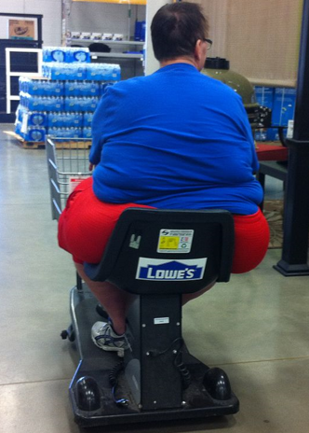
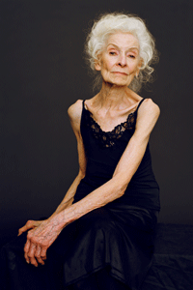
What is Malnutrition?
An acute, subacute or chronic state of nutrition, in which a combination of varying degrees of overnutrition or undernutrition with or without inflammatory activity have led to a change in body composition and diminished function.
Notes:
Formal definition of malnutrition.

Slide 4
Defining Sarcopenia
• The progressive and generalized loss of skeletal muscle which leads to an accelerated loss of muscle mass and muscle function
Notes:
-Malnutrition is often observed and leads to other predisposing factors to sarcopenia, the increased loss of muscle mass with aging.
-From a pathophysiological point of view, both malnutrition and sarcopenia share many components, a low-inflammatory state being an important one. Nutritional interventions with and without physical activity programs can prevent and often also reverse sarcopenia.
Sieber CC. Malnutrition and sarcopenia. Aging Clin Experimental research Res. 2019 Jun;31(6):793-798. doi: 10.1007/s40520-019-01170-1. Epub 2019 May 30. PMID: 31148100.

Slide 5
Sarcopenia and Nutrition
• Risk of sarcopenia increases with age
• After age 50, adults average 1-2 percent muscle mass loss annually1
• The National Health and Nutrition Survey III • In older adults sarcopenia, poor diet quality and physical inactivity are associated with higher risk of mortality • Underlying nutritional causes
• Low protein intake, low energy intake, micronutrient deficiency, anorexia, malabsorption and other gastrointestinal conditions
• Obesity - Sarcopenia can be present in obese individuals, increasing risk of disability and mortality
Serafini E, et al. JGG. 2019;67:52-61. | Frontera W, et al. J Appl Physiol. 2000;88:1321-
Notes:
The relationship between frailty, sarcopenia, and malnutrition in older adults presents unique challenges for health care providers

Slide 6
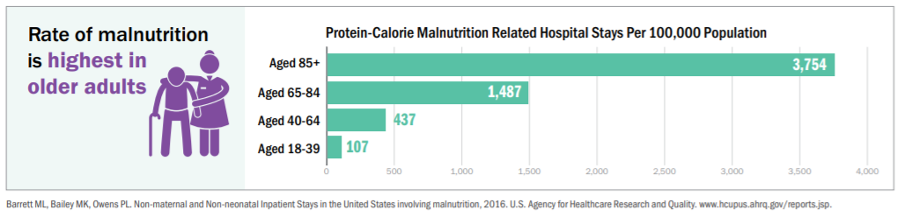
Notes:
Nutrition is an important determinant of health in persons over the age of 65. Malnutrition in the elderly is often underdiagnosed. Careful nutritional assessment is necessary for both the successful diagnosis and development of comprehensive treatment plans for malnutrition in this population

Slide 7
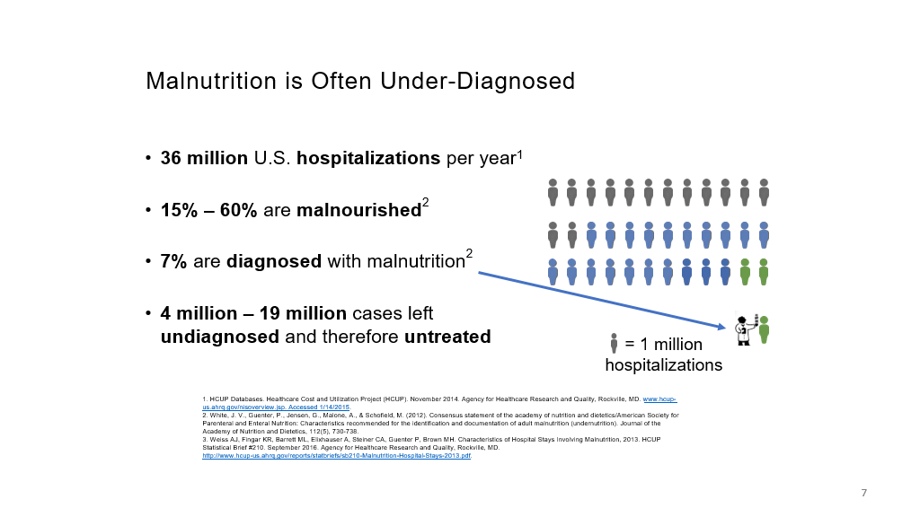

Slide 8
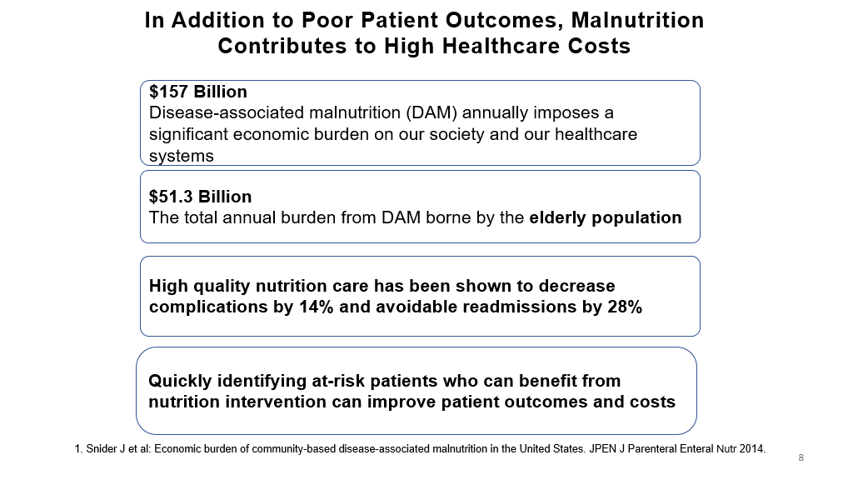
Notes:
By 2040, it is projected that persons age 65 and older will represent a fifth of the US population.³ Older patients tend to have more complex medical problems and average more office visits with doctors than younger patients.⁴

Slide 9
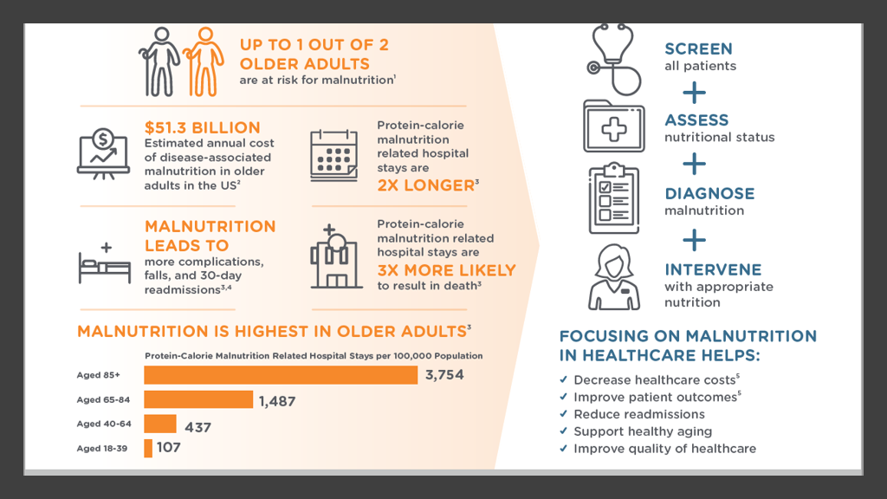
Notes:
Slide from Defeat Malnutrition today.
On Left of slide demonstrates malnutrition an older adult crisis.
Right four steps to improve older adult malnutrition.

Slide 10
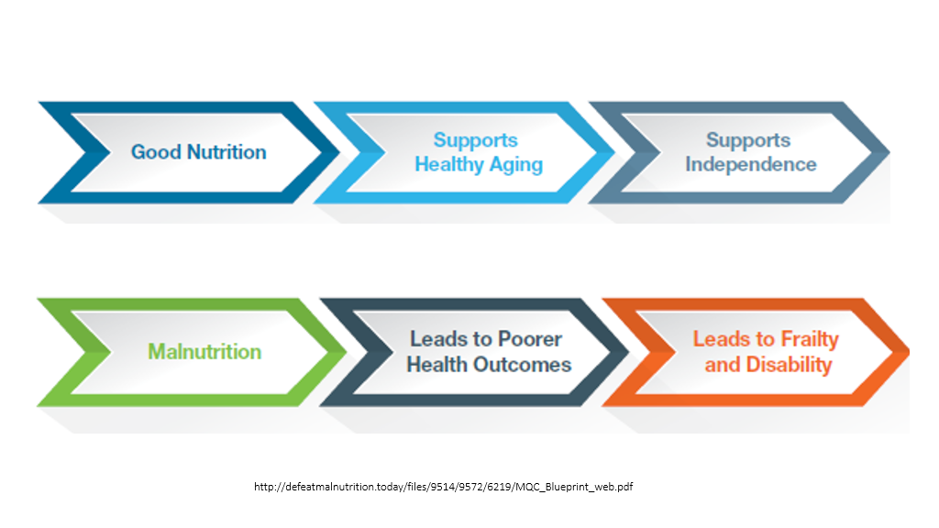
Notes:
From Defeat malnutrition

Slide 11
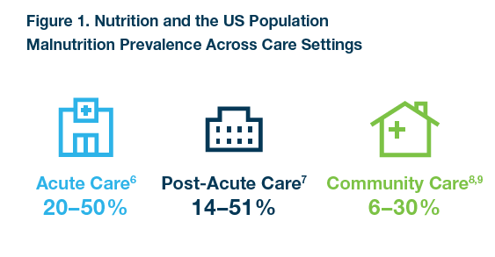
The Malnutrition Quality Collaborative. National Blueprint: Achieving Quality Malnutrition Care for Older Adults, 2020 Update. Washington, DC: Avalere Health and Defeat Malnutrition Today; 2020.
Notes:
This slide demonstrates Existing patient care Transitions pathway.
Too often, as patients transition from one point of care to another, their nutrition status is not evaluated, documented, or even included in patient health conversations. Lack of evaluation and management can result in negative health and financial outcomes as malnourished adults have been found to utilize more health services with more visits to physicians, hospitals, and emergency rooms

Slide 12
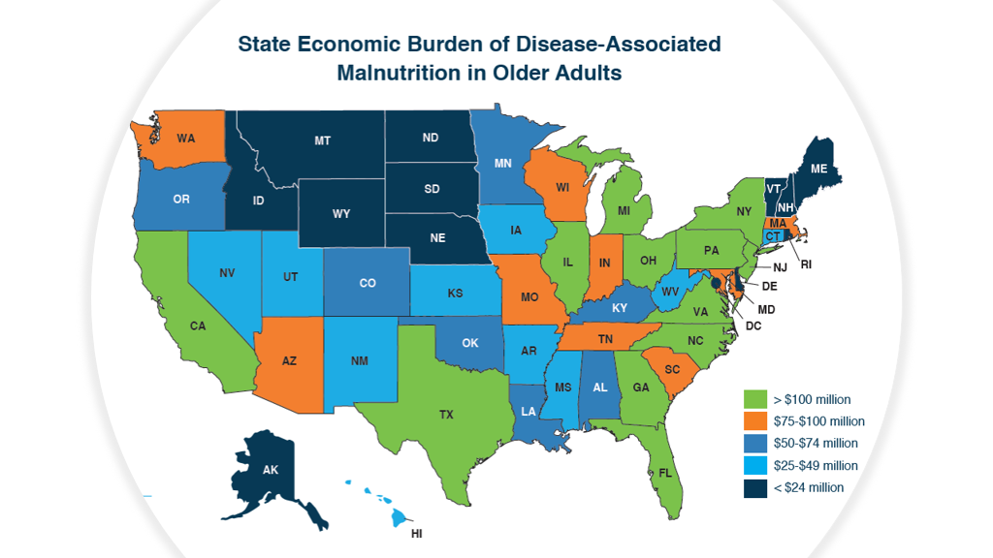
Notes:
Each State is affected by malnutrition.
Getting away from subjective information​
Important of document malnutrition and implications for care​
Reduced LOS and hospital admissions on those identified. Slow/Stop the readmission
Twelve states have an annual economic burden of over $100 million for disease-associated malnutrition in older adults. Disease-associated malnutrition occurs when nutrient intake decreases and inflammatory responses increase.
Malnutrition is intensified by the disparities and social isolation from the COVID-19 pandemic.(4) Additionally, nutrition status is a relevant factor influencing the outcomes of patients with COVID-19

Slide 13
Defining Malnutrition
2/6= Malnutrition
Inadequate Energy Intake
Significant Weight Loss
Loss of Muscle Mass
Loss of Subcutaneous Fat
Diminished Functional Status Measured by Hand Grip Strength
Fluid Accumulation Masking Weight Loss
In 2012, an International Consensus Guideline Committee published a definition based on cause and at least two of six signs /symptoms.
  1.White JV, Guenter P, Jensen G, et al. Consensus statement of the Academy of Nutrition and Dietetics/ American Society for Parenteral and Enteral Nutrition: characteristics recommended for the identification and documentation of adult malnutrition (undernutrition). J Acad Nutr Diet. 2012;112(5):730-8.
Notes:
2012 Academy of Nutrition and Dietetics /ASPEN published a Malnutrition Consensus paper which identifies six criteria in the identification of malnutrition in the presence or absence of inflammation. Identification of malnutrition using the AND/ASPEN criteria has been endorsed by the Nutrition and Food Services Program Office at the Department of Veterans Affairs.
A comprehensive nutrition evaluation during initial or follow-up visits should include, but is not limited to, assessment of all six components of the malnutrition criteria: assessment of intake; assessment of weight history; and a nutrition focused physical exam (NFPE) including muscle mass loss, fat mass loss; edema; and functional status using a hand dynamometer.
Registered Dietitian Nutritionists (RDNs) are the food and nutrition experts. RDNs have special training to offer medical nutrition therapy and work as part of the health care team or Primary Care Aligned Care Team (PACT) in the treatment and prevention of disease. RDNs promote healthy lifestyle choices and create personal nutrition plans for individuals of all ages using a whole health approach. RDNs empower and equip people to take charge of their health and well-being to live their life to the fullest. They are able to separate facts from fads and give you evidenced-based nutrition information that you can use.
Dietitians in the Va System have received the specialized training to assess patients properly to diagnose malnutrition.

Slide 14
Malnutrition Screening Tool
The presence of two or more are necessary for the diagnosis of malnutrition.
Clinical Characteristics of Malnutrition | Malnutrition in the Context of:
 | Acute Illness or Injury Related Malnutrition |  | Chronic Disease Related Malnutrition |  | Social or Environmental Related (Starvation) Malnutrition
 | Non-severe (Moderate) Malnutrition | Severe Malnutrition | Non-severe (Moderate) Malnutrition | Severe Malnutrition | Non-severe (Moderate) Malnutrition | Severe Malnutrition
Weight Loss | 1-2% - 1 week 5%- 1 month 7.5%- 3 months | >2% -1 week >5%- 1 month >7.5%- 3 months | 5%- 1 month 7.5%- 3 months 10%- 6 months 20%- 1 year | >5%- 1 month >7.5%- 3 months >10%- 6 months >20%- 1 year | 5%- 1 month 7.5%- 3 months 10%- 6 months 20%- 1 year | >5%- 1 month >7.5%- 3 months >10%- 6 months >20%- 1 year
Energy Intake | <75% for >7 days | ≤50% for ≥5 days | <75% for ≥1 month | ≤75% for ≥1 month | <75% for ≥1 month | ≤50% for ≥1 month
Body Fat | Mild depletion | Moderate depletion | Mild depletion | Severe depletion | Mild depletion | Severe depletion
Muscle Mass | Mild depletion | Moderate depletion | Mild depletion | Severe depletion | Mild depletion | Severe depletion
Fluid Accumulation | Mild | Moderate → severe | Mild | Severe | Mild | Severe
Grip Strength | N/A | Not recommended in intensive care unit | N/A | Reduced for age/gender | N/A | Reduced for age/gender
White et. al, JPEN 2012
Notes:
This is the complete screening tool developed by AND and ASPEN to diagnosis malnutrition with the presence of two or more of the clinical characteristics.
I will review each clinical characteristics
Chronic is defined as a disease/condition lasting 3 months or longer.

Slide 15
Step One: absent
Step One: Determine the Cause, including whether Inflammation is present or absent
CHRONIC DISEASE RELATED
Mild To Moderate Inflammation:
Cardiovascular disease, congestive heart failure, cystic fibrosis, inflammatory bowel disease, celiac disease,
Chronic pancreatitis, rheumatoid arthritis, solid tumors, hematologic malignancies, sarcopenic obesity, diabetes mellitus,
Metabolic syndrome, cerebrovascular accident, neuromuscular disease, dementia, organ failure/transplant (kidney, liver, heart, lung, or gut),
Periodontal disease, pressure wounds, chronic obstructive pulmonary disease.
Notes:
Refeeding and or nutrition support may stabilize but not significantly improve nutrition parameters in the presence of inflammation.

Slide 16
Step One: Determine the Cause, including whether Inflammation is present or absent.
Step One: Determine the Cause, including whether Inflammation is present or absent
ACUTE DISEASE/INJURY RELATED
Severe Inflammation:
critical illness, major infection/sepsis, acute respiratory distress syndrome, systemic inflammatory response syndrome, severe burns, major abdominal surgery, multi-trauma, close head injury
ENVIRONMENTAL/SOCIETAL RELATED
No Inflammation:
Anorexia nervosa, major depression
Lack of access to food
Notes:
Continuing step one

Slide 17
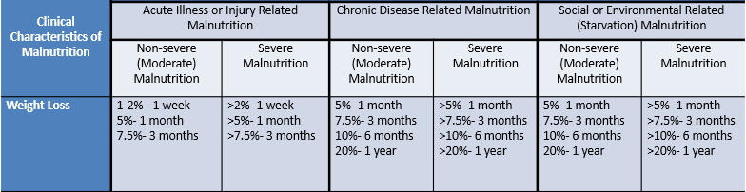
Step Two: Assess Weight Changes
Notes:
Interpretation of weight loss: this is evaluated in light of other clinical findings include the presence of under or over hydration. Weight change over time is reported as % of weight loss from pt’s baseline.

Slide 18
Why Weight Loss?
In addition to loss of fat, about half of any involuntary weight loss is muscle loss.
With any weight loss comes muscle loss.
Notes:
Yes, weight loss is monitored because half of all involuntary weight loss is loss of muscle. Even with a well balanced , weight loss diet, some muscle will be loss but just not as much. The percentage of muscle loss in relation to fat loss depends on the type of diet with the greatest muscle being lost with starvation or mixed food diets less than 1000 calories a day.

Slide 19
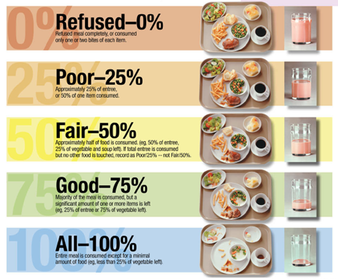
Clinical Characteristics of Malnutrition: Step 3
Energy Intake
Abbott Laboratories Inc., May 2007
Notes:
Correct documentation important of total intake at meals. Varying opinions of actual intake unless trained to correctly assess and document. Tea and toast is not 100%

Slide 20
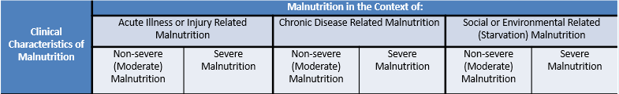
Step Three: Assess Energy Intake
Notes:
Recent intake is compared to estimated energy requirements is a primary criteria defining malnutrition. An Rd obtains and reviews the food and nutrition history, estimate energy needs and compare to with estimates of energy consumed and report adequate vs inadequate intake.

Slide 21
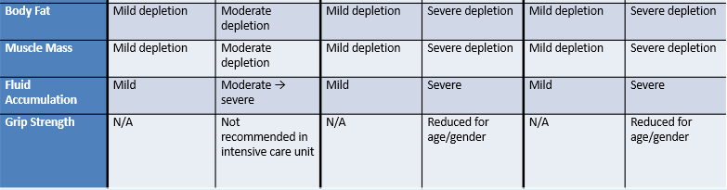
Step Four: Assess Anthropometrics
(Nutrition-Focused Physical Exam; NFPE)
Notes:
Hands on NFPE and hand grip assessment is of particular importance when assessing for malnutrition in normal weight, overweight/obese patients.
Muscle function responds earlier to both nutritional deprivation and repletion that body composition parameters like muscle or body mass. Loss of muscle mass does not appear to be exclusively responsible for muscle dysfunction in malnutrition – further factors like electrolyte status and energy rich compounds appear to be more responsible for early changes in muscle function during malnutrition.

Slide 22

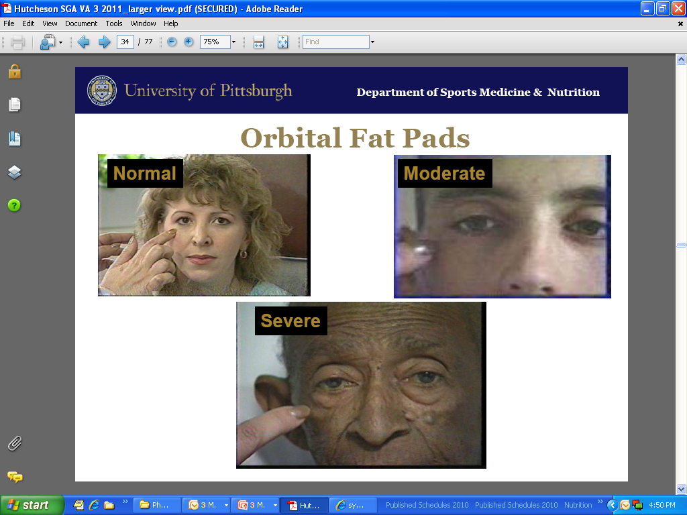

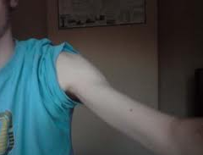
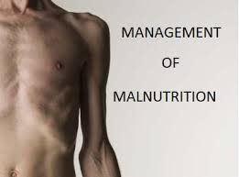
Clinical Characteristics of Malnutrition
Four - Body Fat Loss:
  Orbital fat pads - dark circles, hollow look, loose skin, sunken eye, prominent brow bone.
  Triceps/biceps - look for space between folds if muscle is pinched.
  Anterior Ribs – Examine for loss of fullness.
Notes:
The Nutrition focused exam is hands on lightly touching the head, arms, back ,stomach and legs to assess the nutrient stores.

Slide 23
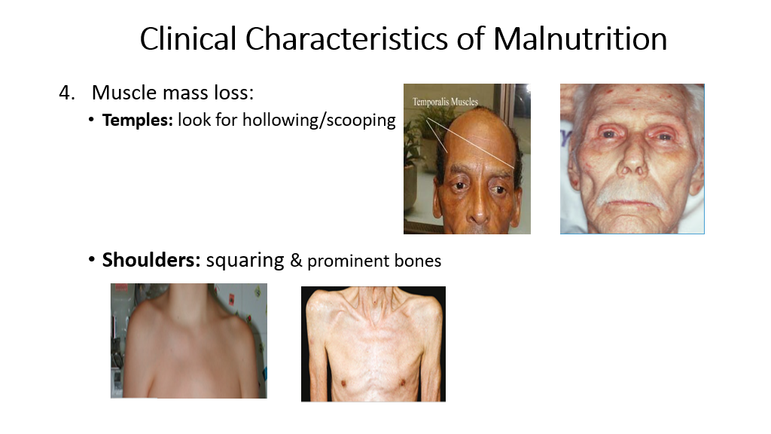
Notes:
Temples- use thumbs to palpate the muscle over the temporal bone , we ask the pat to pretend to chew gm to engage the muscle.
-Shoulders- arms are position at the side. Assessing for squaring of shoulders and prominent acromion process for muscle loss.

Slide 24
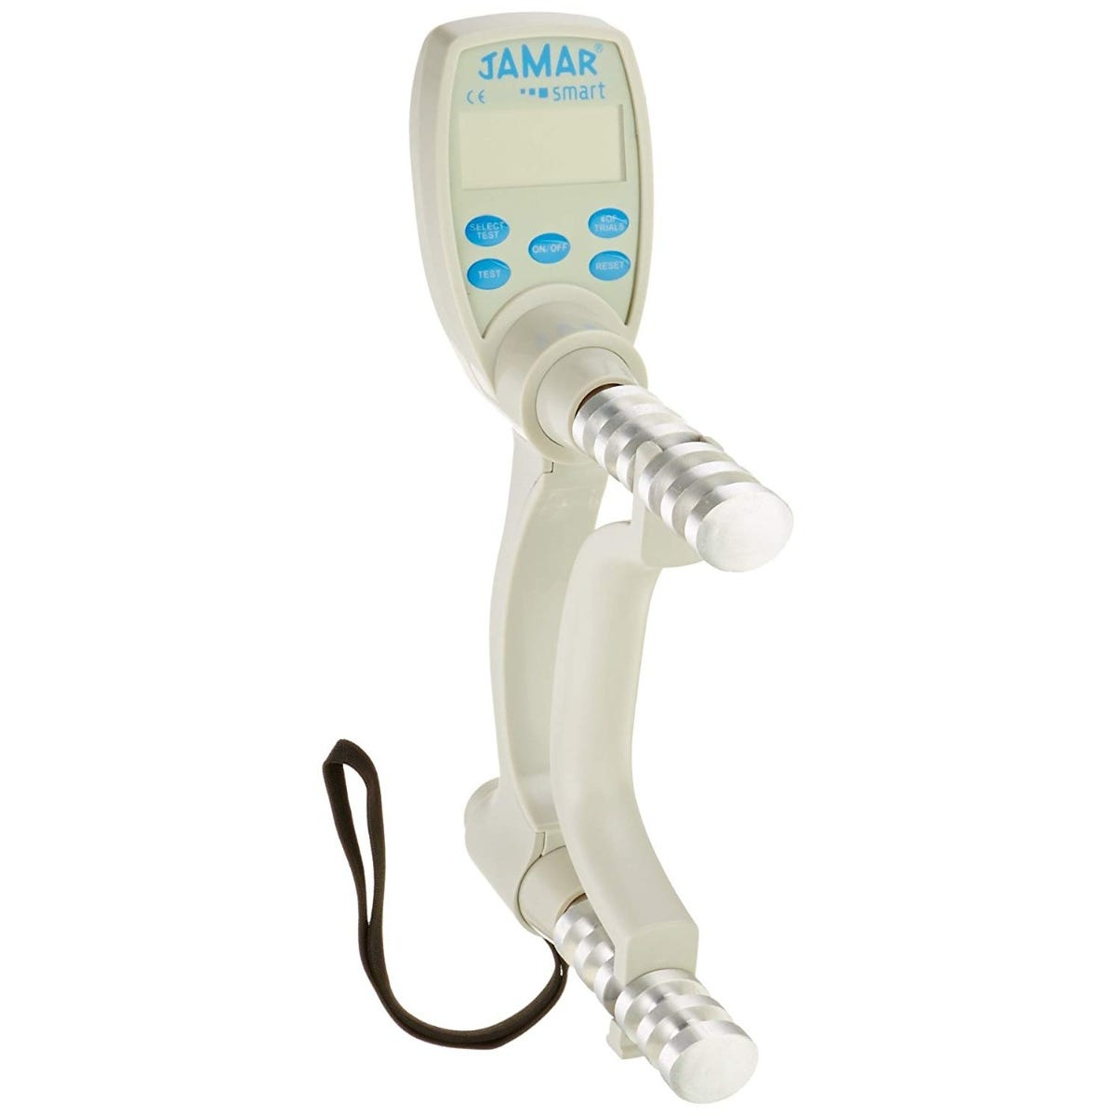
Clinical Characteristics of Malnutrition
Five - Fluid accumulation that may mask weight loss.
Six - Reduced hand grip strength as a marker of decline in function.
Notes:
Step 5 Evaluate generalized or localized fluid accumulation which is evident on exam. (in extremities, or ascites In the abdomen) Weight loss is often masked by generalized fluid retention (edema) and weight gain may be observed.
Step 6 Hand grip strength is a measure of muscle function and offers an additional metric to consider beyond the body composition evaluation that is measured through other aspects of the NFPE. Impaired muscle strength is associated with loss of physical functionality and is associated with disease-related malnutrition. Hand grip strength is accepted as a validated measurement to assess voluntary muscle strength (https://pubmed.ncbi.nlm.nih.gov/21035927/). At this time, there is insufficient evidence to suggest a handshake can be used as an objective replacement for assessment of hand grip strength using a dynamometer. Use of hand squeeze, handshake, or other practical assessment such as opening jar lids can still be used as part of the overall assessment. However, the use of a hand dynamometer is required to ensure objective and measurable evaluation of functional status per the AND/ASPEN consensus paper.
Clinical judgement is used to determine when hand grip strength is not feasible such as in instances of advanced dementia, hand contractures ,ALS or inability to position patient correctly for valid measurement
- Conducting an NFPE including handgrip strength can provide valuable information in this highly vulnerable patient population. The RDN can use the information obtained during the nutrition evaluation and assessment to determine whether the NFPE findings are related directly to improper nutrition or secondary to an associated disease process. Although not part of the AND/ASPEN criteria, the NFPE can also help identify micronutrient deficiencies in the elderly population.

Slide 25
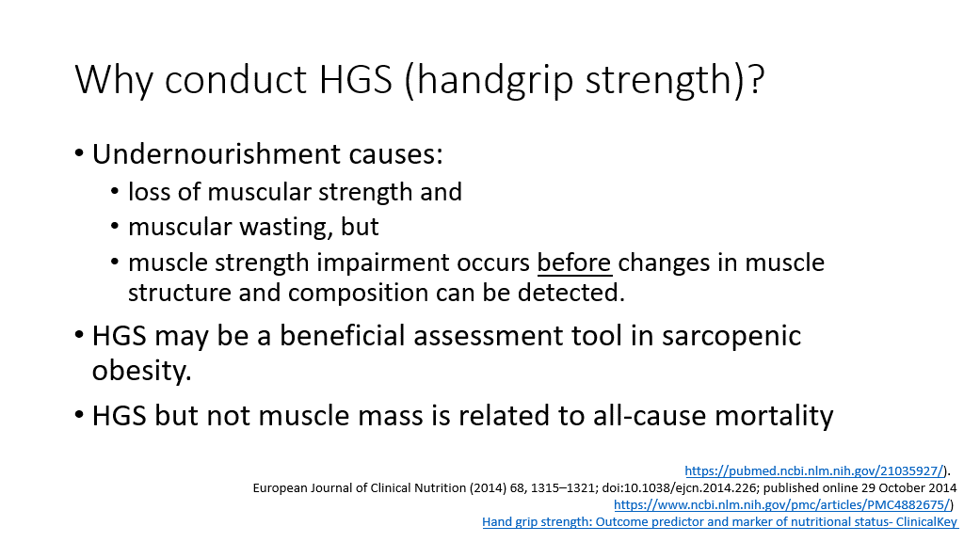

Slide 26
NOT Indicators of Malnutrition
Wounds
BMI: normal BMI for 65 years and older 23-30
Albumin or pre-albumin are NOT appropriate for diagnosing malnutrition as they correlate more with inflammatory status than nutrition status.
National Quality Forum (NQF). Measure #128 National Quality Forum (NQF 0421): Preventive Care and Screening: Body Mass Index Screening Measure and Follow-Up Plan. www.qualityforum.org
Notes:
Wounds…..
Acknowledge prealbumin useful as a marker
BMI- should not be used on it’s own because overweight people can be malnourished. In addition BMI is not well suited as an assessment tool for older population. Criteria for underweight in older adults is 22 where in the general population we use 18.5 as the cutoff for low BMI.
Albumin and Prealbumin are no longer considered a reliable marker of nutrition status. They Do not change in response to changes in nutrient intake.
Albumin and prealbumin are not components of currently accepted definitions of malnutrition.
The serum concentrations of albumin and prealbumin decline in the presence of inflammation, regardless of underlying nutrition status.
Their normalization indicates the resolution of inflammation.

Slide 27
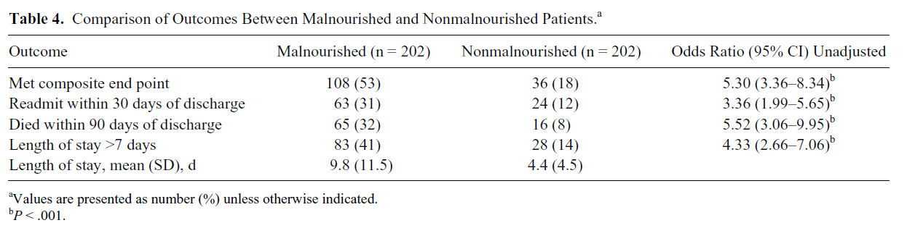
Malnutrition & Mortality
Malnutrition → more 30-day readmissions with higher mortality
Higher mortality -5.3x more likely
Severe chronic disease-related → Highest readmission and Death
(Hiller et al., Difference in Composite End Point of Readmission and Death Between Malnourished and Nonmalnourished Veterans Assessed Using Academy of Nutrition and Dietetics/American Society for Parenteral and Enteral Nutrition Clinical Characteristics 2016)
Notes:
Study: Difference in Composite End Point of Readmission and Death Between Malnourished and Nonmalnourished Veterans Assessed Using AND ASPEN
Study included 202 veterans with malnutrition & 202 veterans w/o malnutrition (matched controls) at Florida VA

Slide 28

Dietary Recommendations for Geriatric patients

Slide 29
25-35 kcals/kg of body weight:
Energy / Calories
200 # = 2272 calories (30 Kcal/kg)– 3181 calories /day (35 kcal/kg)
150# = 2045 calories/day (30 kcal/kg)- 2386 calories/day (35kcal/kg)
100# =1363 (30 kcal/kg)- 1590 calories/day (35 kcal/kg)
Notes:
These numbers might seem high. First line of treatment malnutrition-is for a pt to eat small high energy/protein snacks and meals frequently.
Mcleod, Sandy and Wilkinson, Tim. )Strategies to improve nutrition in elderly people. (Best Practice Journal . 15 August 2008.
Take into account pt’s illness, medication, access to food, dementia, appetite. Can be difficult to achieve to prevent malnutriiton.
Without suffient calories pt will become weaker, loosing weight and muscle strength. Prone to falls and skin injury.
Pts often require fortified foods to meet caloric needs re oatmeal made with creme., crème added to soups.
Often pts require a nutritional supplement in addition to their regular meals to meet their caloric needs due to poor appetites.

Slide 30
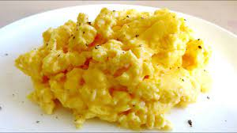
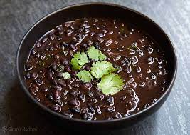
Protein Recommendations
Protein 1.0-1.2 gm/kg/gm
1.0 gm protein
220 lb – 100kg = 100-120 grams protein/day
165 lb -75 kg = 75-90 grams protein/day
130 lb -59 kg = 59- 70 grams protein/day
110lb -50 kg – 50-60 grams protein/day
Notes:
Body composition changes as people get older. One of the noteworthy alterations is the reduction in total body protein. A decrease in skeletal muscle is the most noticeable manifestation of this change but there is also a reduction in other physiologic proteins such as organ tissue, blood components, and immune bodies as well as declines in total body potassium and water. This contributes to impaired wound healing, loss of skin elasticity, and an inability to fight infection. The recommended dietary allowance (RDA) for adults for protein is 0.8 grams of protein per kilogram of body weight. Protein tissue accounts for 30% of whole-body protein turnover but that rate declines to 20% or less by age 70. The result of this phenomenon is that older adults require more protein/kilogram body weight than do younger adults. the requirement for protein is at least 1.0 gram/kilogram body weight for geriatrics. Adequate dietary intake of protein may be more difficult for older adults to obtain. Dietary animal protein is the primary source of high biological value protein, iron, vitamin B₁₂, folic acid, biotin and other essential nutrients. In fact, egg protein is the standard against which all other proteins are compared. Compared to other high-quality protein sources like meat, poultry and seafood, eggs are the least expensive. The importance of dietary protein cannot be underestimated in the diets of older adults; inadequate protein intake contributes to a decrease in reserve capacity,
A more even distribution of protein throughout the day has been shown to be associated with higher muscle mass in older adults (4). As such, spreading protein throughout the day (with 3 meals or adding on high protein snacks) is a good way to ensure our bodies are able to use the protein we are consuming.
During wound healing those needs increase to 1.25 to 1.5 grams of protein per kg body weight (2).

Slide 31
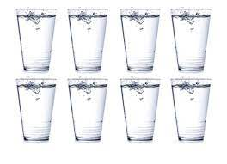
Fluid Needs:
1 mL fluid per calorie (based on caloric needs)
2000 calories/day= 2000ml
(2000ml = 8 - 8oz cups of fluid per day
Notes:
Individuals with certain health conditions (i.e. CHF/renal disease OR serious infections/diarrhea) also have different fluid needs
Typically you get about 20% of water you need from the food you eat to replenish the amount of water that is lost
Average individual >70 years old drinks <1.5 liters per day = 6 cups
Quick way to check if suffient water is consumed is to look at the color of your urine ( assuming no medication will affect urine color). If adequate hydration, urine will a pale yellow color. If it is dark yellow or amber, you will need to increase your hydration

Slide 32

Medical Nutrition Therapy
To maintain the pleasure of eating by only limiting food choices when indicated by scientific evidence.
Notes:
Medical Nutrition Therapy, often abbreviated as MNT, is an evidence-based medical approach to treating chronic conditions through the use of an individually-tailored nutrition plan based on scientific evidence. The principle is to identify and address the underlying cause of an individual's symptoms.
For the geriatric patient we want to maintain their pleasure of eating by only limiting food choices when indicated by scientific evidence.

Slide 33

Individualized Goals of Care:
To address individual
nutrition needs.
Take into account personal
and cultural preferences.
Willingness to change.
Notes:
Important to discuss goal of care during initial visit to determine goals of care with pt/ family or Health care power of Attorney. What is important for pt.
What does the patient set for their Goals.

Slide 34
Strategies to Improve Malnutrition:
Feeding Issues
Lack of hunger and satiety cues
Changes in taste and texture preferences
Consistent routine and schedule
Community dining, socialization
Honor changes in taste preferences
Explore new foods
Notes:
Lack of hunger /early satiety – Sensation of hunger can decrease with age and dementia. Can offer small frequent meals and snacks.
Change in taste, give pt what enjoys and change texture pt will accept. Food may not smell or taste as appetizing as it once did which decrease pt’s desire to eat.
Consistent schedule. Serve snack at 3pm instead of 2 pm to honor Pt’s schedule.
Lack of socialization- include in facilities dining room.
Honor changes in taste preferences- changes may change suddenly and dramatically
Explore new culture of food never tasted or food tasted while on active duty and wish to try again.

Slide 35

Feeding Issue
Possible Strategies
Dysphagia
Modify texture
Oral hygiene
Review goals of care
Refer to SLP
Swallowing precautions
Xerostomia
  Mouth lubricants
  Good hydration
Notes:
zee·ruh·stow·mee·uh

Slide 36

Dehydration
Notes:
Next discuss dehydration. Important topic for our Geriatric pts.

Slide 37
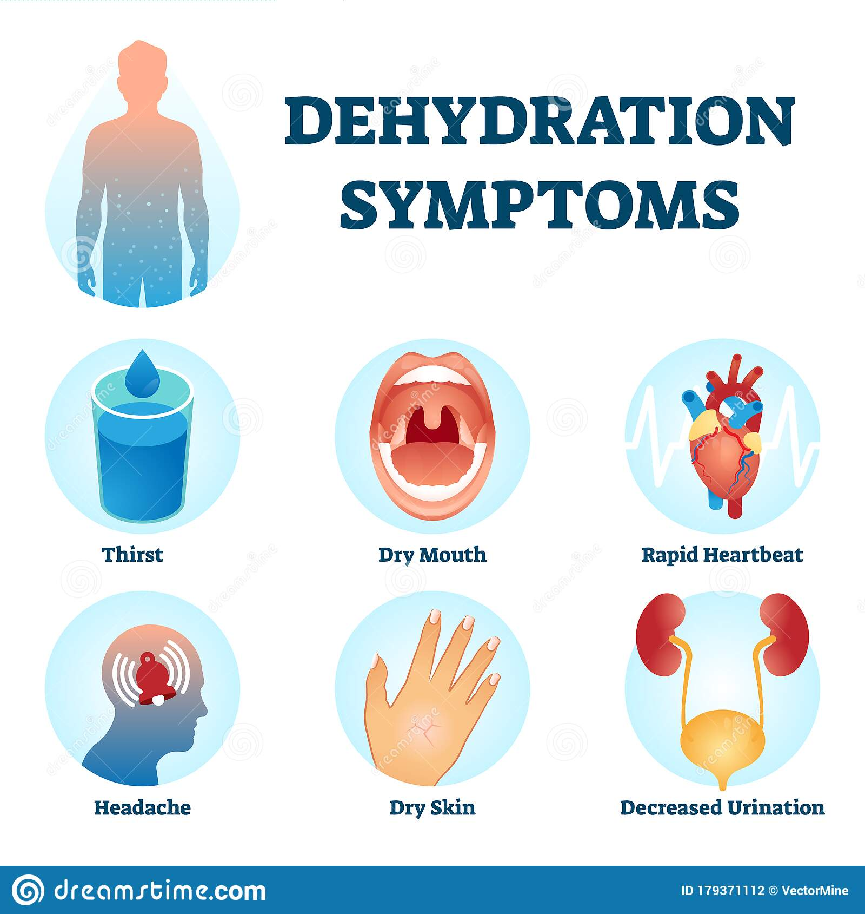
Dehydration:
Symptoms
Causes
Risk Factors
Complications
Notes:
Causes: simple reasons (not drinking enough – sick or busy, lack access to drinking water Re: for a geriatric patient in their home/ALF or SNF unit.
Other causes: diarrhea/vomiting; fever; excessive sweating; increased urination (uncontrolled/undiagnosed DM and certain medications)
25% of patients >65 years old take a diuretic – producing excessive water loss
Incontinence is common in older adults and can play a role in decision to decrease fluid intake. We all know pts who choose not to drink because they will have to get up to go to the bathroom.
Cognitive impairment can make it difficult for individuals to communicate their thirst or need for fluid. Staff not offering the fluids to patients
Risk Factors
Older adults: body’s fluid reserve becomes smaller, your ability to conserve water is reduced and your thirst sense becomes less acute. Some older adults also may have mobility issues that limit their ability to get water on their own
People with chronic illnesses re CHF with a fluid restriction.
Geriatric patients who work or exercise outside – when the air is humid sweat can’t evaporate and cool as quickly and this leads to increased body temperate and need for more fluids
Vasopressin also decreases, reducing the capacity of kidneys to concentrate urine
Muscle stores large amounts of water (contributing ~70% of storage) whereas fat stores only ~10-40% of water. Older adults have decreased muscle mass and increased fat stores so they lose the benefit of a larger water reserve.
Complications:
Heat injury (from mild heat cramps to heat exhaustion to heatstroke)
Urinary and kidney problems: cause urinary tract infections, kidney stones, and even kidney failure
Seizures: electrolytes (K+ and Na+) help carry electrical signals from cell to cell. If these are out of balance, the normal electrical messages can be mixed up which can lead to involuntary muscle contractions and sometimes to a loss of consciousness

Slide 38
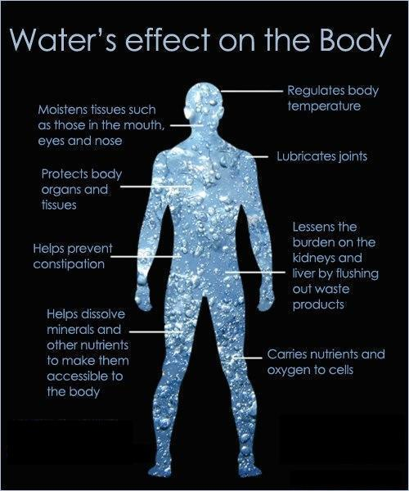
Why is Water Important?
Biochemical processes
Facilitating ingestion and digestion
Lubricant
Flushing of urinary tract, eyes, and other organs
Maintenance of:
  Circulatory system
  Lymphatic system
  Body temperature
  Removal of waste products from cells and the body
Notes:
Water is important for cell shape and structure; water ensures that everything within the cells maintains its right shape
Water helps break down food so nutrients can be absorbed; it also helps to soften stools to prevent constipation
Water is a Lubricant – helps create saliva and tears; keeps joints lubricated

Slide 39
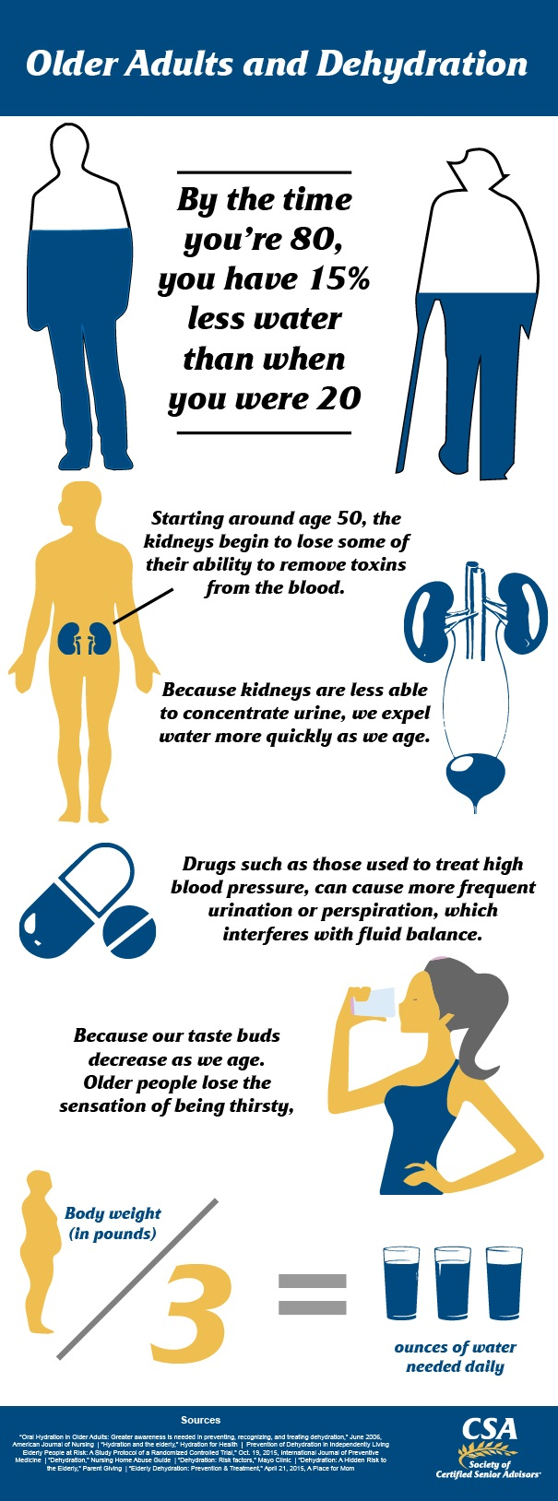
Dehydration &
Older Adults
  Affects 20-30% of older adults
  Thirst = early dehydration
  Mortality
  Morbidity
  Disability
  As of 2015, estimated $5.5 billion of Medicare spent annually for dehydration-related hospital admissions.
Notes:
Symptoms of dehydration are more difficult to identify in older adults. They can be attributed to other medical conditions, aging, or medications.
Associated with increased mortality, morbidity and disability
Thickened liquids can put someone at increased risk for dehydration also for those who have dysphagia.
Read right of slide.

Slide 40


Sources of Hydration
Water
Milk or milk alternatives
Smoothies/milkshakes
Water-rich foods
Fruit Juice or sports drinks
Popsicles
Jello
Soups
Notes:
Water can be sparkling or add fruit to flavor it
Coconut water is another alternative (beware of added sugars by checking the label)
Water-rich foods: watermelon, cucumber, strawberries, lettuce, zucchini, even canned fruit from a MOW can add fluid to a pt’s meal
Limit quantity from fruit juice and sports drinks d/t high content of sugar
- Consuming high sugar, high sodium, and alcoholic and/or caffeinated products can further cause diuresis and fluid shifts
To assist increasing fluid intake- Have fluids at meals and snacks.
Keep fluids close at hand in a bottle, glass or insulated cup.
If the patient is weak, use a small glass or straw to encourage more fluids.

Slide 41
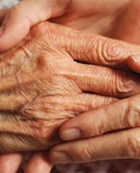
Feeding issues
Most common complication in advanced dementia
Typically last ADL lost prior to death
Mitchell S, TenoJM, Kiely DK, et al. The clinical course of advanced dementia. N EnglJ Med. 2009;361(16):1529-1538. Mitchell SL. A 93-year-old man with advanced dementia and eating problems. JAMA. 2007;298(21):2527-2536.
Slide source: Angela Catic, MD Ask the Expert on Nutritional Issues in Advanced Dementia 3/27/2019
Notes:
Finger foods or foods appropriate for texture are to be served to pt as they are able to feed themselves.
Pt should be given time to eat. It will take longer for the patient to eat.

Slide 42
Enteral Nutrition
Enteral Nutrition does not improve nutritional status in advanced dementia
Study of patients with advanced dementia receiving enteral feeding
Continued weight loss
Continued malnutrition
Complications from enteral feeding (i.e. diarrhea, electrolyte disturbances) can further worsen nutritional status
Henderson CT, TrumboreLS, MobarhanS, et al. Prolonged tube feeding in long-term care: nutritional status and clinical outcomes. Journal of the American College of Nutrition. 1992; 11(3):309–325. Li I. Feeding tubes in patients with severe dementia. American Family Physician 2002;65(8):1605–1610.
Slide source: Angela Catic, MD Ask the Expert on Nutritional Issues in Advanced Dementia 3/27/2019
Notes:
Switching gears to discuss Enteral Nutrition. As elderly do not consume suffient calories p/o. Families will consider enteral nutrition . The health care team will lead the discussion. Discussion how enteral nutrition does not improve nutritional status.

Slide 43
No study has demonstrated a reduced risk of aspiration in elders with advanced dementia fed by PEG or NG tube.
Evidence that aspiration actually increases with artificial feeding-Comparison of enterically versus non-enterically fed patients with advanced dementia, 40% receiving enteric feedings developed aspiration PNA versus 12.8% in the oral feeding arm.
PEG placement may result in relaxation of the lower esophageal sphincter.
Aspiration of oral secretions and regurgitated gastric contents commonly occur.
Aspiration
Notes:
Related to Enteral feeding also need to discuss aspiration

Slide 44
A: Assessing patient’s intake and food dislikes.
B: Assessing patient’s hydration status, and NFPE.
C Assessing patient’s medications and Hand grip strength.
D: Assessing patient’s intake, weight, weight history, NFPE and Hand grip strength.
A Geriatric Patient may be diagnosed as Malnourished by:
Notes:
Questions for you to assess your Knowledge

Slide 45
A: Assessing patient’s intake and food dislikes.
B: Assessing patient’s hydration status, and NFPE.
C Assessing patient’s medications and Hand grip strength.
D: Assessing patient’s intake, weight, weight history, NFPE and Hand grip strength.
A Geriatric Patient may be diagnosed as Malnourished by:
Notes:
Questions for you to assess your Knowledge

Slide 46
Serum albumin and prealbumin are not used as indicators of malnutrition due to.
A: ARE INDICATORS OF FOOD ALLERGIES
B: INFLAMMATION MARKERS
C:CHANGE WHEN A PATIENT LOSES WEIGHT.
Notes:
Our next question

Slide 47
Serum albumin and prealbumin are not used as indicators of malnutrition due to.
A: ARE INDICATORS OF FOOD ALLERGIES
B: INFLAMMATION MARKERS
C:CHANGE WHEN A PATIENT LOSES WEIGHT.
Notes:
Our next question

Slide 48
Conclusion
Documentation and standardized care to improve the care of veterans​.
Prevention of readmissions.
Team collaboration to meet our patient needs.
Preventing further decline in nutritional status.
Notes:
Meeting the needs of the patient if they are in the home , assisted living, dialysis unit, skilled nursing or hospital. Malnutrition is determined using a validated screening tool. A team approach is required once malnutrition has been diagnosed to prevent further decline and improve the patient's quality of life.

Slide 49
Sources
White JV, Guenter P, Jensen G, Malone A, Schofield M; Academy Malnutrition Work Group; A.S.P.E.N. Malnutrition Task Force; A.S.P.E.N. Board of Directors. Consensus statement: Academy of Nutrition and Dietetics and American Society for Parenteral and Enteral Nutrition: characteristics recommended for the identification and documentation of adult malnutrition (undernutrition). JPEN J Parenter Enteral Nutr. 2012 May;36(3):275-83. doi: 10.1177/0148607112440285. PMID: 22535923.
Nutrition and Weight Management in the Elderly , Carolyn Newberry MD and Gregory Dakin MD Clinics in Geriatric Medicine, 2021-02-01, Volume 37, Issue 1, Pages 131-140
Lacey, J., Corbett, J., Forni, L., Hooper, L., Hughes, F., Minto, G., Moss, C., Price, S., Whyte, G., Woodcock, T., Mythen, M., & Montgomery, H. (2019). A multidisciplinary consensus on dehydration: definitions, diagnostic methods and clinical implications. Annals of medicine, 51(3-4), 232–251. https://doi.org/10.1080/07853890.2019.1628352
Gaddey HL, Holder KK. Unintentional Weight Loss in Older Adults. Am Fam Physician. 2021 Jul 1;104(1):34-40. PMID: 34264616.
Hong X, Yan J, Xu L, Shen S, Zeng X, Chen L. Relationship between nutritional status and frailty in hospitalized older patients. Clin Interv Aging. 2019;14:105-111. Published 2019 Jan 10. doi:10.2147/CIA.S1890404
Aging statistics. Administration on Aging website. https://aoa.acl.gov/Aging_Statistics/Index.aspx.

Slide 50
Questions?

