Slide 1
Durham VA Health Care System’s Geriatric Emergency Department
Crystal Church
MSN, RN
Nurse Professional Development Generalist, Emergency Department

Slide 2
Why is it important to focus on the geriatric population?
Over 1 million annual ED encounters within the VA health care system each year for veterans older than 65 years of age.
22% of these encounters result in admission to the hospital.
When admitted, older adults are at risk for developing the “Hazards of Hospitalization.”
Notes:
These hazards include functional decline, such as not being able to ambulate or transfer as well, malnutrition with decreased oral intake, dehydration, pressure wounds due to reduced mobility, and altered cognition. If we are able to prevent unnecessary hospitalizations, we can mitigate these risks.
For example, if a veteran who presents to the ED without an acute medical condition, but rather a need for increased support, we may be able to identify the needs and enact target home services from the ED, avoiding hospitalization.

Slide 3
Why a Senior Friendly Emergency Department?
Older adults discharged from the ED are at risk for:
rapid return to the ED
Rehospitalization
decline in functional status
death following discharge home
Poor communication or execution of care transitions may contribute to these adverse events.
Notes:
Older patients have special needs not always met by standard emergency care.
When in the ED, older patients experience more testing than their younger counterparts, longer ED length of stay, double the rate of ED revisits and higher admission rates. Despite high resource utilization, satisfaction rates are low.
Therefore, there is a push to provide efficient healthcare to a frail older population. More than 1/3rd of US outpatient care is delivered in the acute care setting; therefore the ED is providing significant medical decision making and care planning. The ED should not be viewed as a safety net, but instead of an opportunity for care transition programs.

Slide 4
What makes a Senior-Friendly Emergency Department?
In 2013, emergency doctors and nurses in collaboration with the American Geriatric Society published guidelines describing ideal Geriatric Emergency care.
These guidelines serve as the basis for Geriatric ED Accreditation which is now offered through the American College of Emergency Physicians.
Notes:
In 2019 the Durham VA Health Care System’s (DVAHCS) Emergency Department was awarded the American College of Emergency Physicians Bronze (Level 3) Accreditation.
In 2020 the DVAHCS Emergency Department was awarded the Silver (Level 2) Accreditation.

Slide 5
What makes a Senior-Friendly Emergency Department?
Equipment and Environment
Policies, Procedures and Protocols
Interdisciplinary Team
Notes:
The three pillars of a senior-friendly emergency department include the appropriate equipment and physical environment, policies and procedures guiding geriatric screens and clinical care, and an interdisciplinary team with geriatric knowledge and skillsets.

Slide 6
What has our Emergency Department implemented to become Senior Friendly?
Equipment and Environment
Geriatric patient care requires equipment and an environment designed for the challenges of reduced mobility, impaired sensorium, and increased frailty of the older patient.
Notes:
We identified 2 private rooms and designated them as Geriatric friendly rooms. These rooms have large clocks with easy-to-read numbers and colorful wall hangings.
We have increased the mobility aids on hand.
We placed additional large font signage to identify the restroom and exit.
We have hearing amplifiers on hand and will soon participate in Hearing Impairment, Strategies and Outcomes in VA Emergency Departments (HearVA-ED), a research project conducted by the Division of Geriatric Medicine and Palliative Care from NYU School of Medicine.
We have a supply of sensory and tactile stimulation aids available for patient use.
We have started a pilot program called SCOUTS, Supporting Community Outpatient Urgent Care & Telehealth Services.

Slide 7
What has our Emergency Department implemented to become Senior Friendly?
Using ISAR to identify the older adults in the ED who are at highest risk for adverse events
Screening for delirium and falls risk in all patients age 75 and older
Screening highest risk for:
Cognitive impairment
Functional impairment
Caregiver burden
Depression
Elder Abuse
Polypharmacy
Policies, Procedures and Protocols
Notes:
We developed screenings for delirium, dementia, functional decline, falls, elder abuse, care giver burden, depression and polypharmacy.
Guidelines should be in place to promote nutrition in the ED, avoidance of restraints and catheters, and assurance of appropriate post-discharge follow-up.
We developed guidelines for
Mobility
Minimizing urinary catheter usage
Minimizing use of restraints
Encouraging food and water
Psychiatry
Palliative care
Post-discharge follow-up.

Slide 8
What has our Emergency Department implemented to become Senior Friendly?
Interdisciplinary Team
Nurse practitioner
Bedside Nurses
Intermediate care technicians
ED pharmacists
ED Social Worker
Physical therapists
ED providers
Nurse Educator/Champions
Notes:
A specialized team is in place to provide geriatric care.
This team is comprised of care members already working in the ED who received additional geriatric training.
Our team includes:
Case Manager/screener: Christopher Bean, NP; Crystal Church, RN; Christopher Ritter, ICT; Alain Calimlim, ICT; Collin O’Donnell, ICT; and LaVundra Copeland, ICT - who perform geriatric screens and care coordination
Physician Champion: Dr. Luna Ragsdale
PT/OT: Steve Fairbanks
Social Work: Carlos Bennerman
Pharmacy: Ryan Owenby, Pharm D

Slide 9
Goals for the DVHCS Emergency Department
Our goal with this program is to provide quality emergency care to older veterans while fully evaluating and preparing our geriatric patients to return home safely.
Our hope is to provide care in the most appropriate setting, promote independence, decrease unnecessary admission rates and ED returns.
Notes:
The GERI-VET program:
Identifies at-risk older patients in the ED.
Detects otherwise unrecognized geriatric syndromes.
Provides multidisciplinary care coordination.
With the proper tools (ie walkers, OT consults, med reconciliations) our hope is to decrease admission rates and the return to ED visits.

Slide 10
Objectives for the DVHCS Emergency Department
Screening and detection of geriatric syndromes.
Tailor care to the most appropriate setting.
Improve transitions of care.
Train the VA workforce to care for our aging veterans, with a specific focus on Intermediate Care Technicians.
Notes:
Incorporation of the results of the geriatric screens enables the GERI-VET program to tailor care to the most appropriate setting. Such as avoiding an unnecessary inpatient admission for an older veteran with non-acute but significant psychosocial needs. The GERI-VET program improves transitions of care through communication among ED and outpatient staff. Importantly, the GERI-VET program trains a novel workforce to provide this care, with a specific focus on Intermediate Care Technicians.

Slide 11
GERI-VET Workflow
Notes:
When an older adult checks into the ED (in this example, the cutoff age is 75 years or older), a delirium triage screen and a steadi falls screen is completed by the RN. After that they receive a specialized screen called the ISAR, or Identification of Seniors at Risk screen. If their score is high (greater than 3 out of 6 points), the veteran will receive a GERI-VET screen in addition to standard ED care. The GERI-vET screen, screens for delirium, dementia, fall risk, functional impairment, polypharmacy, caregiver burden, depression, and elder abuse. The ICT (or whomever is performing the geriatric screens) will meet with the ED clinician and ED social worker to discuss positive screens, any concerns that have arisen, and develop a safe discharge or admission plan. Follow-up phone calls are performed with 1 week and again at the 30 day mark.
On average, it takes 20 minutes to perform these geriatric screens.
One of the benefits of structuring the program by using an ICT or other geriatric ED liaison is that they off-load the work of the ED physician. The ICT is the one informing the PCP, ED provider, pharmacist, and ED social work as needed to give report on specific geriatric concerns. They are suggesting consults to the physician, and they are calling the caregiver or APS to find out more information about the patient.

Slide 12
Identification of Seniors at Risk (ISAR)
Notes:
This is an example of the ISAR screen. You can see that it is 6 questions long, and if a patient has 3 or more positive responses, a GERI-vET screen should be completed.

Slide 13
GERI-VET Screening Tool
Notes:
Here is an example of the form used by the screener when meeting with the patient. It provides prompts for each screen, and should be used to take notes which are then entered into a templated CPRS note

Slide 14
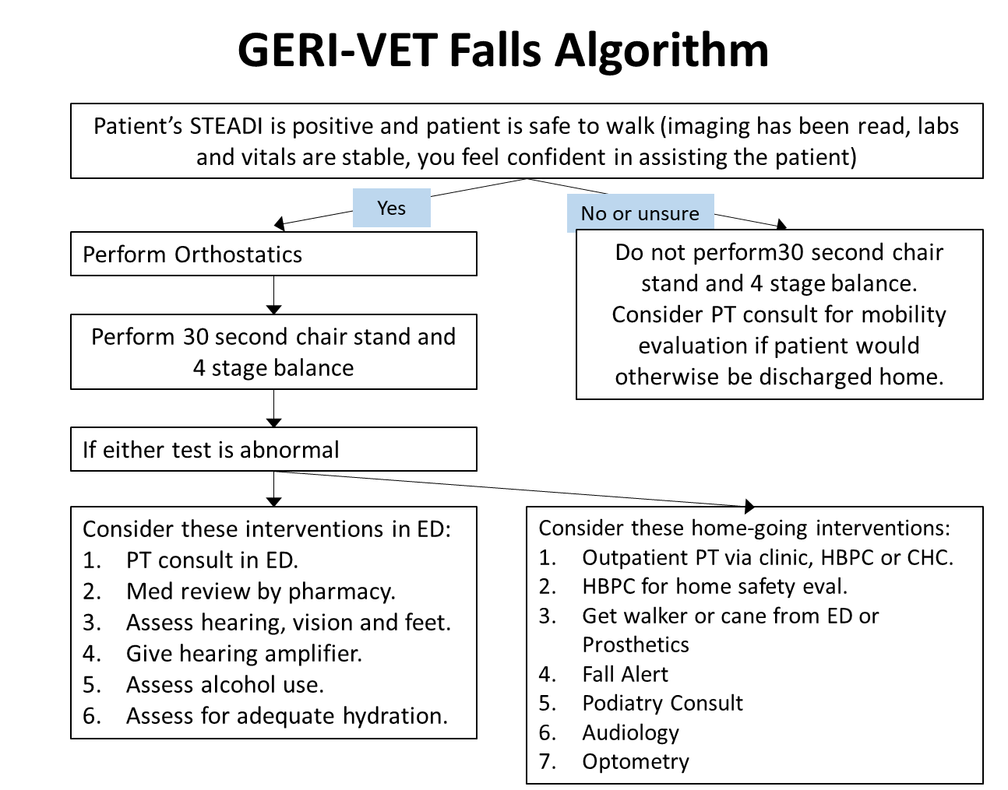
GERI-VET Falls Algorithm
Notes:
Decision-support tools for each screen are provided for the ICT or other person performing the screens. This is an example of Fall risk evaluation. If the fall risk screen reveals moderate to high fall risk, the ICT will find reminders for interventions that can be performed in the ED or outpatient settings.

Slide 15
GERI-VET Quality Metric
Length of stay in ED
Admission rates and LOS
90 day ED revisit and hospitalization rates
“Geriatric” services ordered from ED
Patient and caregiver satisfaction
Notes:
This process is fairly new to our VA however, we plan on evaluating the GERI-VET program with metrics that include ED and hospital length of stay, 90-day revisit and readmission rates, geriatric-themed consults ordered from the ED, and satisfaction rates.

Slide 16
Questions
Notes:
This process is fairly new to our VA however, we plan on evaluating the GERI-VET program with metrics that include ED and hospital length of stay, 90-day revisit and readmission rates, geriatric-themed consults ordered from the ED, and satisfaction rates. We hope to move toward Level 1 Accreditation within the next year!!

