Slide 1

Dementia: Adaptive Approaches in Care
Eleanor (Ellie) McConnell, PhD, RN
Clinical Nurse Researcher
Geriatric Research, Education and Clinical Center (GRECC)
December 2021

Slide 2
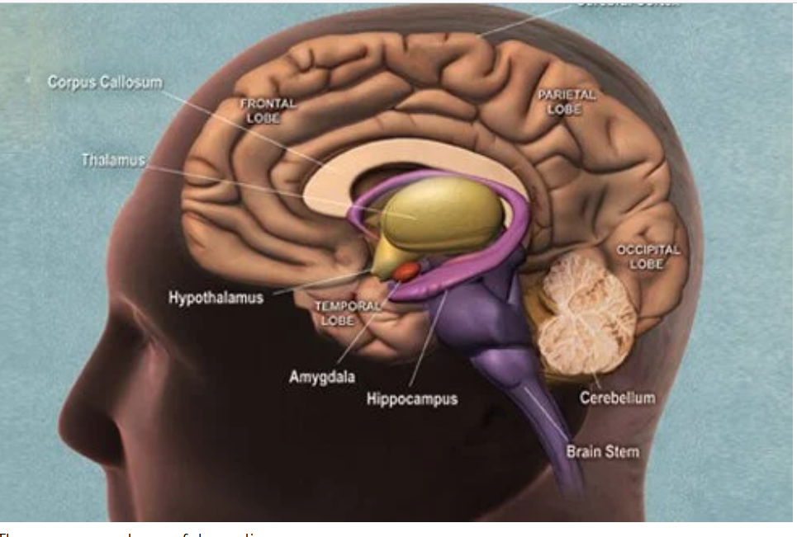
Adaptive Dementia
Care:
Core Competencies
Clinical:
  Ability to integrate needed
  dementia knowledge, skills
  and attitudes into practice
  Ability to adapt caregiving approach and environment according to response of person with dementia
  Demonstrated by response to different levels of impairment in dementia exhibited during performance of different caregiving tasks
Photo credit https://www.medicinenet.com/dementia/article.htm
Notes:
When the core knowledge, skills and attitudes for adaptive dementia care are each mastered, together, these new abilities will result in new competency for caring for people with dementia. To integrate these three components, learners will need to be exposed to situations where they have to assess a person with dementia’s response to a situation, and then select among a variety of responses to the person with dementia’s behavior. In order to build confidence in use of new competencies, the master trainer will need to become comfortable with simulating responses of a person with dementia at different levels of cognitive function. This training manual will provide opportunities for master trainers to observe behaviors of many people with dementia, at many levels of function. We will then provide guidance on how to mimic some of these behaviors, so that you can evaluate performance in the staff you are responsible for training.

Slide 3
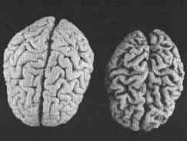
Core Clinical Knowledge
Dementia-related behaviors and behavioral symptoms
come from brain failure
  Different diseases cause dementia
Brain failure is:
  Structural
  Chemical
  Progressive
Managing behavioral symptoms requires that we change….
  Because we can’t change the person with dementia
Our job:
  Recognize underlying cause of behaviors using a systematic process
  Adapt our behavior to support function
  Change the environment
Notes:
To be successful in mastering adaptive dementia care techniques, caregivers must understand 3 core ideas:
People with dementia will display behaviors, sometimes described as behavioral symptoms, that are the result of brain damage or brain failure. Many different diseases can cause the brain to fail, including Alzheimer’s Disease, Vascular Dementia, or Lewy Body dementia. Different diseases will cause different patterns of behavioral symptoms.
In all diseases that cause dementia, the brain damage affects both the structures of the brain and how the chemicals in the brain function, in multiple areas of the brain. The brain damage becomes worse over time, and thus the disease progresses.
Because we cannot reverse the brain damage, or change the person with dementia, the caregiver is the one who must change, or adapt their behavior. Sometimes in adaptive dementia care, caregivers also change the environment.
To be successful in caring for people with dementia, all caregivers (including professional, informal, and family caregivers) must know what may cause a dementia-related behavior, and then know how to adapt your behavior, another caregiver’s behavior, or the environment, to support function and reduce behavioral symptoms.

Slide 4
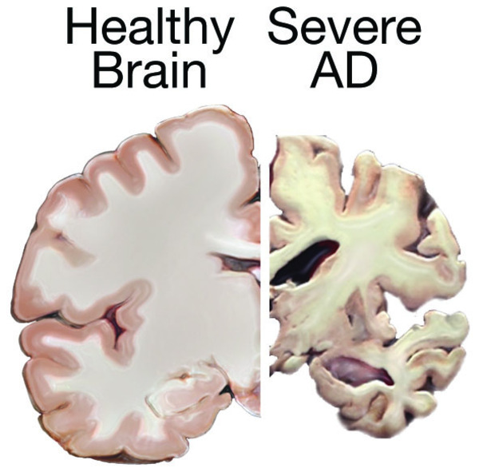
Core Clinical Skills
  Observing Dementia Behavior to
  Adapt Care
  Positive Physical Approach
  Giving feedback
  Will only go this far today…..
  Managing Emotions
  Systematic Cueing
  Hand-under-Hand technique
  Teaching others
Notes:
Four clinical skills form the foundation for implementing adaptive dementia care:
Accurate observation of behaviors in people with dementia, so that the approach or environment can be adapted according to the patient’s response;
A method of approaching the person with dementia, that compensates for visuo-spatial, cognitive and neuro-processing deficits common in dementia;
The systematic use of cues to behavior that compensates for language and memory deficits common in dementia;
The use of a special way of providing physical assistance to someone with dementia, known as “hand-under-hand technique.
Each one of these techniques will be addressed in this training manual.

Slide 5
Session #1: Dementia Overview &
How Being Observant about Behaviors Can Help
Brain Damage
Describe how brain damage affects behavior
Impaired Function
Identify how typical changes in cognition affect ability to provide self-care or cooperate with self-care
Improving symptoms
Identify caregiving skills that make a difference in behavioral or functional symptoms of dementia.
Emotional Responses
Describe emotional responses that occur in dementia caregiving
Observation Skills
Describe behaviors in specific, objective terms
Behavioral Sequences
Analyze behavioral sequences to determine relationship between caregiver behaviors and behaviors of persons with dementia
Notes:
To be successful in implementing adaptive dementia care, caregivers must become very skillful at:
Observing behavior of people with dementia and their caregivers and interpret what underlying problems may explain the behavior
Considering how brain damage that occurs in dementia can result in certain behavioral responses, and
Describe and encourage caregiving behaviors that help to compensate for losses or symptoms that are common in dementia.

Slide 6
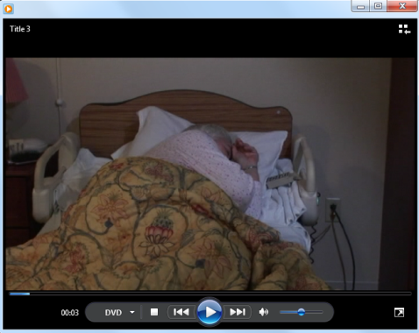
Observing Behavior of Caregiver and Person with Dementia Awakening and Getting Ready for the Day
Watch the 45 second scenario 3 times
  Record personal reaction
    Facilitated discussion
  2. Record observations of person with dementia
    Facilitated discussion
  3. Record observations of caregiver
    Facilitated discussion
  4. Explore options to improve
  interaction
Worksheet #1
Patient Behavior | Caregiver Behavior | Notes
(Video-clip CMS Module 3.3 – Rise and Shine)
Notes:
To begin this lesson, we will ask you to watch a brief video of an interaction between a caregiver and person with dementia three times. After you watch the video the first time, you will be asked to simply reflect on what you observed, and your personal reaction to what you observed. Then the instructor will give you a moment to reflect on what you saw, and then ask you questions about your responses and observations, and facilitate a discussion of how care could be improved.
Transcript of video:
Caregiver: 0-8 seconds
[sound]:
Knocking on door
“Good morning.
Time to get up.”
“Rise & shine”
[begins shaking sleeping
patient]
Patient: 10 sec
Oh..good morning
Caregiver: 11-14 sec
Good morning Mrs. C.
So you need to sit up.
Swing your feet around &
stand up
Patient: 14 sec
Looks confused
Caregiver: 15-17 sec
Sighs & says..let me help you
and begins moving patient
Patient: 18-26 sec
Looks confused, cries out

Slide 7
Step 1: Focus on Your personal reactions:
What was your reaction to seeing this encounter?
  What did you think or feel?
Why do you think you responded this way?
Have you ever seen anything like this before?
  Have you ever done anything like this before?
Do you think there is a better way?
(Video-clip from CMS Module 3.3- Risk and Shine)
Notes:
After showing the video clip, allow about 30 seconds of silence, while you ask the participants to reflect on what they just saw.
Then ask the learners to respond to the question:
“What was your personal response to what you just saw?” Examples of responses you may hear include:
I was sad, or (2) I didn’t like the caregiver…I thought she was mean, or (3) the caregiver was not very good.
After each person’s response, the facilitator should listen actively, paraphrasing and expanding upon what each class member said, using nonverbal communication that encourages the participants to respond.
After each person has voiced their ideas, then ask “Why do you think you responded that way?”
Again, allow each participate to offer at least one idea, responding in the same manner as for the first question.
Then ask the participants: “Have you ever seen anything like this before?” Expected answers would be:
(1) yes, I have,” to which the facilitator would respond, based on the first set of questions something like “many people have observed this type of care…and it is upsetting.” In response to a “no I haven’t” the facilitator would say something like “well, I’m glad for that, however, unfortunately, many staff members who are not knowledgeable about dementia often behave in this manner.”
Sounds like there are a range of responses, from uncomfortable to sad to angry. These responses are what I expect from a group of people who want to improve the care of people with dementia.
Finally, ask the participants: “Do you think there is a better way to help this person with dementia get ready for their day?” As before, the facilitator should allow each person to respond, and use active listening techniques to validate understanding of responses and make key teaching points.
TIP for instructors: At this point in the exercise, keep the focus on the personal reaction – and not on fixing the caregiver.
Let the learners know it is fine to jot down some ideas about how to make the situation better – that we’ll get to that shortly.
At the end of this discussion, the group should have identified that the caregiving interaction was not pleasant for either the caregiver or the patient, that there are several reasons why this might have occurred, including the caregiver being busy, not having the right knowledge or attitudes about dementia care.

Slide 8
Common reactions to Video
Ugh! That’s terrible!!!
Caregiver ….
is rushed
doesn’t pay attention to the person with dementia’s responses
seems unkind
provokes the behaviors of the person with dementia
tried to figure out what was wrong, but did not do a very effective job.
made the person with dementia more upset
This type of caregiving behavior happens frequently if the caregiver doesn’t know better
Notes:
Here are some common reactions to the video we have just watched:
Most people pick up on how rushed the caregiver seems.
Most people also comment on how the caregiver doesn’t seem to be very attentive to the person with dementia – it is as though she is just trying to get her tasks done.
This makes her seem unkind.
Many of the learners will have already identified some of these reactions. If they have, acknowledge that they will hear this when they begin to train.
If these are not all identified, note that different staff members will have different reactions.

Slide 9
Observing Behavior Sequences
Observed Caregiver Behavior | Observed Person with Dementia Response | How to modify to improve response of person with dementia?

Slide 10
Step 2: Focus on the person with dementia’s behaviors during the video
  How did the person with dementia respond to the caregiver’s approach?
  What behaviors did you see the person with dementia show in response to the caregiver’s actions?
  What do you think caused the person with dementia to react the way she did?
Notes:
Now let’s look at the video again. This time, focus on the reaction of the person with dementia to the caregiver’s approach.
How did the person with dementia respond to the caregiver’s approach?
Expect answers such as:
(1) she looked shocked or surprised, (2) she frowned a lot, (3) she shook her head, (4) she had a hard time explaining to the staff member what she wanted, (4) her tone of voice sounded frustrated.
If the participants do not describe specific behaviors, but rather focus on inferred emotional response, ask the participants:
“What behaviors did you see the person with dementia show in response to the caregiver’s actions?”
Once you have had a chance to hear more specific behaviors that indicate distress, ask the participants: “What do you think may have caused the reaction you saw from the person with dementia?”
Listen for answers such as “(1) she didn’t have enough time to process the information the caregiver was giving her, or (2) she may not have understood the language that the caregiver was using.
Ask “Do you think she has intact language skills?” Probe for the observation that the person with dementia was able to ask “Oh no, are they broken?”

Slide 11
Brain Disease and Behaviors in Dementia
Brain Function | Behavior in Video
Neural processing speed | Slowed
Language | Difficulty understanding caregiver’s instructions and Difficulty finding words to speak with caregiver
Sequencing of motor tasks | Difficulty getting up out of bed
Judgment | Cried out, was easily frustrated
Concentration | Difficulty switching tasks when asked
Notes:
Many brain functions are affected by dementia. If you compare a brain of someone with dementia and someone who does not have dementia, you will see many impressive differences, similar to the picture on this slide. These brain changes directly affect the behavior of a person with dementia.
In the video sequence you just observed, the patient showed evidence of difficulty with language, sequencing of motor tasks, judgment and concentration.
Other cognitive functions, such as memory, and visuo-spatial function may also be affected, but these were not prominent features of the behaviors seen in the video.

Slide 12
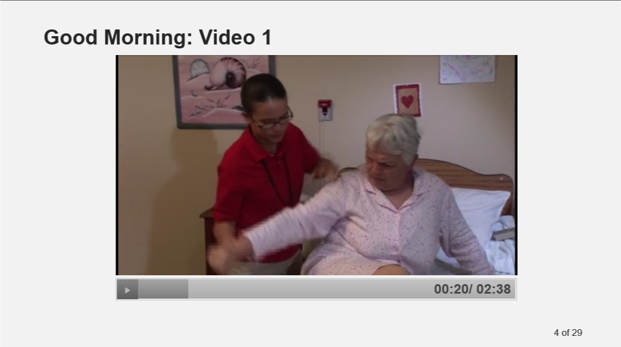
Step 3: Focus on the caregiver’s behavior.
What did the caregiver do during the interaction?
What did the caregiver do that was helpful?
What did the caregiver do that was not helpful?
  Record observations of caregiver on worksheet
Why do you think the caregiver behaved the way she did?
Do you think there is a better way?
Notes:
Now, we are going to look at the video one more time.
This time, pay attention to what the caregiver does during this sequence. Focus on the words the caregiver uses, what the caregiver does to the person with dementia, including her facial expressions.
You may wish to take some notes while you look at the video.
After a moment for reflection, ask the participants: What did the caregiver do during the interaction? Examples of responses you might hear include: (1) Knocked on the door, (2) Said “rise and shine,” (3) shook her when she didn’t respond, (4) Gave many instructions, (5) Pulled on her to get her up, (6) Tried to figure out what was wrong, (7) tried to give her glasses, and they were knocked out of her hand
“What did the caregiver do that was good, or helpful?”
Examples of answers you might expect include: (1) calls her by her name, (2) recognizes that the person with dementia is upset, (3) tries to figure out the source of the person with dementia’s distress, such as when she asks if she needs to use the bathroom, when the person with dementia looks upset, and struggles to explain.
Once all participants have had a chance to offer an observation, then ask “What did the caregiver do that was not helpful?”
Examples of responses you might hear include: (1) moved too fast, (2) showed her frustration by looking upset, using “baby talk” (3) moving the patient before she was prepared

Slide 13
Step 4: What could have been done differently to help the person with dementia have a better start to her day?
  How would you recommend the caregiver begin the encounter?
  2. What would you recommend the caregiver do when the person with dementia did not respond as expected?
  3. What could the caregiver have done when she became frustrated?
Notes:
Now let’s consider what could have been done differently to help the person with dementia begin their day more successfully. Thus far, you’ve mentioned that the caregiver [list things the caregiver did wrong and right].
“How would you recommend the caregiver begin the encounter?”
[listen for ideas such as (1) wait longer for a response from the person with dementia, or (2) try using a different type of cue, or being more gentle or patient with cues that were used.
People with dementia often have unexpected responses to a caregiver’s approaches. What would you recommend the caregiver do when the person with dementia did not respond as expected?
[listen for ideas such as (1) try using different words or gestures, (2) try leaving and coming back later if the person is upset, (3) try mirroring the emotion that the person with dementia is displaying. ]
Caregivers of people with dementia may become frustrated when the person with dementia does not understand their instructions.
What could the caregiver have done when she became frustrated?

Slide 14
Adaptive Dementia Care Approaches
Caregiver Behavior | Person with Dementia Response | How to modify to improve response of person with dementia?
Knock on door | No response | Wait for response
Good morning – time to get up | No response or unhappy response | 1 message at a time
Shaking person with dementia | Becomes upset | Use more gentle tactile cue
Helping person with dementia get up | Becomes more upset | Wait for person to respond before moving them.
Notes:
The chart on this slide analyzes the behaviors that the caregiver used to try to get the person with dementia awake and started for the day.
The first column lists the behaviors the caregiver used, and the second column lists the person with dementia’s response to those behaviors.
Consider how the caregiver might modify her behavior to obtain a more desirable response.
The caregiver knocked on the door to awaken the person with dementia, but she didn’t get a response.
What else might the caregiver have done when she did not get a response?
[Listen for suggestions such as “knock louder,” or “try again.”]
The caregiver said “good morning” and then “time to get up” without waiting for a response. She could have waited for a response to “good morning” before giving additional information.
The caregiver shook the person with dementia to get her to awaken. She could have used a different type of cue, such as playing music before shaking the person, which can easily be mis-interpreted by the person with dementia.
The caregiver started moving the patient prior to allowing the patient a chance to move for herself. She could have waited, or offered more limited assistance.

Slide 15
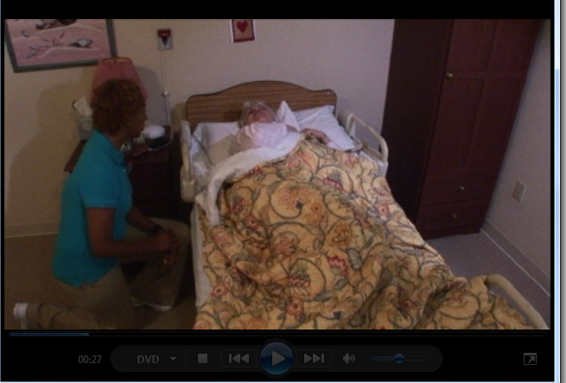
Scenario 2: Observing Behavior with Adaptive Dementia Care Approach.
Watch the 45 second scenario 3 times
  Record personal reaction
    Facilitated discussion
  2. Record observations of person with dementia
    Facilitated discussion
  3. Record observations of caregiver
    Facilitated discussion
https://qsep.cms.gov/data/208/ce7b114b-efaa-e811-952d-0e63451df8f4/story_html5.html?lms=1
Notes:
Now we will watch a brief video of an interaction between a different caregiver and person with dementia three times.
As before, after you watch the video the first time, we will ask you simply to reflect on what you observed, and your personal reaction to what you observed.
The instructor will give you a moment to reflect on what you saw, and then ask you questions about your responses and observations, and facilitate a discussion of how this caregivers approach results in an improved care outcome.

Slide 16
Step 1: Focus on Personal Reactions:
What was your reaction to seeing this encounter?
  What did you think or feel?
Why do you think the you responded this way?
Have you ever seen or done anything like this before?
How do you think this compared to the first encounter you observed?
https://qsep.cms.gov/data/208/ce7b114b-efaa-e811-952d-0e63451df8f4/story_html5.html?lms=1
Notes:
After showing the video clip, allow a period of about 30 seconds of silence, while you ask the participants to reflect on what they just saw.
Then ask each person present to respond to the question:
“What was your personal response to what you just saw?” Examples of responses you may hear include:
That was much better than before or (2) This caregiver was much nicer, or (3) the caregiver much better.
After each person’s response, the facilitator should listen actively, paraphrasing and expanding upon what each class member said, using nonverbal communication that encourages the participants to respond.
After each person has voiced their ideas, then ask “Why do you think you reacted that way?”
Again, allow each participate to offer at least one idea, responding in the same manner as for the first question.
Then ask the participants: “Have you ever seen anything like this before?” Expected answers would be: (1) yes, I have,” to which the facilitator would respond, based on the first set of questions something like “Good – we are trying to help more people know how to give care in this manner. In response to a “no I haven’t” the facilitator would say something like “Well, I’m not surprised to hear you say that. Unfortunately, many staff members don’t have enough knowledge about dementia to alter their care in this manner.”
Finally, ask the participants: “How do you think this compared to the first encounter you observed?” As before, the facilitator should allow each person to respond, and use active listening techniques to validate understanding of responses and make key teaching points.
At the end of this discussion, the group should have identified that the 2nd caregiving interaction was more pleasant for both the caregiver or the patient, that there are several reasons why this might have occurred, including the caregiver being more knowledgeable, and having the right knowledge or attitudes about dementia care to respond to the challenges posed by the person with dementia.

Slide 17
Step 2: Focus on the person with dementia’s behaviors
  How did the person with dementia respond to the caregiver’s approach?
  What behaviors did you see the person with dementia show in response to the caregiver’s actions?
  What do you think caused the person with dementia to react the way she did?
  How were these behaviors similar or different from the behaviors in the first video?
CMS video 3.2
https://www.vapulse.net/videos/3296
Notes:
Now let’s look at the video again. This time, focus on the reaction of the person with dementia to the caregiver’s approach.
How did the person with dementia respond to the caregiver’s approach?
Expect answers such as (1) she was slow to wake up and respond, (2) she looked a little confused, (3) she had trouble telling her caregiver what she wanted (4) she couldn’t get out of bed all by herself.
If the participants do not describe specific behaviors, but rather focus on inferred emotional response, ask the participants: “What behaviors did you see the person with dementia show in response to the caregiver’s actions?” Expect answers such as (1) she did as the caregiver asked her, or (2) she became upset when the glasses fell on the floor
“What do you think may have caused the reaction you saw from the person with dementia?”
Listen for answers such as “(1) she was worried her glasses had broken, or (2) she may not have understood the language that the caregiver was using, or (3) she seemed at ease with the caregiver and the way she was approached.
Ask “Do you think she has intact language skills?” Probe for the observation that the person with dementia was able to ask “Oh no, are they broken?”

Slide 18
Step 3: Focus on the caregiver’s behavior.
What did the caregiver do during the interaction?
What did the caregiver do that was good?
What did the caregiver do that was not good?
Record observations of caregiver on worksheet
Notes:
Now, just as we did with the first video, we are going to look at this video several more times. This time when you watch, please pay attention to what the caregiver does during this sequence. Pay attention to the words that she uses, what she does to the person with dementia, including her facial expressions. You may wish to take some notes while you look at the video.
After a moment for reflection, ask the participants: What did the caregiver do during the interaction? Examples of responses you might hear include:
(1) Knocked several times on the door, called resident by name, and asked if she could come in (2) Waited for resident to respond(3) Got at eye level, and said “good morning” and introduced herself. (4) Waited for response (5) Gave fewer instructions, but used gestures
“What did the caregiver do that was good?”
Examples of answers you might expect include: (1) calls her by her name, (2) provides her with visual cues as well as verbal directions (3) gave her time to respond,
Once all participants have had a chance to offer an observation, then ask “What did the caregiver do that was not good?” Examples of responses you might hear include: (1) dropped her glasses

Slide 19
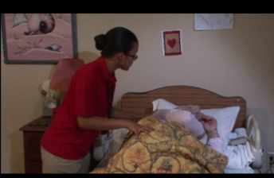

Compare the Two Caregiving Encounters
Approach | Caregiver 1 Behavior | Resident Behavior | Caregiver 2 Behavior | Resident Behavior
Awakening the person | Knocked on door, Good morning, Shaking awake | Ignored caregiver | Knocked several times, Called resident by name | Awakened without shaking
Giving Instructions | Many instructions | Ignored caregiver | Waited for response Used gestures as well as words | Resident got up
Adapting Approach due to response | Tried to figure out source of distress | Became more upset | Observed problem with getting out of bed | Offered tactile and visual cue to assist
Notes:
Let’s take a few minutes to summarize what we’ve just observed in these two videos.
In the first encounter, the caregiver approached the patient without adapting her approach, her pace, or her language.
She did not pay close attention to the reaction of the person with dementia. As a result, the person with dementia became increasingly confused, and upset.
In contrast, in the second video, the caregiver changed her approach to allow the person with dementia to notice that she was present without startling her, remained relaxed throughout the encounter, and adjusted her pace and cues to behavior based on her observations of the person with dementia’s responses.
Pause and ask for questions.

Slide 20
Checklist for observing behaviors
Observing behaviors steps | Yes/No | Suggestions to improve skills
1. Uses objective language to describe behavior, rather than more global or judgmental descriptors
2. Includes both verbal and non-verbal behaviors in descriptors
3. Able to describe sequence of events
4. Able to identify behaviors that reflect common dementia-related deficits: Memory loss Language production Language comprehension Sequencing of tasks
5. Able to identify caregiver behaviors that trigger negative behaviors in a person with dementia
Notes:
If we want to treat observing behaviors as a skill, then we need to use a checklist such as this one.

Slide 21
Core Clinical Attitudes
Person with dementia is doing the best that he or she is able to do
All behavior has meaning
Caregiver’s job is to recognize problems, and to adjust the environment or caregiving approach so that the person with dementia:
    is not distressed, and
    is successful in getting basic needs met
Skills improve over time, with continued reflection and expert feedback
Notes:
In addition to acquiring core knowledge and skills, to implement adaptive dementia care, master trainers will also need to adopt certain beliefs or attitudes toward care of people with dementia.
First, to engage in adaptive dementia care successfully, the caregiver must believe that the person with dementia is doing all they can do to manage. Behavior symptoms they display are due to the brain disease, and not due to willfulness.
Second, caregivers must understand that all behavior has meaning. Behavioral symptoms may be the only way in which the person with dementia can express an unmet need.
Third, a critical function of the caregiver is to recognize when a person with dementia is distressed or uncomfortable, so that unmet needs are identified promptly, and further distress is prevented.
Fourth, since people with dementia present a great variety of challenges to caregivers, mastery of adaptive dementia care will require patience, an openness to feedback, and willingness to change long-standing caregiving habits that often create difficulties for the person with dementia

Slide 22
Summary & Questions
People with dementia have a form of structural and chemical brain failure – they are doing the best they can to function
Adaptive dementia care requires new knowledge, attitudes and skills be integrated into your routine care approaches
How will you approach mastering these competencies?
What will interfere with your ability to master them and use them in routine care?
How will you overcome those barriers?
Notes:
New content from original manual, and new from 1st session in Durham…

Slide 23
Resources
How Alzheimer’s Disease Affects the Brain:
https://www.nia.nih.gov/health/video-how-alzheimers-changes-brain?utm_source=ADvideo&utm_medium=web&utm_campaign=rightrail

Slide 24
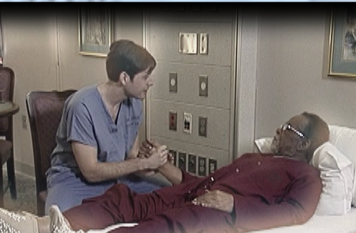
Session #2: Positive Physical Approach
Learning Goals:
Experience negative affect associated with not using the positive physical approach
Describe essential steps in using the positive physical approach
Discuss rationale for each step in the positive physical approach
Demonstrate the positive physical approach according to the standard skills checklist
Minute 5:56
From VA DVD
http://link.brightcove.com/services/player/bcpid4521574267001?bckey=AQ%7E%7E,AAACmABW4_k%7E,u3UC4vmaozkRbnTOHzovpplgn0QYiIND&bctid=4665839300001
Notes:
In this session, we will focus on the attitudes and skills needed to approach a person with dementia in a manner that compensates for common neuropsychological deficits. As before, we will use a combination of an experiential learning approach, and a deliberate practice approach to learning this new skill.
Review key points from observing behavior
View VA video clips on Positive Physical Approach
Have master trainers observe the patient’s responses using handout (see slides 18 & 31)
Practice with feedback

Slide 25
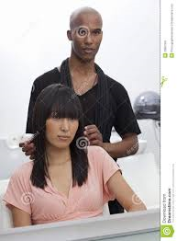
Exercise: Personal Response to Conventional Caregiver Approach
Pair up with a partner
  One person seated, one person standing behind them.
Follow the instructions for each exercise
  Being touched from behind lightly
  Being greeted from behind
  Being approached too quickly
Process the experience using discussion questions
Notes:
In this exercise, the person in the chair is going to have a simulated experience of what it might be like to live in the world of the person with dementia. The person standing behind them is in the role of the caregiver.
Before we are finished, you will trade places so everyone has an opportunity to experience both roles. Let’s get started.
Experience #1: [Being touched from behind, unexpectedly]
The person in the chair should close their eyes.
The person standing should lightly touch the sitting person’s hair and head.
The instructor asks the people who are sitting: “How did that feel?” Typical answers are: (1) like bugs crawling on me, or (2) creepy. Key point: Most people are uncomfortable when people are behind them.
Experience #2: [Being greeted from behind, unexpectedly]
Ask the standing person to put their hands on the shoulder of the sitting person, lean over, smile broadly, and greet or say “Hello”!
Ask people who are sitting: How does that feel? Why do you think it feels that way? How do you think they are equipped to respond?
Explain: When we approach from behind, the person being approached may not be aware of us, and may respond with a startle reflex, or worse, may strike out.
Key point: Always approach the person with dementia from the front – within visual range.
Experience #3: [Being approached too quickly]
Instruct people who are standing to move 5 feet in front of the people who are sitting. Have the standing person run up to the sitting person as fast as they can.
Ask sitting person: What happened, and how did you respond?
Explain: While caregivers do not actually run up to people with dementia, we often move more quickly than they can process information.

Slide 26
Key Steps in the Correct Approach
Key Steps | Rationale -- Compensates for:
Approach
Pauses at the edge of personal space | Slow processing
Approaches within visual range | Visuo-spatial perception
Moves one step per second | Slow processing
Position
Uses supportive stance during interaction: to the side and at eye level | Visuo-spatial perception and Judgment
Engage
Uses preferred name for attention | Orientation-Concentration
Offers physical contact to establish interaction | Slow processing/concentration
Awaits resident response | Language
Acknowledges resident response | Slow processing
Slow processing
Visual spatial perception
Slow processing
Judgment
Visual spatial perception &
Judgment
Judgment
Orientation/Concentration
Slow processing/ concentration
Language
Slow processing
Notes:
Having experienced the difference between the conventional approach, and how it feels to the person with dementia, and our preferred approach, let’s discuss how each of the recommended steps helps a caregiver compensate for neuro-cognitive deficits that commonly occur with dementia.
People with dementia typically have slowed processing, and visuo-spatial processing difficulties.
They also often have difficulty understanding words reliably, and therefore may not understand why a caregiver is engaging in certain tasks.
Also, people with dementia have difficulty suppressing instinctual responses such as the fight or flight responses, and so may react badly if they are startled, or feel threatened.
Each of the steps in the approach we recommend has a very specific purpose – to compensate for these common deficits, and allow the person with dementia to feel comfortable with the caregiver before they begin to engage in self-care tasks.

Slide 27

Approach Skills Checklist
Key Steps of Approach | Y/N | Comments
Approach
Pauses at the edge of personal space
Approaches within visual range
Moves one step per second
Position
Uses supportive stance during interaction: Stands on the person’s side and lowers self to eye level
Engage
Uses preferred name for attention
Offers physical contact to establish interaction
Awaits resident response
Acknowledges resident response
Recommendations for continued practice:
Notes:
Now practice this approach by having one pair at a time demonstrate, and the other pairs rate their performance.
Notice how the instructor gives very specific feedback and advice about how to improve.
Demonstration will show feedback given in response to performance gap, and includes guidance about how to correct any performance gap.

Slide 28
Session 3: Giving Feedback on Performance Using Deliberate Practice
By the end of this session the learner will be able to:
Demonstrate the Positive Physical Approach according to the skills checklist
Give feedback to partner using Deliberate Practice Method
Notes:
You have just learned about the positive physical approach, and some of the common challenges that caregivers experience in mastering the skill.
You have also just observed a master trainer giving someone feedback. Now we would like for you to try observing someone else implementing this skills, so that you can practice observing and giving feedback.

Slide 29
Skills Checklist on Giving Feedback
Step | Y/N | Comments/Suggestions for Improvement
Observes performance using checklist
Identifies steps done correctly, and steps not done correctly
Gives specific advice on how to correct steps not done correctly
Allows time to practice using corrective feedback
Allows for practice with feedback until all steps are performed correctly
Recommendations for Practice
Notes:
In the deliberate practice method, feedback is given in a very specific manner. The table on this slide outlines each step.
First, it is important that you observe using the skills checklist for a given task.
Second, be prepared to decide whether the person met the standard or not, by noting which of the steps in the skill were done correctly, and which were not.
Third, for each step that was done incorrectly, you will need to offer suggestions about how the learner can correct their performance.
Fourth, make certain the learner has the opportunity to practice the skill using your suggestions.
Finally, until all steps of the skill are performed correctly.

Slide 30
Approach Skills Checklist
Key Steps of Approach | Y/N | Comments
Approach
Pauses at the edge of personal space
Approaches within visual range
Moves one step per second
Position
Uses supportive stance during interaction: to the side and at eye level
Engage
Uses preferred name for attention
Offers physical contact to establish interaction
Awaits resident response
Acknowledges resident response
Recommendations for continued practice:
Try out using VA DVD clip – begin at 5:56 seconds.
http://Minute 5:56
link.brightcove.com/services/player/bcpid4521574267001?bckey=AQ%7E%7E,AAACmABW4_k%7E,u3UC4vmaozkRbnTOHzovpplgn0QYiIND&bctid=4665839300001
Notes:
Here is the skills checklist we will be using to observe your performance.
Try it out with this video, and then compare ratings among each of the people.
Then identify performance gaps
Then describe specific feedback you would give.
Examples of performance gaps include:
Forgetting to use preferred name for attention
Taking person’s hand, instead of waiting for person to take his hand.
Examples of recommendations for practice would be:
Jot down the person’s name before you knock on the door
Practice waiting……

Slide 31
Approach Skills Checklist: Example from Video
Key Steps of Approach | Y/N | Comments
Pauses at the edge of personal space | Y
Approaches within visual range | Y
Moves one step per second | Y
Uses supportive stance during interaction: to the side and at eye level | Y
Uses preferred name for attention | N | Not at first – did good job of recovering
Offers physical contact to establish interaction | Y
Awaits resident response | N | Took patient’s hand, rather than waiting for patient to accept touch
Acknowledges resident response | Y
Recommendations for continued practice: |  | Work on waiting for patient to respond Develop system to remember preferred name
Notes:
Here’s how I would have rated this caregiver’s performance.
Notice how specific the feedback is for next time…all related to performance gaps.
One of the key aspects of this is to structure time for the learner to practice and get feedback.

Slide 32
Approach Skills Checklist
Key Steps of Approach | Y/N | Comments
Approach
Pauses at the edge of personal space
Approaches within visual range
Moves one step per second
Position
Uses supportive stance during interaction: to the side and at eye level
Engage
Uses preferred name for attention
Offers physical contact to establish interaction
Awaits resident response
Acknowledges resident response
Recommendations for continued practice:
Notes:
Let’s practice this approach by having one pair at a time demonstrate, and the other pairs rate their performance.
Instructor should then pause and demonstrate how to give feedback.
Perhaps insert video clip of Melanie instructing one of our visiting scholars, and giving feedback.
Demonstration will show feedback given in response to performance gap, and includes guidance about how to correct any performance gap.

Slide 33
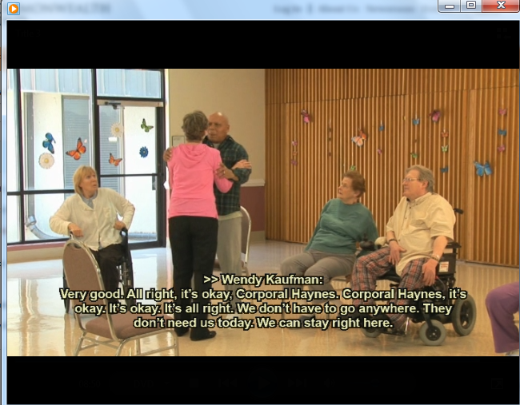
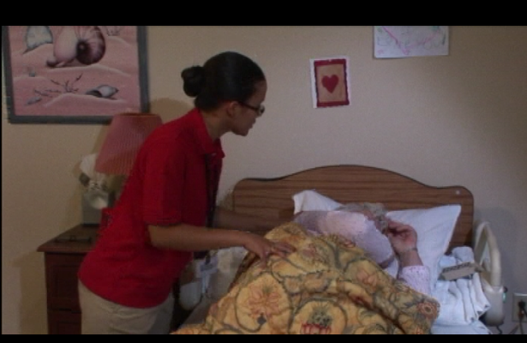
Common errors in performance of Positive Physical Approach
  Failure to give visual cue
  Moving too fast or too slow
  Failing to get to side (confrontational stance)
  Not respecting personal space
  Not making contact
  Not allowing enough time for response
Notes:
There are many ways in which caregivers who are learning new approach skills can perform the skill incorrectly.
These pictures show several of the common errors that you should look for, and be prepared to correct.

Slide 34
What’s new at DVAHCS?
Virtual Reality Empathy Training for Dementia
(Contact Eleanor.mcconnell2@va.gov if interested).
Prevention and Management of Agitated and Aggressive Behaviors
DVAHCS Dementia Committee
Geriatric Surgery Verification Program
Geriatric Friendly Emergency Department

Slide 35
Background
34% of Veterans nationally in acute care are classified as complex care patients.
In addition to acute medical/surgical needs they have either:
(a) mental health and/or substance use disorders, or (b) cognitive impairment (1, 2).
56% of Veterans in VISN6 fall into this category. These Veterans are at high risk for
injuries, poor quality of life, and higher service utilization (2).
Durham VA, in response to a patient safety event experienced by a complex care Veteran with dementia resulting in patient and staff injury, assembled an inter-professional team to address the management and prevention of agitation and aggression in acute care dementia patients.
Sources: (1) Karel & Cortina, 2015. Inpatient Care for Veterans with Complex Cognitive, Mental Health and Medical Needs Task Force
(2) Vinson et al., 2017. Caring for Behaviorally and Medically Complex Inpatients in VHA: Assessment of Program Needs and Models of Care

Slide 36
The Team!
Belanger, Tiffany (nursing ed) Braxton, Loretta (psychology) Briggs, Melvania (psychiatry) Bullard, Martine (rec therapy) Davagnino, Judith (GRECC, social work) Eyster, Julie (occupational therapy-OT) Fox, Valerie (OT) Harris, Julie (hospital medicine) Holsinger, Tracy (psychiatry) John, Baby (PARC) Joseph, Letha (NP-CLC) Knight, Christy (GRECC, SW) Laufer, Richard (CNO-PARC, BERT team)
Libman, Craig (psychology)
McConnell, Ellie (GRECC, VAQS, nursing)
Moore, Thomasena (VAQS, surgery)
Myers, Elizabeth (VAQS, nursing)
Patterson, Anne-Marie (NP-PARC)
Patterson-Powell, Annmarie (RN, medicine)
Orsini, Maria (CNO, Performance Imp).
Previll, Laura (Geriatric Medicine)
Riordan, Paul (Psychiatry)
Rooks, Elliot (Nurse Manager – 6B)
Schneider, Brian (Hospital Medicine)
Tabb, Sue (Nurse manager, 6A)
Tiegreen, Joshua (psychology)
Utin, Enobong (nursing ed- PARC)
Wolfe, Nicole (psychiatry)

Slide 37
Current Process of care
Targets for improvement in yellow boxes
How are activities in orange box connected to the main plan of care?
Could we make processes more consistent?
May or may not include info re: dementia status
Could huddles and dementia-friendly environment prevent agitated and aggressive behaviors?
Does transfer process include behavioral approaches to care?

Slide 38
Reduce Agitation and Aggression Among Veterans with Dementia in Acute Care by 20% by end of FY22
Understand and standardize current care processes for dementia recognition and personalizing care
Create dementia-friendly rooms and stock supplies for diversional activities on unit
Implement daily huddles regarding implementation of care techniques
Staff education in evidence-based dementia care practices
Measure processes of care and outcomes

Slide 39
What makes this really exciting…..
Connection to Geriatric Surgery Verification and
Geri-ED and AFHS
Person-Environment Fit
Engages Therapists
Opportunities for Educational Innovation-linked with Clinical Demo
Alignment with AHRQ Patient Safety and Implementation Principles
Opportunities for Advanced Trainees:
OAA Special Fellowships in Geriatrics, VA Quality Scholars, ECHO???

