Slide 1
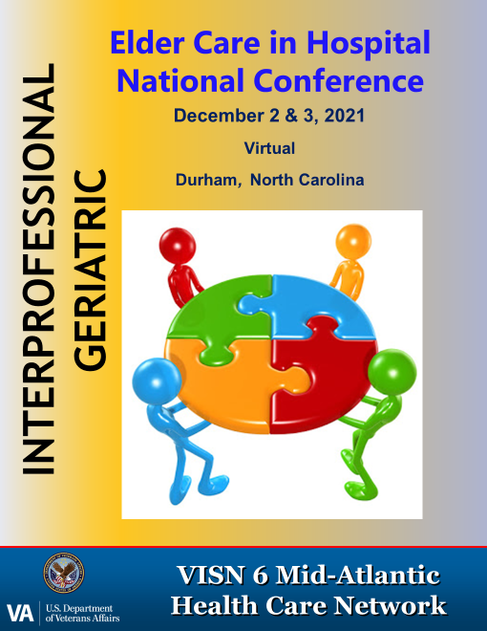
Medication Use in Older Adults
Janine Bailey, PharmD, BCPS
Clinical Pharmacy Specialist
Home Based Primary Care
Jon Hale, PharmD, BCPS
Clinical Pharmacy Specialist
Home Based Primary Care, TLC

Slide 2
Objectives
Identify pharmacokinetic (PK) and pharmacodynamic (PD) changes in older adults and review the impact these changes may have on medication use
Describe common medication-related problems in older adults related to adverse drug reactions
Review the Beers Criteria to identify potentially inappropriate medications (PIMs) in older adults and apply knowledge to a patient case

Slide 3
Which of the Following Statements is False?
A. Constipation is NOT related to select medications, dehydration or inactivity
B. Decreased sensation of taste does NOT impact appetite in older adults
C. Anticholinergic medications may DECREASE the risk of urinary retention

Slide 4
False
C. Anticholinergic medications may DECREASE the risk of urinary retention

Slide 5
Summary of Age-related Changes in Pharmacokinetics and Pharmacodynamics

Slide 6
Definitions
http://www.themednote.com/2011/07/10/pharmacodynamics-vs-pharmacokinetics/#.WWYdQTYUkpE Accessed 11.14.19
Notes:
PD: Relation of the drug concentration and pharmacological response

Slide 7
Absorption
Age related changes
Delayed gastric emptying
Decreased gastric acid secretion
Reduced GI blood flow
Oral absorption
Delay in absorption but generally not extent of absorption
Transdermal absorption
Skin->thinning of dermis, less subcutaneous fat
Lower absorption rate of lipophilic medications (fentanyl, estradiol, testosterone)
Journal of Pharmacy Practice 2007.20;1:4-12

Slide 8
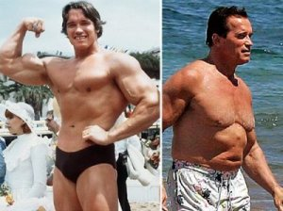
Age Related Changes: Distribution
Decreased Total Body Water
Decreased Lean Body Mass
Increased Fat Stores
https://angelcasiano.com/2013/10/26/the-young-and-the-old/old-look-young-hollywood-actor/Accessed 11.14.19

Slide 9
Distribution
Age-Related Change | Effect on Drug Distribution | Specific Drug Examples
Decreased total body water and lean body mass | Drugs that distribute to body water or muscle cells will have a higher drug concentration at a lower dose | Digoxin, aminoglycosides, lithium
Increased fat stores | Drugs that distribute to body fat will require a longer time to steady state and have an increased half-life | Diazepam (half-life in younger adults ~44 hours vs. 80 hours in older adults)
Decreased plasma albumin (frail elderly) | Higher percentage of drug that is unbound (free) -> free drug is available for action | Phenytoin, warfarin
Journal of Pharmacy Practice 2007.20;1:4-12

Slide 10
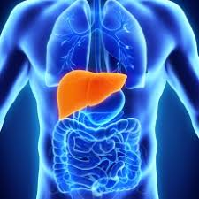
Metabolism
Decreased liver blood flow, size, and mass
Reduced metabolism/prolonged clearance
Higher drug concentrations of medications that undergo significant first pass metabolism
Examples: Morphine, metoprolol, statins
Journal of Pharmacy Practice 2007.20;1:4-12
Notes:
All decrease proportionally so there is no net change

Slide 11
Elimination
Changes | Effect | Examples
↓ blood flow to the kidneys ↓ size of kidney ↓ # functioning nephrons ↓ tubular secretion | Higher drug levels Longer duration of action and half-life of medications Decreased elimination of medication | Antibiotics (Aminoglycosides, quinolones) CNS agents (gabapentin, duloxetine) GI agents (H2 blockers) (famotidine) Direct Oral Anticoagulants (DOACs) (dabigatran, rivaroxaban)
Journal of Pharmacy Practice 2007.20;1:4-12
Notes:
(~10% decrease per decade of life)

Slide 12
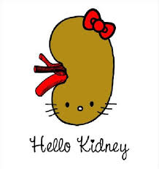
Example: Creatinine Clearance vs. Age in a 65inch, 55 kg Woman
Age
SrCr
CrCl
30
1.1
65
50
1.1
53
70
1.1
41
90
1.1
30

Slide 13
Pharmacodynamics
Age-related changes in drug sensitivity
Results from changes in # of receptors, drug affinity to receptor, and/or post-receptor effects
Variable effects on overall homeostasis

Slide 14
Pharmacodynamics: End Result
Central Nervous System (CNS)
Sensitivity to CNS medications and anticholinergics
Permeability of blood-brain barrier
CNS reaction time
Psychomotor retardation
Cardiovascular system
Sensitivity to medications that prolong QTc interval
Risk of orthostatic hypotension
responsiveness of cardiac beta receptors to beta blockers
Journal of Pharmacy Practice 2007.20;1:4-12

Slide 15
Overall Picture

Slide 16
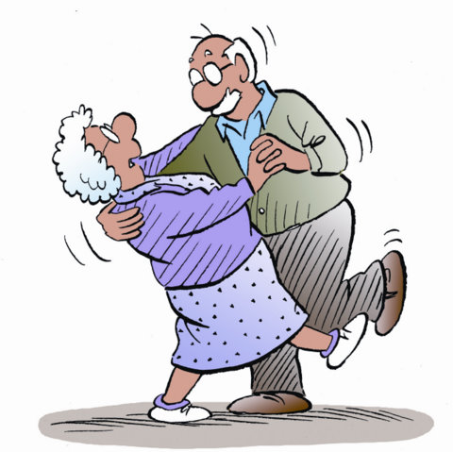
Case: Mr. A
https://quotesgram.com Accessed 10.29.21

Slide 17
Mr. A
HPI: Mr. A is an 83-year-old male who presents to the ED after sustaining a fall with hip pain. He reports a history of falling about once per month due to dizziness, loss of balance, and lower extremity weakness. His wife reports that he has had recent complaints of constipation and seems more confused lately which is a change from baseline. He was recently seen by his mental health provider who started him on hydroxyzine as needed for anxiety and sleep.

Slide 18
Past Medical History
Osteoarthritis
Hypertension
Depression
Chronic kidney disease (CKD)
Stroke
Gastroesophageal reflux disease (GERD)
Macular degeneration
Insomnia
Stroke
Benign Prostatic Hyperplasia (BPH)

Slide 19
ED Visit
Chem7 WNL with SrCr 2 (baseline) and creatinine clearance of ~29 mL/min
CBC WNL
He reports adherence to his medication regimen
He has multiple risk factors that may contribute to falls including poor vision, lower extremity weakness, hypotension (BP was 92/52 mm Hg in ED) and medications
Xray was negative for a fracture. He was sent home on short course of acetaminophen for pain

Slide 20
Medications
Medication | Reason for Use
Lisinopril 20mg daily | Hypertension
Aspirin 81mg daily | Stroke
Atorvastatin 40mg at bedtime | Stroke
Paroxetine 20mg daily | Depression
Zolpidem 5mg at bedtime | Insomnia
Terazosin 10mg at bedtime | Prostate
Ibuprofen 400mg BID | OA Pain
Hydroxyzine 25mg BID PRN *new medication* | Anxiety/sleep
Cholecalciferol 1000units daily | Bone health
Pantoprazole 40mg daily | GERD
Gabapentin 300mg q8h | Nerve pain

Slide 21
Question 1
Considering the potential for altered PK which medication(s) are the most likely potential problems for Mr. A?
Gabapentin
Terazosin
Aspirin
A and B

Slide 22
Question 2
Considering the potential for increased PD sensitivity, which medication(s) are most likely potential problems for Mr. A?
Paroxetine
Gabapentin
Zolpidem
Hydroxyzine
All of the above

Slide 23
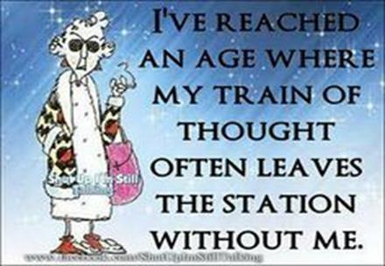
Adverse Drug Reactions (ADRs)

Slide 24
Pop Quiz
New symptoms or complaints in an older adult may be related to a medication side effect.
True
False

Slide 25
Definitions
Adverse drug event (ADEs):
Any physical or mental harm resulting from medication use be it misuse, under-dosing or overdosing
Adverse drug reactions (ADRs):
An appreciably harmful or unpleasant reaction resulting from an intervention related to the intentional use of a medicinal product, which predicts hazard from future administration and warrants prevention or specific treatment, or alteration of the dosage regimen or withdrawal of the product
Lancet. 2000 Oct 7; 356(9237):1255-9; Ann Intern Med. 2004 May 18; 140(10):795-801.

Slide 26
Scope of the Problem
ADRs cause 6-12% of hospital admissions in older adults
Most ADRs causing admissions are predictable from the known pharmacology of the drug
More than half of hospitalizations from ADRs are preventable
Clinical Interventions in Aging 2016:11. 497-505

Slide 27
Presentation of ADRs in Older Adults
ADRs should be in the differential diagnosis of any geriatric symptom or syndrome (e.g. delirium, falls, incontinence)
ADRs may present non-specifically
Signs and symptoms may be attributed to a pre-existing disease, a new disease, or “normal” aging

Slide 28
ADRs in Older Adults
Mallet L, Spinewine A, Huang A
SO
Lancet. 2007;370(9582):185
Number of medications
Strongest marker of ADR risk in older adults
Other risk factors
Multiple diseases, frailty, previous history of ADRs, age, female sex, alcohol use, poor adherence, fragmented medical care, PK/PD changes, cognitive impairment
Onder, et al. JAGS 50:1962–1968, 2002.; Mallet etl al. Lancet. 2007;370(9582):185.
Notes:
Exponential relationship between number of drugs and likelihood of ADR
Independent of therapeutic class and underlying conditions

Slide 29
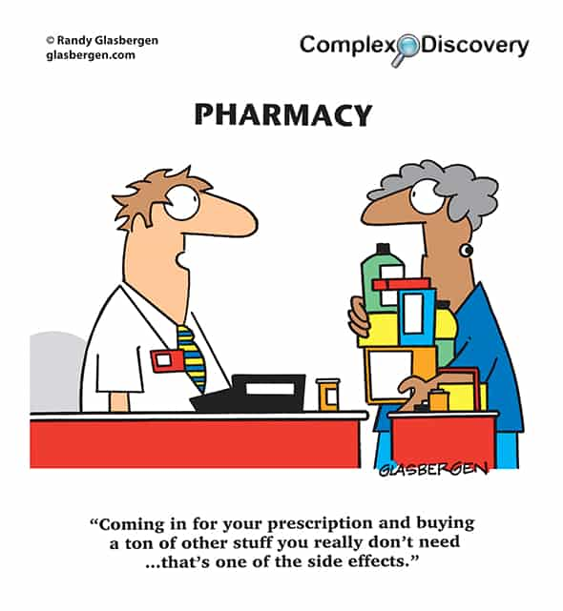
Polypharmacy
Concurrent use of multiple drugs
Specific number not established
Use of more drugs than clinically indicated
Excessive/unnecessary med use
Medications without indications
Ineffective drugs
Therapeutic duplication
Hanlon JT et al. J Am Geriatr Soc 2001; 49: 200-209
Hanlon JT et al. Therapeutics in the Elderly, 3rd Edition

Slide 30
Polypharmacy May Lead to ADRs
ADR | Drug Class
Bleeding | NSAIDs, anticoagulants, antiplatelets
Hypoglycemia | Insulin, oral hypoglycemics
Delirium | Opioids, anticholinergics, CNS, H2 blockers
Acute Kidney Injury/ Electrolyte abnormalities | Diuretics, ACE inhibitors, NSAIDs
Hypotension/syncope | CNS, cardiovascular
Falls/injury | CNS, cardiovascular
C. difficile colitis | Antibiotics, PPIs
CNS: benzodiazepines, antipsychotics, antidepressants, anticonvulsants
Schmader KE et al., Am J Med 2004;116:394-401; Juurlink DN et al. JAMA 2003;289:1652-8;
Gurwitz JH et al. Am J Med 2000;109:87-94; JAGS 67:674–694, 2019

Slide 31
Hypertension
HCTZ
Urinary Frequency
Oxybutynin
Prescribing Cascade
Urinary Retention
Terazosin
Orthostatic Hypotension
Falls
Hip Fracture

Slide 32
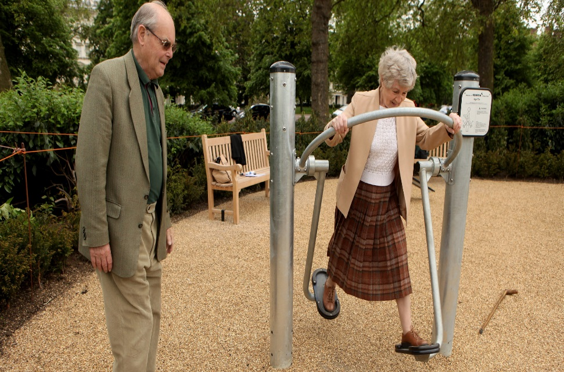
Fun Fact
When it comes to health there is no
“typical” older person
http://www.who.int/features/factfiles/ageing/en/. Accessed 11.14.19

Slide 33
Potentially Inappropriate Medications (PIMs) Screening Tools

Slide 34
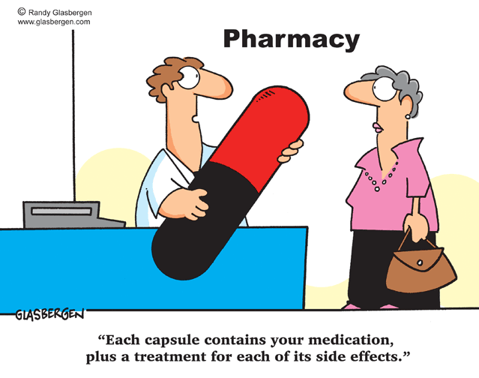
Goal of Screening Tools
Optimize prescribing appropriateness and reduce negative outcomes including preventable ADRs

Slide 35
PIMs Screening Tools
Screening Tool of Older Persons’ Potentially Inappropriate Prescriptions (STOPP)
Screening Tool to Alert doctors to the Right Treatment (START)
Beers Criteria (Update 2019)
O’Mahony D, O’Sullivan D, Byrne S, et al. STOPP/START criteria for potentially inappropriate prescribing in older people: Version 2. Age Ageing 2014; 44: 213–218; 2019 American Geriatrics Society Beers Criteria Update Expert Panel (2019). American Geriatrics Society 2019 Updated AGS Beers Criteria for Potentially Inappropriate Medication Use in Older Adults. Journal of the American Geriatrics Society, 67(4), 674-694.
Notes:
80 STOPP Critiera, 34 start criteria organized into physiological systems (developed in Ireland, initially in 2008, then in 2014)
Beers: 5 catergories; 1991 (updated 5 times since then), AGS update and maintain Beers since 2011

Slide 36
Pop Quiz
The Beers Criteria applies to which of the following celebrities?
Jerry Seinfeld
Jackie Chan
Reba McEntire
All of the above

Slide 37
Purpose of the Beers Criteria
Identify PIMS that should be avoided in many older adults
(> 65 years)
Reduce ADEs and drug related problems
Improve medication selection and medication use in older adults
Designed for use in any clinical setting with the exception of hospice and palliative care settings
2019 American Geriatrics Society Beers Criteria Update Expert Panel (2019). American Geriatrics Society 2019 Updated AGS Beers Criteria for Potentially Inappropriate Medication Use in Older Adults. Journal of the American Geriatrics Society, 67(4), 674-694.

Slide 38
Beers Criteria Guide
Medication Tables:
PIMs that should generally be avoided in older adults
Drug-disease / Drug-syndrome interactions
Drugs to be used with caution
Drug-drug interactions
Drugs with renal dose adjustment
Alternative medications (published separately)
2019 American Geriatrics Society Beers Criteria Update Expert Panel (2019). American Geriatrics Society 2019 Updated AGS Beers Criteria for Potentially Inappropriate Medication Use in Older Adults. Journal of the American Geriatrics Society, 67(4), 674-694.

Slide 40
Question 3
After performing an intense medication review, which of Mr. A’s medications may be considered potentially inappropriate?

Slide 41
Medications
Medication | Reason for Use
Lisinopril 20mg daily | Hypertension
Aspirin 81mg daily | Stroke
Atorvastatin 40mg at bedtime | Stroke
Paroxetine 20mg daily | Depression
Zolpidem 5mg at bedtime | Insomnia
Terazosin 10mg at bedtime | Prostate
Ibuprofen 400mg BID | OA Pain
Hydroxyzine 25mg BID PRN *new medication* | Anxiety/sleep
Cholecalciferol 1000units daily | Bone health
Pantoprazole 40mg daily | GERD
Gabapentin 300mg q8h | Nerve pain

Slide 42
Mr. A’s PIMs: Beers Criteria
Independent of Disease – Table 2
Drug | Reason | Alternative
Anticholinergics: Hydroxyzine | Anticholinergic | Discontinue
Peripheral alpha 1 blocker: Terazosin | Orthostasis | Selective alpha 2 blocker (tamsulosin, afluzosin)
Antidepressant: Paroxetine | Highly anticholinergic, sedating, orthostatic hypotension | Switch to alternate SSRI, taper off?
Z drugs: Zolpidem | Cognitive impairment, falls, delirium, fractures | Taper off
PPI: Pantoprazole | Cdiff, fractures, bone loss: avoid use > 8 weeks unless high risk | Taper off? Tums PRN?
Non-COX–Selective NSAIDS: Ibuprofen | GI AEs in high risk groups: age > 75 or taking anticoagulants, antiplatelets or corticosteroids | Schedule APAP, topical diclofenac gel

Slide 43
Mr. A’s PIMs: Beers Criteria
Drug/Disease State Interactions – Table 3
Disease State/Syndrome | Drug
? Delirium | Anticholinergics: Paroxetine, Hydroxyzine Z-drugs: Zolpidem
History of falls | Antiepileptics: Gabapentin Z-drugs: Zolpidem Antidepressants: Paroxetine
CKD | Non-COX–Selective NSAIDS: Ibuprofen (CrCl < 30ml/min)
BPH | Anticholinergics: Hydroxyzine, Paroxetine

Slide 44
Mr. A’s PIMs: Beers Criteria
Drugs to be Used with Caution – Table 4
Drug | Reason
SSRIs: Paroxetine | May exacerbate or cause SIADH

Slide 45
Mr. A’s PIMs: Beers Criteria
Drug/Drug Interactions – Table 5
SSRIs: Paroxetine Z drug: Zolpidem Anticonvulsant: Gabapentin | Avoid > 3 CNS medications: increased risk of falls and fractures
Anticholinergics: Paroxetine and Hydroxyzine | Avoid, minimize number of anticholinergic medications: increased risk of cognitive impairment

Slide 46
Mr. A’s PIMs: Beers Criteria
Reduced renal function – Table 6
Gabapentin | Reduce dose with CrCl < 60ml/min; 600mg q12h -> 600 mg once daily

Slide 47
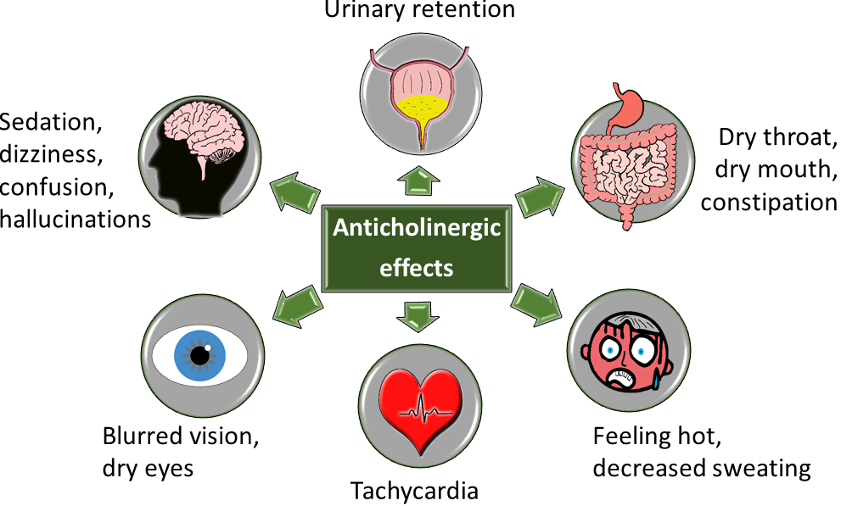
Anticholinergic Medications
So what’s so bad about anticholinergic medications…
https://www.medicinesafety.co.uk/2019/02/anticholinergics-safety-concerns.html. Assessed 11/1/2019
Notes:
CNS side effects: Cognitive impairment, delirium, falls/dizziness, agitation
PNS side effects: Dry mouth/eyes, constipation, urinary retention

Slide 48
Anticholinergic Medications

Slide 49
Question 4
Which of Mr. A’s medications can be contributing recent complaints of constipation and confusion?
Terazosin
Hydroxyzine
Aspirin
Paroxetine
B and D

Slide 50
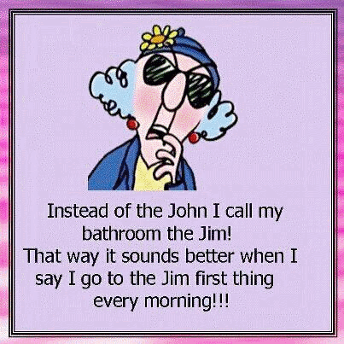
Helpful Hints

Slide 51
Is There Truly a Reason to Use a Drug?
Many medical problems in older adults do not require a pharmacological solution
Nonpharmacological approaches are useful for urinary incontinence, constipation, hypertension, pain syndromes, sleep disorders, depression, etc.

Slide 52
Principles of Geriatric Pharmacotherapy
Start low and go slow
Consider whether medication therapy is necessary
Choose medications to optimize benefit/risk ratio
Use age-appropriate doses and dosing intervals
Establish reasonable therapeutic goals
Monitor for beneficial effects and ADRs/ADEs
Regularly review the need for chronic medications

Slide 53
Conclusion
PK/PD changes may lead to increased drug concentrations and increased drug sensitivity in older adults
The possibility of an ADRs/ADEs should be evaluated when caring for an older adult
Screening for PIMs may lead to a reduction in ADRs/ADEs and improved outcomes in older adults

Slide 54
Questions
Email: Janine.Bailey@va.gov
Jonathan.Hale@va.gov
https://superiorhealthcaregreenville.com/chiropractic/greenville-chiropractor/happy-holidays/Accessed 11.14.19

