Slide 1

Palliative Care: Goals of Care, Advanced Care Planning & Symptom Management
Dr. Toni Cutson MD Director of Hospice & Palliative Medicine DVAHCS
Michaelene Moore, MSN, ANP-C, CNS-BC, ACHPN
Jamie Grant, MSW, LCSW (Palliative Care/Hospice Coordinator)

Slide 2
Objectives
Describe:
Palliative Care vs. Hospice Care
Resources provided through the Durham VAHCS
Goals of Care Conversations
Nursing Care for the dying patient

Slide 3
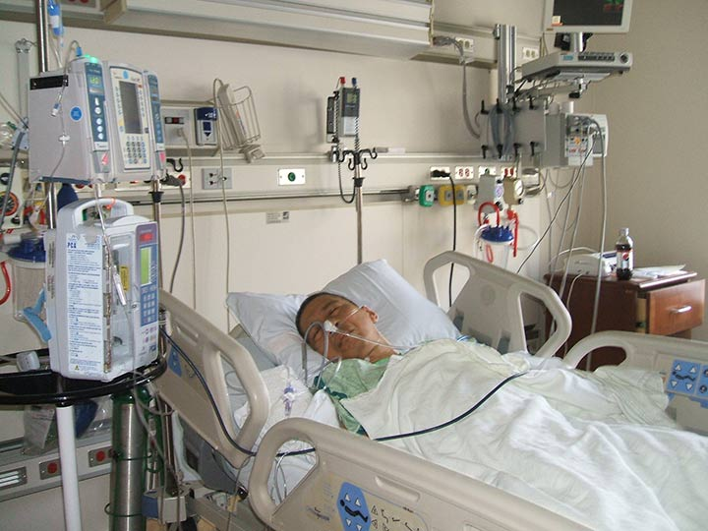
Current Trends in Acute Care
1.7 million deaths of chronic illness
70% admitted to the hospital
during the last 6 months of life
60% of all deaths occur in hospital; 18% in ICU
50% of terminally ill die with undertreated pain
CDC National Center for Health Statisitcs cdc.gov/nchs/fastasts/deaths.htm
Notes:
Many hospitals do not have guidelines specific for the care of the dying patient
Even if a pathway or consult service is available for dying patients-> its often initiated to late or not at all due to the unwillingness of ordering physician to make the diagnosis of dying
US Bureau of Health Statistics (2013) http: www.health statistics.org ( Retrived 12/31/14) ; Freeman,B. CARES: An acronym organized tool for the care of the dying. J Hosp Palliat Nurs. 2013; 15 (3) 147-153

Slide 4

Facts: Veterans Deaths
More than 50,000 Veterans die each month (600,000/year).
Veteran deaths account for almost 28% of all deaths in the U.S.
Only 4% die in a VA facility
http:National Hospice & Palliative Care.Org. (2010), retrieved 1/21/14.

Slide 5
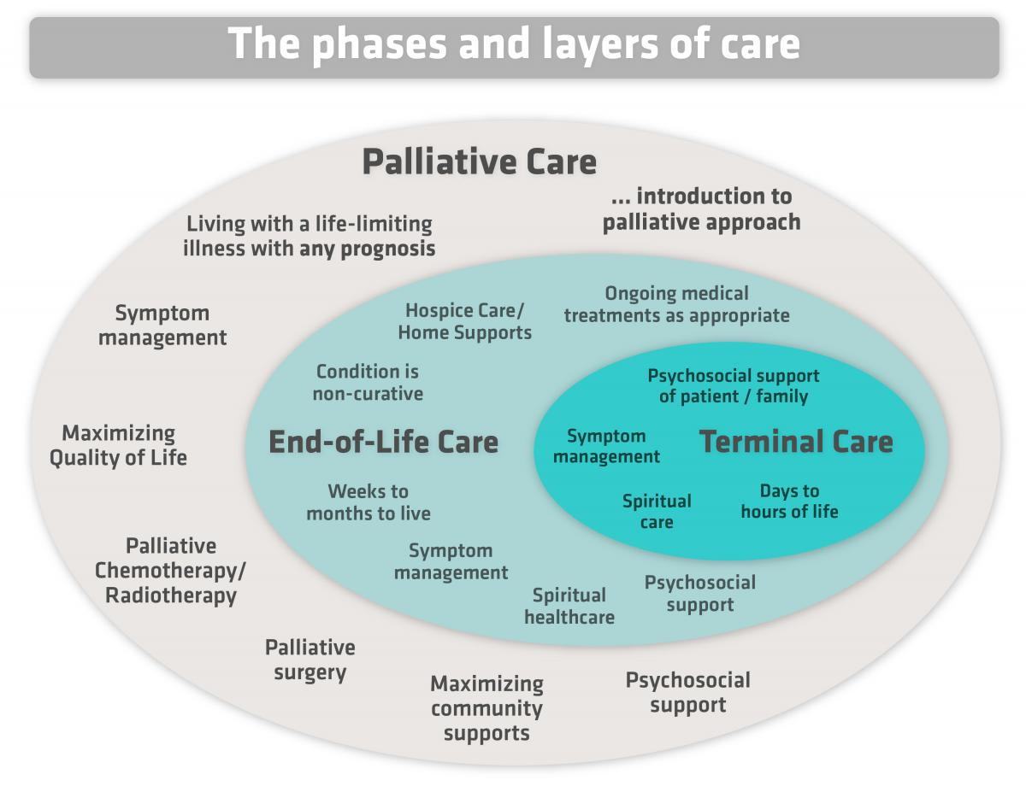

Slide 6

Palliative Care Services:
Benefits for Patients and Hospitals
Increases patient/family satisfaction
Increases support for staff
Decreases Length of Stay (LOS)
Cost Savings
Decreases readmission rates
The National Consensus Project for Quality Palliative Care Clinical Practice Guidelines for Quality Palliative Care 3rd edition 2013
Notes:
Baer, Hanson Families’ perceptionso fhte added value of hospice in the nursing home JAGS 2000;48:879-82
Miller SC, Gozalo P, Mor V Outcomes and Utilization for hospice and non-hospice nurinsg facility decendents. Available at: http://www.aspe.hhs.gov/daltcp/reports/oututil.htm.
Cost savings assoc iwth expanded hospice use J Pall Med 2015;18(5): 400-401
Kyeremanteng et al J Intensive Care Med 2018 Jun ;33(6):346-53.

Slide 7

Differences in Hospice & Palliative Care
 | Palliative Care: Newer specialty | Hospice Care: Well Established
Goal: | Prevent/ relieve suffering & improve QOL for chronic illnesses/ life threatening illnesses | Provide comfort & manage symptoms during the End of Life Death is inevitable outcome
Patient Population: | Follows those with complicated or advanced medical disease No life expectancy requirement Can be receiving concurrent therapies | Accepts those near the “end of life” Medical prognosis of 6 months or less if the disease runs its normal course
http://www.nextstepincare.org: Retrieved 1/16/16
Notes:
There are differences between Palliative Care and Hospice Care … and yet, there is a relationship between the two. 1950s that Cicely Saunders, who later founded St Christopher's Hospice in London, developed many of the foundational principles of modern hospice care. In 1971, Hospice, Inc. was founded in the United States, first bringing the principles of modern hospice care to that country.[3]

Slide 8

Differences in Hospice & Palliative Care
 | Palliative Care: | Hospice Care:
Who Provides the Care: | Doctors & Nurses with specialized training Multidisciplinary | Doctors & Nurses with specialized training Multidisciplinary
Payer for Services: | No special insurance benefit-health insurance usually covers services | Medicare Some state Medicaid plans & private health insurance plans
All Hospice patients receive palliative care.
Not all Palliative Care patients are eligible for Hospice.
Palliative Care provides education about Hospice so that patients & families have a better understanding of Hospice services when they are eligible.
http://www.nextstepincare.org: Retrieved 1/16/16

Slide 9

Hospice & Palliative Care at the DVAHCS
10 Bed Inpatient hospice unit (Total: +140 admissions FY19)
Consultation service: Inpatient and Outpatient
Inpatient consults in hospital, ICU’s, CLC, ED
Outpatient clinic three ½ day/week
Telehealth Clinic at Greenville HCC
Referrals: oncology, pulmonary, renal, liver, radiation oncology services and primary care
VA funds one position of Duke affiliated Palliative Medicine fellowship

Slide 10

Resources for Families & Patients
Hard Choices For Loving People
(Author: Chaplain Hank Dunn)
-provides guidance with medical care
treatment decisions in laymen's terms
Gone From Sight: The Dying Experience
(Author: Barbara Karnes RN)
The hospice unit can answer questions, please use us as a resource x 172840 for the nurses’ station,
x 177836 for Michaelene Moore, NP M-F 7-4
Durham Palliative Care Medicine Service/Hospice purchase and provide theses books to families and staff. If you are caring for a dying patient & feel the family may benefit call Michaelene Moore extension: 177836.

Slide 11

Goals of Care Conversations
Provider(s), Patient and Family Verbal Discussions
Goals of Care Discussions Focus On:
    -Cure and aggressive treatment
    -Stabilization of functioning
    -Preparing for a comfortable and dignified death
  Goals may change as the patient’s condition changes
  Readdressing goals may be an ongoing and fluid process

Slide 12

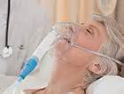
Goals of Care Conversations
Benefits of Discussing:
Associated with better QOL
Reduces anxiety & increases care satisfaction
Reduced use of Life Sustaining Treatment near death
Earlier Hospice referrals
Care is consistent with Patient Preferences
Cost savings for hospital and patient
Improved bereavement outcomes for family members after death
Bernacki,R.E, & Block, S. (2014).Communication about serious illness care goals. JAMA Int. Med. 174(12); Izumi,S. & Van Son, C.(2016). “I didn’t know he was dying.” Missed opportunities for making EOL care decisions for older family members Journal Hospice Pall Med, 18(1).

Slide 13
Goals of Care Conversations: When & Who
Triggers
Life-limiting illness
Multiple Comorbidities
Patients 80 or older-big trigger
Change or deterioration in status
Multiple hospital admissions
You say “No” to the following question: Would I be surprised if this patient died in a year?
CAN score
Mullick, A , Martin ,J & Sallnow, L. (2013) Advance Care Planning. BMJ, 347; Boyd, K et.al. (2010) Advance care planning for cancer patients in primary care. BJGP, 303(3). Bernacki , RE,& Block ,S . (2014). Communication about serious illness care goals. JAMA Int. Med, 174(12)..
Notes:
Should be done when patients are willing to participate, make sure the patient has appropriate understanding and mental capacity to make decisions.

Slide 14

Who is Responsible to Initiate Conversation?
AA
As Providers “We All Are”
Medicine Internists/Surgeons
Specialists (Oncology, Nephrology, Cardiologists)
Primary Care Physicians
Nurse Practitioners & Physician Assistant’s
Nurses, Social Workers, Chaplains
Consult Palliative Care: If patient situation is complex, with family dysfunction, or other compounding factors exist
Bernacki, R.E. & Block, S.A.(2014). Communication about serious illness care goals. JAMA Internal Medicine, 174(12)

Slide 15
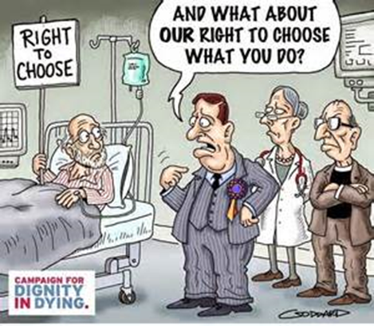
Barriers to Goals of Care Conversations
Patient Factors | Anxiety Desire to protect family members Denial
Clinician Factors | Lack of communication skills & confidence Source of discomfort Lack of time for quality discussions Difficulty with prognostication
System Factors | Lack of Education on LSTDI Non compliance with LST policy
Mullick, A., Martin, J. & Sallnow, L. (2013). Advance care planning. British Medical Journal, 347, 28-32;Boyd, K., et.al. (2010). Advance care planning for cancer patients in primary care: a feasibility study. British Journal of General Practice, 303(3), 1-22.

Slide 16
“Dying in America”
Institute of Medicine Communication and Advanced Care Planning
Recommendations
Professional Societies & Organizations: develop measurable, actionable, evidenced-based standards for clinician- patient communication & advanced care planning
Payers & health care delivery systems:
Adopt standards & integrate them into assessments, care plans and the health care quality reports
Payers: Standards to reimbursement incentives
Professional Organizations:
Adopt standards into credentialing, reimbursement & licensing
Institute of Medicine of the National Academies. (2014) Dying in America Improving quality & honoring individual preferences near end of life. Retrieved from: http/www. iom.nationalacademies.org/Reports/2014/Dying-In-America-Improving on 11/8/16.

Slide 17

Advanced Directives
Legal instruments intended to secure a patients wishes regarding health care
Sections of Advanced Directive:
Instruction Directive:
-known as living wills. Instructions on what the person would or would not want
(Trigger phrase: “If I am in a coma.. or “ If I am terminally ill…)
Appointment Directive:
-known as health care proxy or durable power of attorney
-capacitated person can legally appoint another decision maker if capacity is lost
Boltz, M.,et.al, (2016). Evidenced –based geriatric nursing protocols for best practice,5th Ed. Springer Pub.: New York NY.

Slide 18

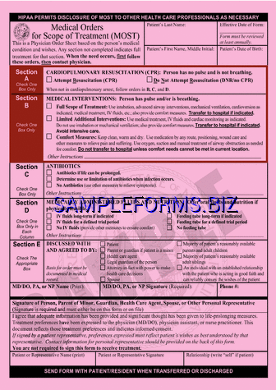
North Carolina: Legal Forms State DNR & MOST (Medical Orders for Scope of Treatment

Slide 19
VA Life-Sustaining Treatment
Decisions Initiative
  National quality improvement initiative to promote personalized, proactive, patient-driven care for Veterans with serious illness
Desired outcomes:
The values, goals, and life-sustaining treatment decisions of Veterans with serious illness are proactively elicited, documented, and honored
https://myees.lrn.va.gov/Watch/Video%20Center.aspx?vid=5249271653001

Slide 20
Why LSTDI?
Conversations about goals and LST decisions often initiated too late – after the patient has lost decision-making capacity or during a medical crisis
Difficult to locate CPRS documentation of the patient’s goals of care and LST decisions
VA orders pertaining to LST were limited to CPR – no orders available regarding other LSTs (mechanical ventilation, feeding tubes, others)

Slide 21
LST Orders
To address all LST decisions - not just CPR
At the top of the list on the CPRS Orders tab in ‘Default’ view
Can be written for patients in any care setting
Durable – DO NOT AUTO-DISCONTINUE when patient changes location of care
Can be written by physicians, residents, APRNs and PAs, without need for follow-up attending orders*
*Supervision documented through co-signature or addendum to LST progress note

Slide 22

Practice Makes Perfect(sort of)
Empathetic responses
What Do I Say?
Silence IS OKAY

Slide 23

Typical Stages of Dying
EARLY STAGE | MID STAGE | LATE STAGE
bed bound loss of interest and ability to drink/eat cognitive changes: either hypoactive or hyperactive delirium or increasing sleepiness | further decline in mental status—obtunded "death rattle" -- pooled oral secretions that are not cleared due to loss of swallowing reflex fever is common | coma cool extremities altered respiratory pattern--either fast or slow, fever is common; death.
*Not always sequential, not everyone will have all of these symptoms
*May have a “rally” period
Weissman,D. (2014) Fast Fact #3: Syndrome of Imminent Death. Retrieved from: http://www.mypcnow.org on 1/6/2017
Image from http://www.carefacts.com/images/Hospice.jpg

Slide 24

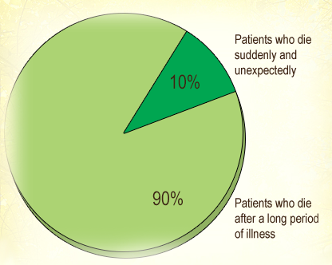
Predicting Time of Death
All deaths are individual and unique to the person dying
We can not predict exactly
Time ranges can be very helpful for families
Nurses can and should let families know when in “hours to days” phase
MOST hospice deaths have a period of decline with some variety of predictable signs and symptoms
EPEC, Last Hours of Living ," The Education in Palliative and End-of-life Care (EPEC) Curriculum: © The EPEC Program, 1999-2011
Image from http://www.meylercapital.com/wp-content/uploads/2015/03/410958.jpg
Notes:
EPEC module, ELNEC

Slide 25
Symptoms & Signs in Last 48 Hours
MOST COMMON SYMPTOMS AND PREVALENCE
Noisy, moist breathing (terminal secretions) | 56%
Urinary incontinence | 32%
Urinary retention | 21%
Pain | 42%
Restlessness, agitation | 42%
Dyspnea | 42%
Nausea, vomiting | 14%
Sweating | 14%
Jerking, twitching (myoclonus) | 12%
Confusion | 8%
* Terminal Respiratoryis a strong indicator of impending death->76% will die in 48 hours
Hallenbeck, J., Katz, S. & Stratos, G.(2003). Stanford Faculty Development Center. Retrieved from: http://www.growthhouse.org/stanford on 1/6/2015.
Notes:
TRS is a strong indicator of impending death->76% will die in 48 hours

Slide 26
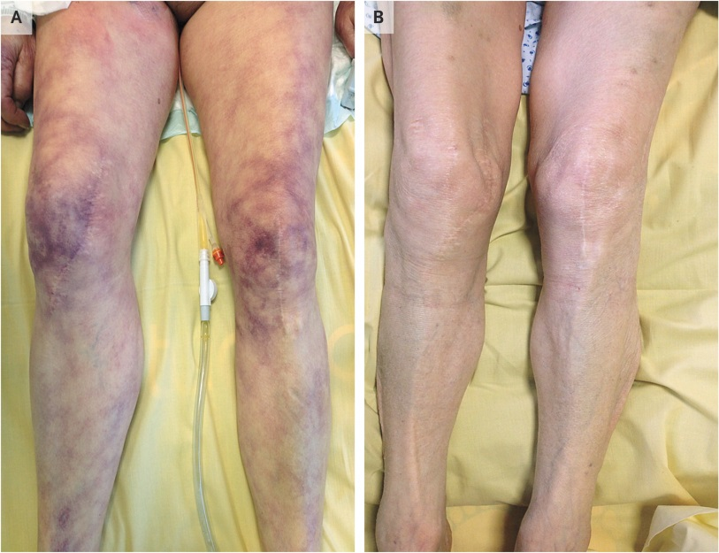
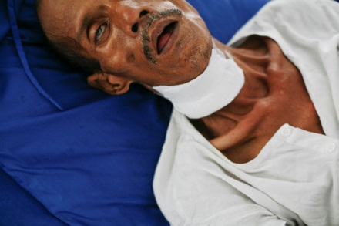
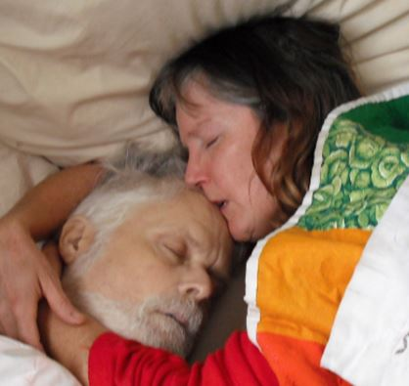
Signs of ACTIVE Dying Process
No intake of water or food
Non-responsive
Skin color changes pallor, ashen, mottling
Respiratory mandibular movement
Sunken cheeks, relaxation of facial muscles
Terminal Secretions: “Death Rattle”
Cheyne Stokes respirations: periods of apnea Lack of pulse
mottling
obtunded
pallor
Hallenbeck, J., Katz, S. & Stratos, G.(2003). Stanford Faculty Development Center. Retrieved from: http://www.growthhouse.org/stanford on 1/6/2015
Images from :http://blogs.reuters.com/photographers-blog/files/2013/02/mdf1491867.jpg; http://www.orderofthegooddeath.com/jeremys-death

Slide 27
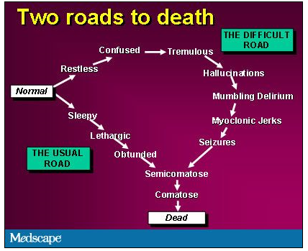
The Dying Process Difficult vs Typical Path
Be aware that “terminal delirium” is possible
Assess for reversible causes, but know that it is likely irreversible
Will require extra management: time, medications, education and support

Slide 28

C.A.R.E.S. acronym (Freeman, City of Hope)
Comfort
Airway
Restlessness and delirium
Emotional and spiritual support
Self-care
Image from: http://www.my-personaltrainer.it/salute/img/palliativo-cure-palliative.jpg
Freeman,B. CARES: An acronym organized tool for the care of the dying. J Hosp Palliat Nurs. 2013; 15 (3) 147-153
Notes:
Image from: http://www.my-personaltrainer.it/salute/img/palliativo-cure-palliative.jpg

Slide 29
Pearls for Pain at the End of Life
Precepts
Prevalence
Pain progressively worsens during EOL for both cancer & non-cancer diagnoses.
Pain is the most feared symptom at EOL
Existential distress impacts on degree of suffering from pain. Pay attention to psychological, social and spiritual distress.
Maximize use of adjuvant agents, non-opioid analgesics & non-pharmacologic therapies (heat , cold, positioning)for best results.
Pain is always unpleasant and therefore an emotional experience.
Address “Existential Distress” impacts pain experience (psychological, social & spiritual suffering)
Fear that opioids will hasten death is an inappropriate barrier to their use
In general 50% experience pain at EOL
Non-cancer diagnosis: more than 40% experience severe pain within days of death
Advanced stage cancer: 64% of patients with ratings moderate to severe
43% of patients with cancer receive inappropriate care for pain
Take Away Point
It is a Professional & Ethical responsibility to provide adequate pain relief for patients during EOL trajectory
Chi,N. & Demeris, G.(2017) Family caregivers’ pain management in EOL care: A systematic review. Journal of Hospice & Palliative Medicine, 34 (5): 470-485. Stitzlien Davies,P. (2016) Pharmacologic pain management at the end of life. The Nurse Practitioner, 41 (5):26-37. Weinstein, S., Portenoy, R., & S.E. Harrington. (2012).UNIPAC 3: Assessing and Treating Pain. C.Porter Storey (Ed.). Boulder, Co: AAHPM., Paice,J.(2015) Pain at the end of life. In B. Ferrell, N. Coyle & J. Paice (Eds.), Oxford textbook of palliative nursing (135-153). New York: Oxford University Press.
Notes:
Despite all the progress in pain control, many patients continue to endure pain especially during last months of life. Per ANA’s Position Statement: Pain Management at EOL NURSES should be competent in managing pain and other distressing symptoms in patients with life limiting illnesses

Slide 30
Family Education and Support
CALM & CLEAR COMMUNICATION
Address concerns related to FEEDING and HYDRATION
Educate about EOL breathing patterns-very distressful to family but NOT causing suffering to veteran
Use INTERDISCIPLINARY TEAM: chaplain service, psychology, social work
Family may need or want to give veteran permission to let go
TOUCH and HEARING-last senses to go, make use of them
Your presence and humanity are important!
Normalize the experience: Grief is expected!
Notes:
Feeding and hydration: normal part of dying process to lose interest in them, forcing or alternate routes can cause uncomfortable side effects)

Slide 31
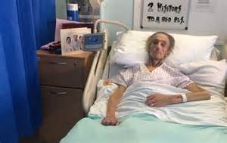
Case Study
Palliative Care: Symptom Management/Advanced Care Planning
Meet Mr. B

