Slide 1
Geriatric Trauma
Luna Ragsdale, MD, MPH
Chief, Emergency Department
Durham VA Health Care System
December 2, 2021

Slide 2
Goals
Describe age-related anatomic and physiologic changes as a basis for assessment of the older adult trauma patient.
Describe mechanisms of injury associated with the older adult trauma patient.

Slide 3
Geriatric Trauma
Fifth leading cause of death
12% of all traumas
28% of all trauma deaths
Aschkenasy MT, Rothenhaus TC. Trauma and falls in the elderly. Emerg Med Clin North Am. 2006 May;24(2):413-32.

Slide 4
Aging differences
Different injury patterns
Results in a loss of functional reserve in most organ systems
Notes:
Geriatric patients have different injury patterns
Physiologic changes that occur with age affect patients in a number of ways, but generally results in a loss of functional reserve in most organ systems.

Slide 5
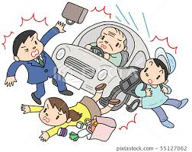
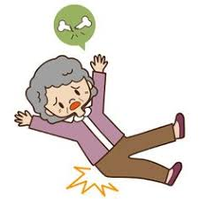
Causes of trauma
Majority of injuries due to falls (60.7%)
Motor vehicle accidents (21.5%)
Notes:
Study of prehospital data of trauma patients over 70 who present to the ED

Slide 6
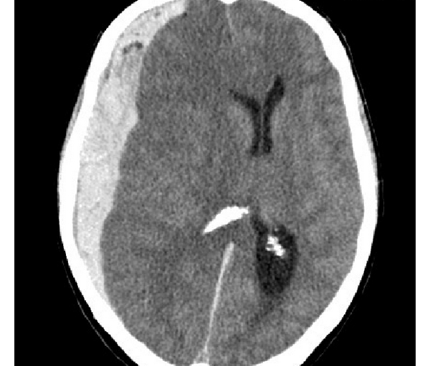
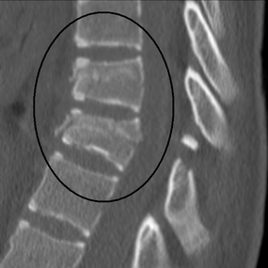
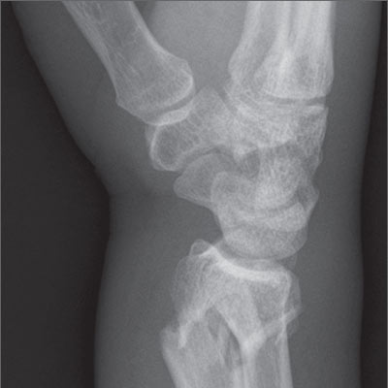
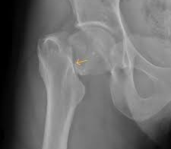
Sites of Injury
Head and face
Extremities

Slide 7
Aging →Decreased physical reserves
Cardiac functional reserve is diminished
Decrease heart rate response to catecholamines
Changes in other organ systems (pulmonary, renal system, skin)
Notes:
Cardiac functional reserve is diminished with age. Older patients have a lower cardiac output, decreased cardiac reserve, and are less likely to be able to tolerate hemodynamic stress as well as younger patients
Decrease heart rate response to catecholamines
From aging conduction system
From medications (beta blockers or CCB)
Compensatory tachycardia not often seen
Changes in other organ systems (pulmonary, renal system, skin)
Less pulmonary compliance, less

Slide 8
Brain changes
Decrease in brain weight and thus size
Stretching of the bridging vessels over the surface of the brain results in increased susceptibility to tearing under shear forces
Age-related decline in cerebrovascular autoregulation

Slide 9
Skin Changes
Thinner, less vascular and less able to thermoregulate
More prone to
Hypothermia
Skin and soft tissue infection
Rapid development of pressure ulcers
Notes:
Get older patient off the back board as soon as possible!!!
Get out of wet clothes!!

Slide 10
Other Factors
Medications
Comorbidities
Notes:
What about these?

Slide 11
Assessment
Are normal vital signs normal?
Systolic of 120 could be hypotension
HR 90-100 could be tachycardia if betablocked
Significant blood loss can be occult (femur fractures, pelvic fractures, retroperitoneal bleed) esp if anticoagulated

Slide 12
Case 1
82 year old male with h/o COPD, EMS receives call for shortness of breath, decreased breath sounds and hypoxic with mild respiratory distress.
Nebulizer, solumedrol given
On arrival to ED, still hypoxic with mild respiratory distress
EMS states found in basement
Patient reported small fall landing down stairs landing on back

Slide 13
Falls
Most common cause of fatal injury
Most common cause of nonfatal trauma related admission
Most frequent cause of traumatic brain injury
1 in 4 >65 report falling each year
10-15% cause serious injury
Psychological injury

Slide 14
Frequency
Every 11 seconds an older adult is treated in the ED for a fall
Every 19 minutes, an older adult dies from a fall
https://aging.com/preventing-falls-in-older-adults/

Slide 15
Fall often?
Approximately 30% to 40 will a significant fall in their lifetime.
Approximately 50% of individuals living in a long-term care facility will sustain a fall
Risks of falls doubles or triples in the presence of cognitive impairment or history of previous falls
Aschkenasy MT, Rothenhaus TC. Trauma and falls in the elderly. Emerg Med Clin North Am. 2006 May;24(2):413-32
Al-Aama T. Falls in the elderly: spectrum and prevention [published correction appears in Can Fam Physician. 2014 Mar;60(3):225]. Can Fam Physician. 2011;57(7):771-776.

Slide 16
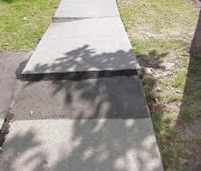
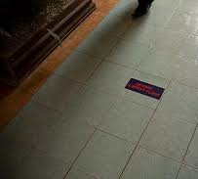
Environmental Causes
Poor lighting
Slippery floors
Uneven surfaces
Notes:
30-50% are due to environmental causes

Slide 17
What causes falls?
Changes in CNS (slower nerve conduction, slower reflex response)
Changes in MSK (arthritis, decreased muscle mass)
Sensory and cognitive impairments
Decreased proprioception and vibration
Medications
High risk medications: antihypertensives, sedatives, diuretics, autonomic meds
Complicated by anticoagulation meds
Burns E, Kakara R. Deaths from Falls Among Persons Aged ≥65 Years — United States, 2007–2016. MMWR Morb Mortal Wkly Rep 2018;67:509–514.

Slide 18
Medications
Over 80% of patients evaluated after accidental fall are found to be on medications easily implicated in contributing to the fall
The presence of four or more chronic medications seems to correlate well with an increasing risk of falls
Aschkenasy 2006

Slide 19
Screening for Falls?
STEADI (Stopping Elderly Accidents, Deaths and Injuries)
CDC (implements AGS and BGS guidelines)
Screen
Assess
Intervene

Slide 20
STEADI Process
Screen
At risk or not at risk?
Assess
Modifiable risk factors and fall history
Intervene
Reduced identified RF

Slide 21
Screen with 3 key questions
Do you feel unsteady when walking or standing?
Do you worry about falling?
Have you fallen in the past year?
If “yes” ask, How many times? Were you injured?
“At Risk” if “yes” to any question above

Slide 22
Assess
Orthostatic vital signs
Evaluate gait, strength and balance
Identify medications that increase fall risk
Ask about potential home hazards (throw rugs, slippery tub)
Check visual acuity
Assess feet/footwear
Assess vit D intake
Identify comorbidities

Slide 23
Intervene
Reduce identified fall risk
Interdisciplinary team approach
Physical Therapy
Occupational Therapy
Pharmacist
Nursing

Slide 24
Interventions: Do they Work?
Reduced 30- and 60-day fall-related ED revisit rates after ED visits for a ground-level fall for older adults who received PT services during their index ED
Multifactorial fall prevention programs are effective in reducing the number of fallers or fall related injuries is limited
Lesser et al. JAGS 2018; 66(11): 2205-2212.
Gates et al. BMJ 2008;336:130.
Notes:
Fall prevention programs in primary care, community or emergency care settings

Slide 25
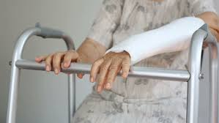
Disposition?
Case 2
80 year old female who lives at home alone. Ambulates with a walker. She tripped on a sidewalk at home and broke her wrist on her dominant hand.
Notes:
A highly functional person, who uses a walker, may lose his/her mobility because of a wrist fracture and need a period of convalescent admission

Slide 26
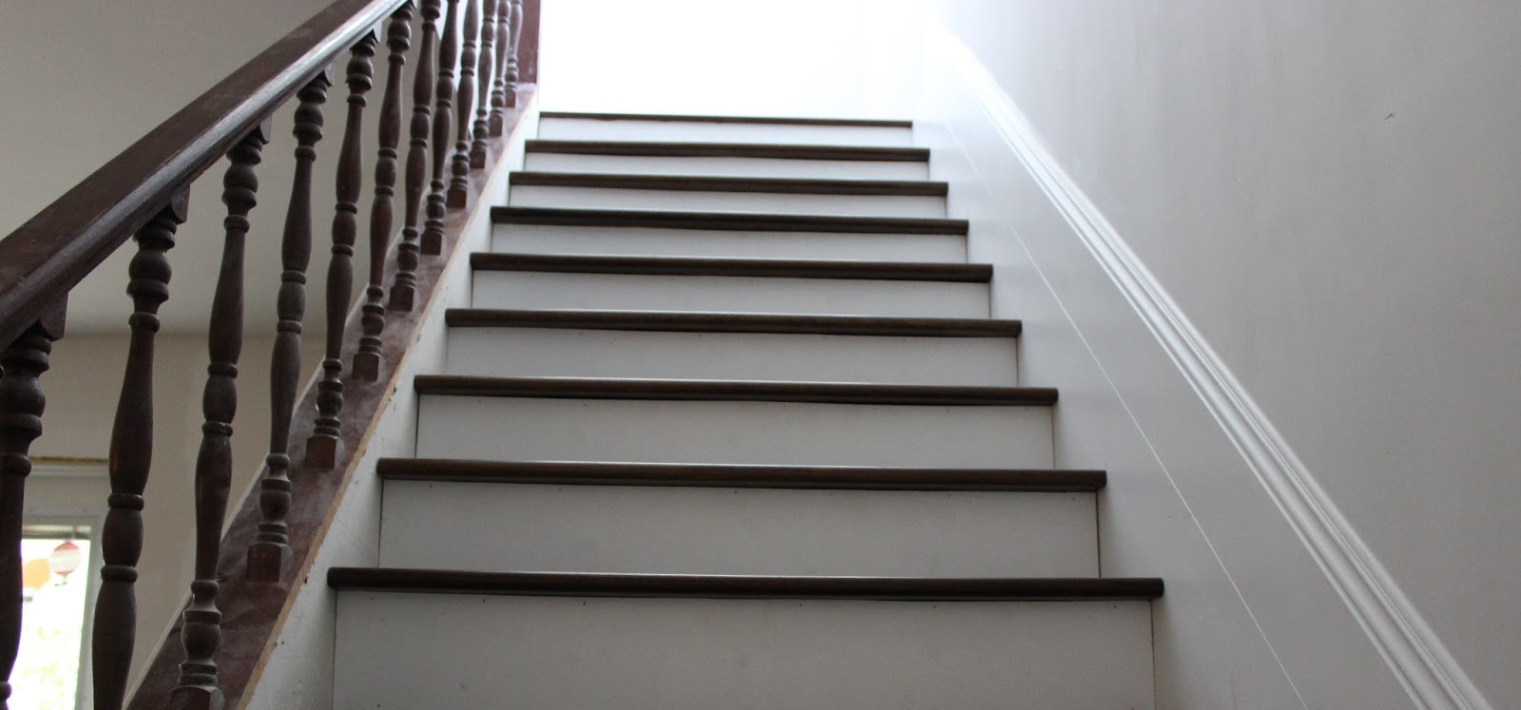
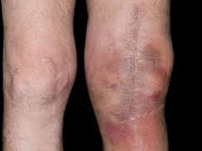
Disposition?
Case 3
70 year old with afib on coumadin fell and now with a swollen knee; lives at home with spouse in a two-story home
Notes:
A person with a knee contusion living in a two-storey home may need additional home care or adjustments of the home environment (bed and commode on ground floor).

Slide 27
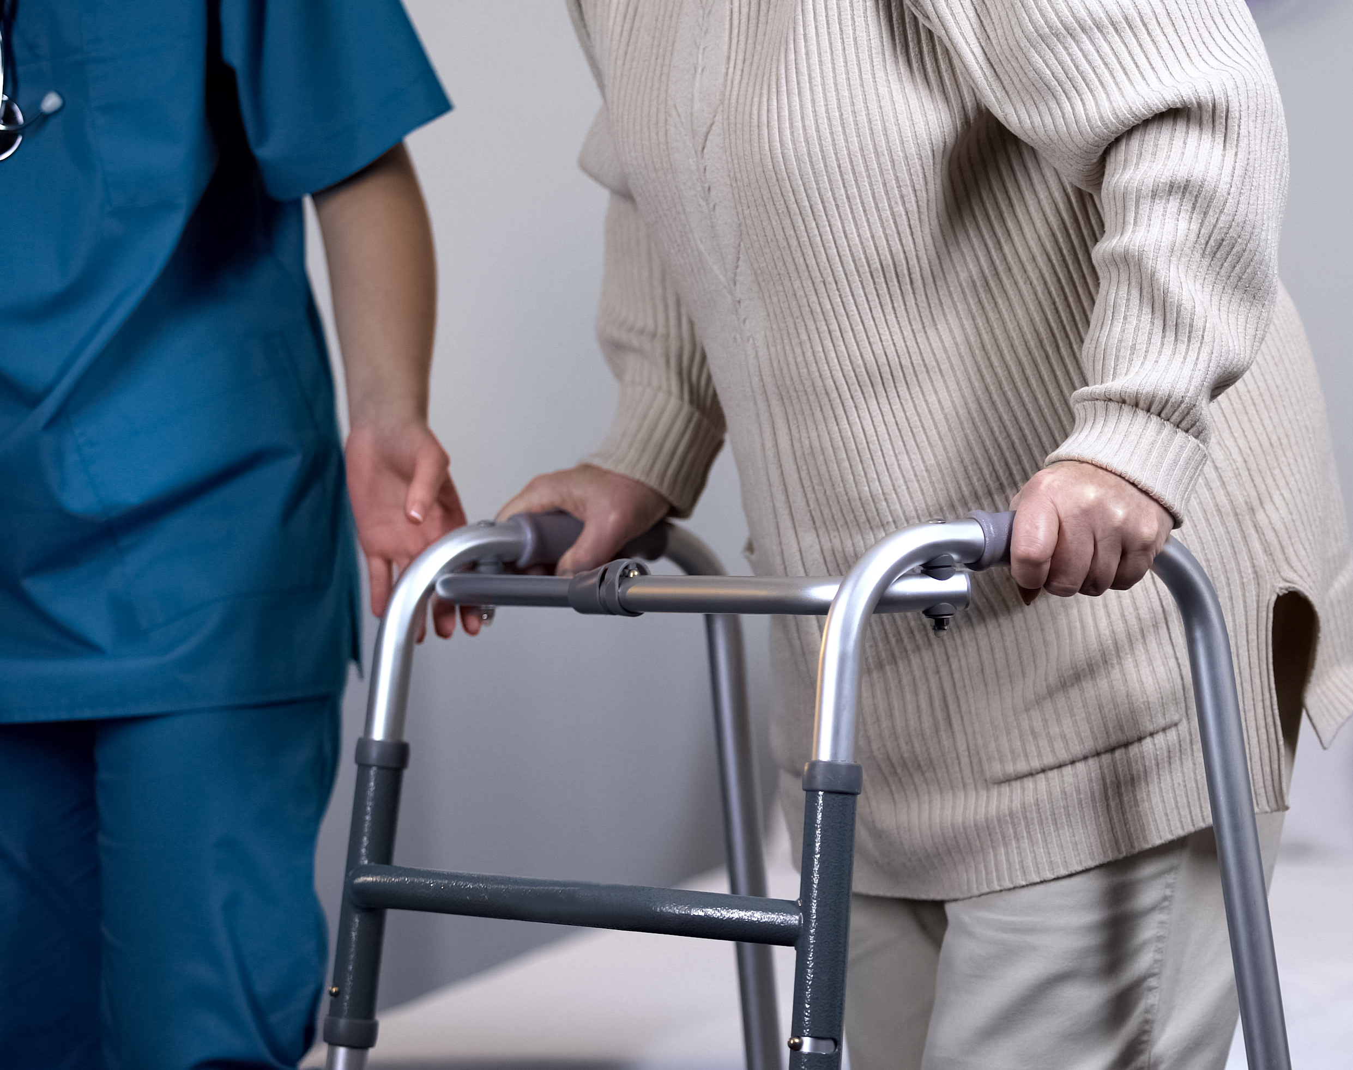
Disposition?
Case 4
75 year old female who fell and sustained a pelvic fracture. No other injury.
What else do you want to know?
Notes:
A person living on one floor with a pelvic fracture may be able to go home, but need support in hiring some private home help and additional support services through home care

Slide 28
Safe disposition
Some assessment of function in the department is imperative before discharge
Needs to be able to ambulate independently
Needs to function independently or have adequate support
Discharge planning/Care coordination

Slide 29
True or False?
Older patients only need to be transferred to a trauma center if the trauma is acute and/or if emergent surgery or procedures are needed?
Notes:
FALSE, older patients with nonoperative injuries benefit from specialized trauma care from coordinated multidisciplinary teams at a regional trauma center.⁵ The lack of need for emergency surgery should not preclude consideration for transfer to a lead trauma center. For example an older adult who presents to the ED several days after a fall found to have multiple rib fractures.

Slide 30
Team Approach
Avoid admissions
Improved outcomes
Team members
-Advanced or focused practice nurse or a social worker
-PT
-Pharmacist
-Community-based care coordinator
Notes:
Advanced or focused practice nurse or a social worker to coordinate the non-medical components of the visit;
access to a physiotherapist and or an occupational therapist who can do mobility and function assessments
a pharmacist available to assess medication use, interactions, and compliance;
access to community-based care coordinator to arrange additional home care or assessment of the home for safety and mobility

Slide 31
True or False?
Do not give older adults any opioid pain medication because of potential side effects.
Notes:
FALSE, adequate treatment of pain will decrease risk of delirium and agitation

Slide 32
Case 5
74 year old male with a h/o dementia, afib on Eliquis sent to the ED with a L hip fracture. Unwitnessed fall; SNF obtained xray through DMH that demonstrated likely L femoral neck fracture or possibly intertrochanteric. Transported via EMS who gave him 50 mcg fentanyl in route
Mental status change in route
Initial blood pressure systolic 99
Quick drop to systolic 60s
Never tachycardic
Mental status improved with increase in blood pressure
Notes:
Need to be aware that a simple fall can be considered a Level 1 Trauma, especially when on anticoagulation
Patient transferred to a Level 1 trauma center

Slide 33
Take Away Points
Be wary of normal vital signs
Falls are not innocuous
Assess for function prior to discharge
Interdisciplinary team approach necessary

