Slide 1
COVID 19 and Older Adults
Luna Ragsdale, MD, MPH
Chief, Emergency Department
Durham VA Health Care System
December 2, 2021

Slide 2
Geriatric Emergency
Older Adults 65 years and older
16.9% of US population
12.7% of total COVID cases
76.8% of all deaths
https://www.commonwealthfund.org/publications/issue-briefs/2021/mar/managing-medicare-beneficiaries-chronic-conditions-covid#12
Notes:
2020 us population

Slide 3
Risks for Older Adults
85 years and older
13 fold higher risk of hospitalization
630-fold higher risk of death

Slide 4
World Data
In China, case fatality rate for >80 years was 21.9% compared to 1.4% in patient of all ages with no underlying conditions
In Italy, where 23% of the population is over 65 years
-89% of COVID-19 deaths are over 70 years old
-31% between 70-79
-58% are over 80 years old

Slide 5
It’s not all bad news…
103-year-old Zhang Guangfen was admitted to Wuhan’s Liyuan Hospital March 1st and has completely recovered

Slide 6
2nd oldest known living person in the world
-Weeks before her 117th birthday tested positive
-Care home, southern French city of Toulon
https://apnews.com/article/europe-coronavirus-pandemic-58ae17c41d911db7e216760297f9f6c0
Notes:
Sister Andre, Lucile Randon
Asymptomatic, 81 of 88 residents tested positive, 10 died

Slide 7
Older adults more at risk
Underlying medical conditions (dementia)
African Americans
Members of Hispanic communities
Residents of ALFs and SNFs
Living in rural communities
Socio-economic vulnerabilities
Lower SES
Homebound

Slide 8
Most common symptoms
Fever
Cough
A, Al-Saad SR, Karbowski LM, et al. COVID 19 - Clinical Picture in the Elderly Population: A Qualitative Systematic Review[J]. Aging and disease, 2020, 11(4): 988-1008.
Notes:
Systematic review from Jan 2020 to Jun 2020 - 17 studies reported symptoms on 1285 patients (age >60) -Fever and cough were the first and second most common symptoms respectively, in which fever presented in 83.6% and cough in 62.7%.

Slide 9
Symptoms
Variation in symptoms and illness severity
80-90% are asymptomatic
Tabata S,Imai K, Kawano S, et al. Clinical characteristics of COVID-19 in 104 people with SARS-CoV-2infection on the Diamond Princess cruise ship: a retrospective analysis. Lancet Infect Dis 2020;20(9): 1043-50. Available at https://www.thelancet.com/journals/laninf/article/PIIS1473-3099(20)30482-5/fulltext.
Notes:
-Lancet article retrospective analysis of people on Diamond Princess cruise ship found 80-90% asx (median age 68) – June 2020

Slide 10
Nonspecific Symptoms
Weakness
Delirium
Fall
Dizziness/Syncope
9%
30%
28%
11%
Kennedy M, Helfand BK, Gou, RY et al. Delirium in older adults with COVID-19 presenting to the Emergency Department. JAMA Netw Open. 2020;3(11):e2029540. doi:10.1001/jamanetworkopen.2020.29540.
Notes:
multicenter cohort study at 7 ED sites NE, Midwest and SE – at least 30 patients from each site – total of 817 patients
Over 50% had fever, sob or cough BUT…

Slide 11
Delirium
16 % presenting complaint
37% no fever or shortness of breath
Increased risk for poor hospital outcomes
ICU stays
In hospital deaths

Slide 12
What is a fever?
IDSA recommends modified fever definition for older patients:
Oral temperature over 100 F (37.8 C)
TWO oral temperatures over 99 F (37.2C)
Elevation of 2 F (1 C) from baseline body temp
Notes:
20-30% old older adults do not mount a fever with infectious process
Immune response may be blunted and ability to regulate temperature may be altered, in addition chronic illnesses or medications can mask or interfere with signs of infection (think altered cough reflexes_

Slide 13
Some atypical presentations
Incontinence, lethargy and sneezing on and off
Fall or injury as a result of weakness and dehydration
Disorientation, dysarthria
Nausea, vomiting, diarrhea

Slide 14
Why are older adults affected more?
Immunosenscence
Inflammaging
Decreased clearing
Notes:
Immunosenscence
gradual deterioration of the immune system brought on by natural age advancement. The adaptive immune system is affected more than the innate immune system.
Inflammaging
elderly exhibit a continual production of inflammatory mediators and cytokines
Decreased clearing
Aberrant ciliary function and ciliary ultrastructural anomalies might jeopardize successful clearance of virus SARS-CoV-2 particles in older adults

Slide 15
Perrotta F, Corbi G, Mazzeo G, et al. COVID-19 and the elderly: insights into pathogenesis and clinical decision-making [published correction appears in Aging Clin Exp Res. 2020 Sep;32(9):1909]. Aging Clin Exp Res. 2020;32(8):1599-1608. doi:10.1007/s40520-020-01631-y

Slide 16
Radiographs
Multilobar findings
Bilateral findings
Ground glass opacities
Notes:
A, Al-Saad SR, Karbowski LM, et al. COVID 19 - Clinical Picture in the Elderly Population: A Qualitative Systematic Review[J]. Aging and disease, 2020, 11(4): 988-1008.
In 9 articles with a total of 402 patients, 62.2% affecting multiple lobes, bilateral distribution 58.2% and most common description GGO in 28.6%

Slide 17
COVID Lab Findings
Lymphopenia
C-reactive protein (>10 mg/L)
ESR (>35 mm/h)
Notes:
Lab findings of 1194 patients
WBC <1.1 x 10⁹ /L ; of less common were thrombocytopenia <150, higher levels of LDH and D dimers, abnormal renal markers

Slide 18
Complications
Renal impairment/injury
Coinfections
Hepatic injury
ARDS
CV related (acute heart injury, insufficiency, arrhythmias)

Slide 19
Treatments
Supportive
Antivirals
Antibiotics (most commonly administered)
Interferon therapy
Glucocorticoids
Immune-globulins
Notes:
Agnieszka Neumann-Podczaska , Salwan R Al-Saad , Lukasz M Karbowski , Michal Chojnicki , Slawomir Tobis , Katarzyna Wieczorowska-Tobis. COVID 19 - Clinical Picture in the Elderly Population: A Qualitative Systematic Review. Aging and disease. 2020, 11(4): 988-1008 https://doi.org/10.14336/AD.2020.0620

Slide 20
No need for hospitalization…what then?
What is the living situation?
Independent
Alone
Institution
Outpatient monitoring and treatment
Post-ED options expanded
Hospital-at-home
Community paramedicine
Telehealth

Slide 21
Levels of Care
Independent Living
Assisted Living
Skilled Nursing

Slide 22
COVID 19 and Nursing Homes
45% of all COVID deaths from long-term care facilities

Slide 23
Assisted Living
May only have one licensed practical nurse for entire facility
Less therapeutic and diagnostic capabilities

Slide 24
Nursing Homes
Combo of long-term care patients and shorter term skilled nursing/rehab
Have medical and nursing oversight
Most have diagnostic and therapeutic capabilities
Xray (mobile)
IV fluids/medications
Labs (mobile)

Slide 25
Nursing Home Staffing
Federal law requires Medicare and Medicaid certified nursing homes to have :
A registered nurse (RN) on duty at least 8 hours a day, 7 days a week
A licensed nurse (RN or LPN) on duty 24 hours a day
Direct care by certified nursing assistants
1:7-10 daytime
1:20-25 nighttime
Notes:
No staffing ratio mandate in North Carolina

Slide 26
What Can SNFs provide?
Oxygen
IV Meds
Nebulized treatments

Slide 27
SNF placement?
On March 12, 2020, CMS waived an important restriction to nursing home and skilled nursing facility (SNF) access called the “the 3-day rule”.
Relaxation of this rule with this waiver now allows direct transfer of appropriate stable older adults to SNF from the ED.
Notes:
On March 12, 2020, CMS waived an important restriction to nursing home and skilled nursing facility (SNF) access called the “the 3-day rule”. This CMS regulation required 3 days of inpatient hospitalization for a patient to qualify for CMS payment of admission into SNF rehabilitation. Relaxation of this rule with this waiver now allows direct transfer of appropriate stable older adults to SNF from the ED. The implications of this new transfer ability to free both ED and inpatient resources is clear and may greatly reduce burden of stable patients who require only skilled care.

Slide 28
COVID sequelae
Social Isolation
Disruption in routine care
Cognitive Impairment/Dementia

Slide 29
Social Isolation
Baseline isolation
Little Reserve
Lack of family visitors
Lack of regular interactions
Restrict needed access to food and med
Health deterioration
Notes:
U.S., 27% of adults ages 60 and older live alone; Older people are more likely to live alone in the U.S. than elsewhere in the world | Pew Research Center
isolation at baseline, due to institutionalization, and impaired function and cognition thus face loneliness and anxiety with little reserve; Lack of family visitors may limit the most meaningful part of an older person’s life. Lack of regular interactions may decrease ability for a caregiver to pick up on changes in cognition and function. Additionally, isolation may restrict needed access to food and medication, and lead to unrecognized falls or health deterioration

Slide 30
Impact on Older Adults with Chronic Illnesses
Medical conditions with higher risk of severe illness from COVID
Chronic lung disease
Chronic liver disease
Mental Health disorders (Mood d/o, schizophrenia)
Cancer
Cerebrovascular disease
Chronic Kidney Disease
Diabetes (Type 1 and 2)
Heart conditions (HF, CAD, CM)
Obesity (BMI>30)
Smoking (current and former)
Tuberculosis
https://www.cdc.gov/coronavirus/2019-ncov/science/science-briefs/underlying-evidence-table.html
Notes:
Delayed care
Less in home care available
Decrease hospital resources

Slide 31
Delayed care
4/10 Adults reported delaying or avoiding medical care
55% with multiple chronic conditions
69% affected ability to manage chronic conditions
Closing of gyms
Food access
Isolation
ED volume dropped by 50%
Notes:
https://www.commonwealthfund.org/publications/issue-briefs/2021/mar/managing-medicare-beneficiaries-chronic-conditions-covid#12

Slide 32
Impact on Older Adults with Dementia
More likely to contract COVID -19 (AOR 2)
Once infected, high risk of morbidity and mortality
Worsening neuropsychiatric symptoms and severe behavioral disturbances
Increase in 60% of patient
Nearly 2/3 caregivers with increase in stress related symptoms
Cagnin Annachiara et al. Behavioral and Psychological Effects of Coronavirus Disease-19 Quarantine in Patients With Dementia.Frontiers in Psychiatry. Vol 11, 916 (2020).
Wang Q et al. COVID-19 and dementia: Analysis of risk, disparity, and outcomes from electronic health records in the US. Alzhiemer’s and Dementia. Vol 17(8): 1297-1306; August 2021.
Notes:
6 month mortality and hospitalization risks were 21% and 59%
Study in Italy in April of 2020 looked at close to 5000 caregivers, reported that during quarantine, increase of behavioral and psychological symptoms in approx. 60% of patient and nearly 2/3 of caregivers had increase in stress-related symptoms.

Slide 33
COVID factors
NO VISITORS – strict visitor policies
PPE
Isolation/Immobility
Notes:
-Decreased availability of caregivers to orient and provide meaningful interactions.
-Trouble hearing (sensory impairment) worsened by use of PPE. Older adults with sensory or cognitive limitations (dementia), will no longer be able to read lips or hear communication obscured by masks, and may become disoriented, frightened, and agitated by gowned and masked caregivers.
c. Being placed into isolation. Closing of the exam room door, curtailing ambulation and mobility in the ED, and how the patient sees people in protective gear doing invasive tests (nasopharyngeal swabs, blood draws) is stressful for all. For confused patients, it can only be worse.
d. Polypharmacy and use of new anticholinergic or psychoactive medications.

Slide 34
Importance of Advanced Care Planning
Proactively identifies who does not want aggressive, invasive interventions
Clearly documented in easily accessible location

Slide 35
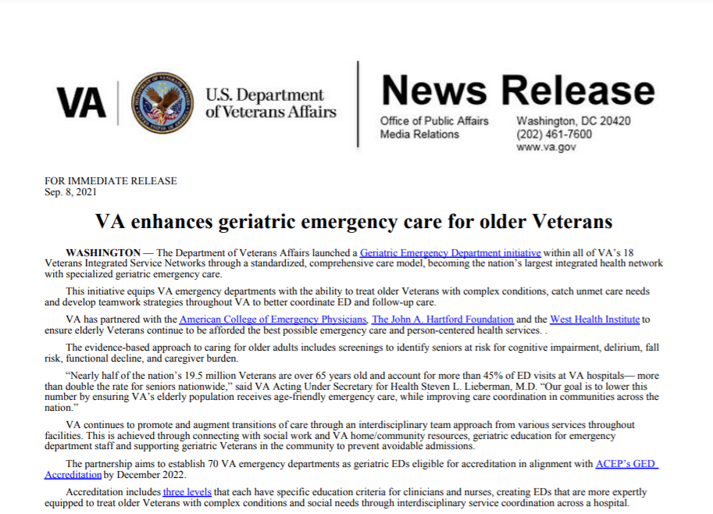
Geriatric Emergency Departments
Notes:
COVID highlighted the need for geriatric EDs even more; In 2018 the VA with the leadership of Chad Kessler in National EM office and Tom Edes in Office of Geriatrics and Extended care, brought together experts in the field to expand geriatric emergency care in the emergency department.

Slide 36
VA Geriatric Emergency Departments Cohort #1
Notes:
In 2019, in partnership with John A Hartford, WestHealth and ACEP, 20 VAs were selected to for geriatric ED accreditation; Building on this success and realizing the importance of continuing this work, continued partnerships with these entities will be ongoing for two more years.

Slide 37
Notes:
Over 50 sites engaged in geriatric emergency department initiatives; 100% VISN participation
Will be recruiting for more sites for Cohort #3 in December!! Be on lookout for link in EM catalyst!

Slide 38
VA Geriatric Emergency Department Core Team
VHAEDGEDCoreTeam@va.gov

