Slide 1
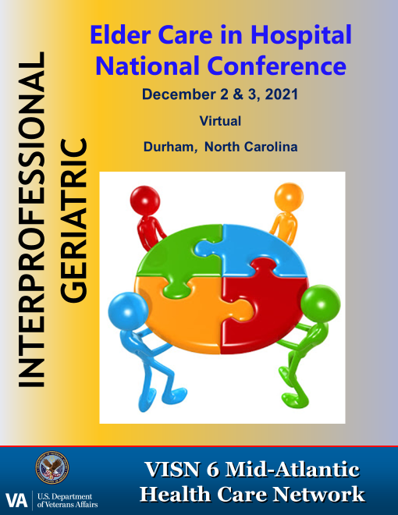
Evidence-Based Practices in Dementia Care
Judith Davagnino, LCSW, MSW, CSW-G
COACH Program Director
Jayme Tetro, LCSW, MSW, CSW-G
Community Living Center

Slide 2
EBP IN DEMENTIA CARE
Communication skills
    Verbal and non-verbal communication
    Validation and Empathy
Reminiscence
Notes:
Other EBP: Music, Exercise, Tailored activities, home modifications, Adult Day Care centers

Slide 3
COMMUNICATION
Communication is a basic human need
We communicate verbally and non-verbally
Behaviors are ways of communication

Slide 4
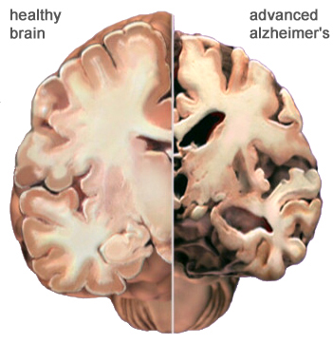
HOW DEMENTIA AFFECTS COMMUNICATION
Dementia is a brain disorder affecting memory, language, executive functioning
It destroys vital brain cells, causing confusion, impaired reasoning, personality changes, inability to plan and organize
Affects the receptive and expressive language and the ability to communicate

Slide 5
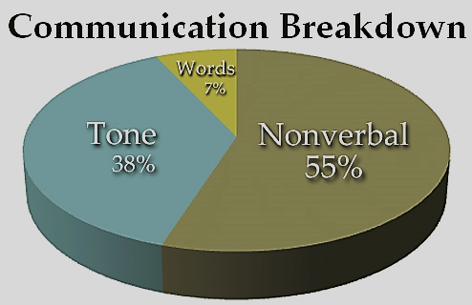
VERBAL AND NON-VERBAL COMMUNICATION
Pay attention to your voice
  Tone
  Speed of speech
  Inflection
  Words
Notes:
- Your tone should be soothing and sound pleasant to the ears, especially important if your partner is upset or angry.
- Keep the pitch somewhere in the middle. High pitched voices can be jarring to the nerves; a low pitch can seem threatening.
- Keep the speed of your speech average. If your speech is too slow they may loose the thread of what you are saying. If it is too fast they may not understand.
- Inflection helps them understand the meaning of what you are saying.

Slide 6

COMMUNICATION
    USE OF A PLEASANT, CALM, AND REASSURING MANNER GOES A LONG WAY
    People with dementia tend to “mirror” the mood of the person in front of them
    They may respond to what is being said by reading non-verbal cues
    Pay attention to your body language
    Smile often
Notes:
- Keep your face relaxed and smiling. Your eyes need to look that way too. It is hard to keep calm and pleasant if you do not feel that way, but the patient will read your face and may become upset if you do not look pleasant, calm and reassuring.
- Be aware of your body posture, hand and arm movements.

Slide 7
COMMUNICATION
Acknowledge them
Give plenty of time for them to respond
Use short, simple words and sentences
Repeat as needed
Avoid contradicting
Avoid “Why” questions
Be patient and supportive

Slide 8
COMMUNICATION STRATEGIES
M - Maximize attention (attract attention, avoid distraction, one thing at a time)
E - Expression (relax, calm, show interest)
S - Simple (short, simple, familiar, clear choices)
S - Support (give time, repeat/remind as needed)
A - Assist with visual aids (gestures, objects, pictures)
G - Get their message (listen, watch, detective work)
E - Encourage & engage in communication

Slide 9
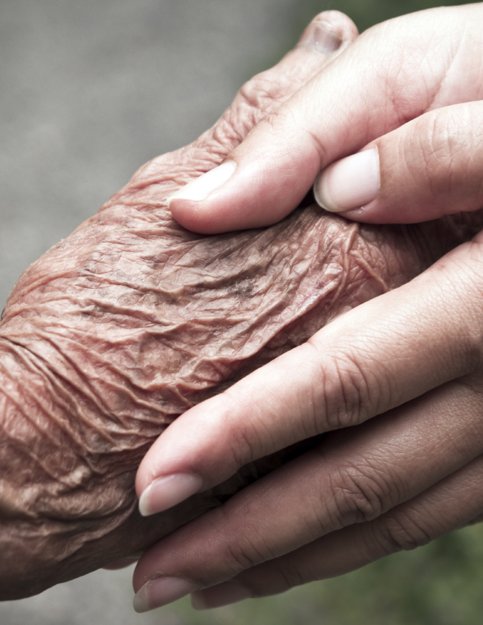
Beyond Communication… Validation
Based on Validation Therapy by Naomi Feil
It is a therapeutic communication
Responds to the emotion behind the behavior
Validates their feelings of distress

Slide 10
Validation techniques
Listen carefully and empathically to make a connection
Join them where they are without correcting them
Tell you understand how they might feel
You may say something like “it sounds like you are feeling sad”, “it looks like something is bothering you”, “You are right, that sounds very upsetting”, “Tell me about it”
Reminisce with them
Notes:
Maintain eye contact and show respect

Slide 11
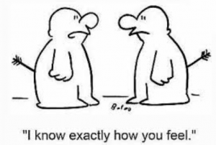
Empathy
Placing yourself in someone’s shoes
Try to understand from their world view
You may ask yourself:
  How would I feel if I lose my memory?
  How would I feel if I got lost?
  How would I feel if I do not recognize a place or people?
Being compassionate

Slide 12
Validation benefits
It gives them a sense of dignity
It acknowledges their emotional pain
It reduces anxiety
It makes them feel better

Slide 13
Practicing connection using a
POPPY FLOWER
WHO AM I?
My interests and hobbies
My past occupations
Branch of service
People and pets important to me
Places that I have lived
Best way to approach me
My favorite music, shows, or movies
Preferred name
Best way to communicate with me
My favorite food or drinks
I am upset by
Other things to know about me
I am calm by
Comfort measures that I prefer
Someone who motivates me to cooperate
I need assistance with

Slide 14
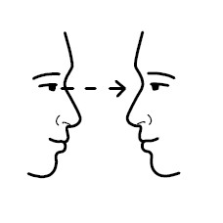
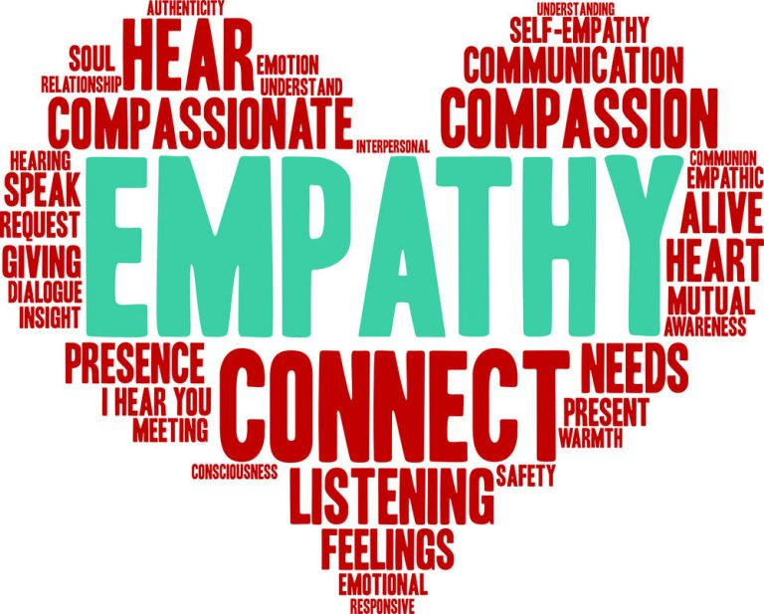

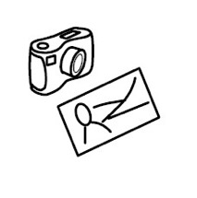
body posture
facial expression
eye contact
Poppy flower
Visual/written cues
familiar objects
Notes:
Make eye contact at their eye level
Get their attention with gentle touch
If it is a task, show objects involved
Use non-verbal cues
Use all the senses to give cues
Use positive body language
Be patient and supportive
Avoid a condescending tone of voice

Slide 15
QUIZ
What is the most important element when communicating with a person living with dementia?
Reality orientation
Get them to understand the situation
Establishing a connection
Notes:
Acknowledge their request
Use simple and short sentences
One instruction/one step at a time
Repeat as needed
Avoid “Why” questions
Avoid contradicting or arguing
Give plenty of time for them to respond
Give them choices whenever possible

Slide 16
QUIZ
What can we say when a patient with dementia is trying to leave the place without supervision?
Why are you leaving?
Sorry, you are not allowed to leave this place, that is the policy here
It looks like you are searching for something. Is there anything I can do to help you? Please tell me about it.

Slide 17
References
Glenner, J. A., Stehman, J.M., Davagnino, J., Galante, M.J., Green, M.L. (2005) When Your Loved Has Dementia: A Simple Guide for Caregivers. John Hopkins University Press.
Smith, E. R., Broughton, M., Baker, R., Pachana, N. A., Angwin, A. J., Humphreys, M. S., Mitchell, L., Byrne, G. J., Copland, D. A., Gallois, C., Hegney, D., & Chenery, H. J. (2011). Memory and communication support in dementia: Research-based strategies for caregivers. International Psychogeriatrics, 23(2), 256–263. https://doi.org/10.1017/S1041610210001845.
Mehrabian, A. (1981) Silent Messages: Implicit communication of emotions and attitudes.
Feil, Naomi, De Klerk-Rubin, Vicki. The Validation Breakthrough: Simple Techniques for Communicating with People with Alzheimer's and Other Dementias. Health Professions Press, 1993.
Poppy flower created by Justin Wheeler, BSN, RN, CMSRN, RN-BC, at the William S. Middleton Memorial Veterans Hospital, Madison, WI.

Slide 18
Reminiscence Therapy

Slide 19
Reminiscence: What is it?
The enjoyable recollection of past events
A story told about a past event remembered by the narrator
Reminiscence is not simply remembering

Slide 20
Reminiscence: Who benefits from it?
Everyone!
Specifically, reminiscence can be a therapeutic intervention for people with various stages and types of dementia and cognitive impairment
Caregivers
(Woods, Spector, Jones, Orrell & Davies, 2005)
Notes:
In a study reviewing 4 trials of reminiscence therapy provided to over 144 individuals. Caregivers showed statistically significant lower reports of caregiver strain following introduction of reminiscence techniques to their caregiving and in participating in these groups.

Slide 21
What are the benefits?
Allows patient to be the expert
  With varying types of dementia, short term memory is lost early on and long-term memories are preserved until much later in disease progression
Socialization
  Small group of others with dementia
  Family members
Decreases depressive symptoms
Increases life-satisfaction
Presents as a meaningful and engaging activity
(Bademli, Lök& Selçuk‐Tosun, 2018)

Slide 22
The Theory Behind Reminiscence
DECREASING demands on impaired brain functions and CAPITALIZING on preserved parts of brain functioning

Slide 23
In the Literature…
Pre/test, Post/Test study in Konya, Turkey
60 elderly individuals with dementia
Weekly reminisce therapy for 8 weeks
Results: Mini-mental scores improves, quality of life scores improved, depressive symptoms decreased
                (Bademli, Lök& Selçuk‐Tosun, 2018)
Notes:
Mean MMSE pre: 18.26 ± 3.69, Mean MMSE post: 21.08 ± 1.94 while the control group remained the same
Cornell Scale for Depression, Pre: 10.66 ± 3.61, post: 8.86 ± 1.56, control group remained the same
Quality of Life Scale: Pre: 18.05 ± 3.17, Post: 20.22 ± 3.61, control group remained the same

Slide 24
More In the Literature…
Similar study in the Czech Republic
116 men and women with mild & moderate cognitive impairment living in LTC centers
Results: Improvement in mental health, social participation, reduction in depression & elevated attitudes towards their old age and aging in general
(Siverová & Bužgová, 2018)
Notes:
WHOQOL‐OLD – The World Health Organization Quality of Life‐Old
AAQ – The Attitude to Aging Questionnaire
GDS – The Geriatric Depression Scale, short version
MMSE – Mini‐Mental State Examination

Slide 25
So… How do we use it?
Individual: life review
Group: introducing various objects, sounds and shared topics/ life events
Notes:
Individual: My life, my story

Slide 26
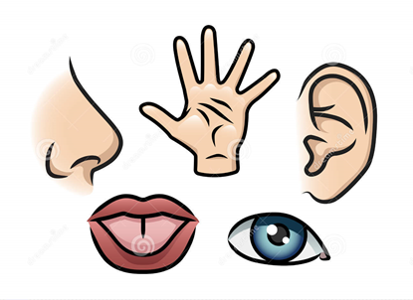
Focusing on the Senses
TOUCH
HEARING
SMELL
TASTE
SIGHT

Slide 27

Focusing on the Senses: Taste
Stimulate memories by providing comforting foods
Favorite foods from childhood?
Ask what it tastes like? What does the taste remind them of?
If they can’t respond to these questions, try to give foods that you know they like
Changing flavors: salty, sweet, sour, bitter, savory

Slide 28


Focusing on the Senses: Hearing
Music
Comforting and familiar sounds
Common phrases
http://musicandmemory.org/
Notes:
Describe henry
Activity for common phrases

Slide 29
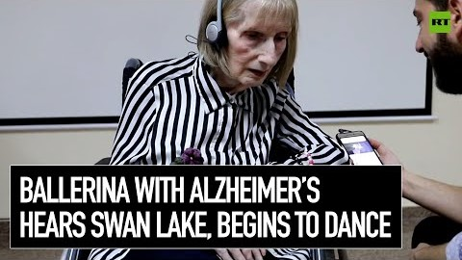

Slide 30

Focusing on the Senses: Touch
Familiar objects
Familiar textures

Slide 31
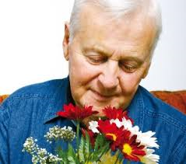
Focusing on the Senses: Smell
Familiar scents
Soothing smells
Candles, food, flowers

Slide 32
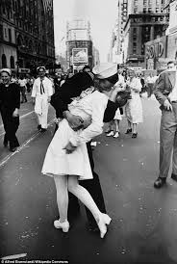
Focusing on the Senses: Sight
Family Pictures
School Yearbooks
Pictures of Favorite Places
Familiar Objects

Slide 33
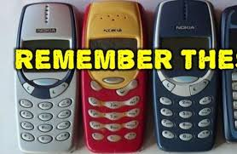
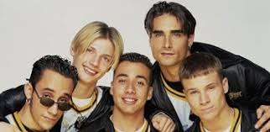
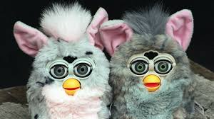
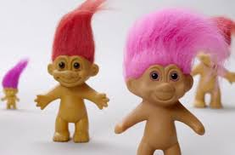

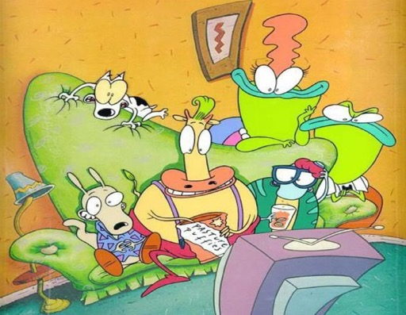

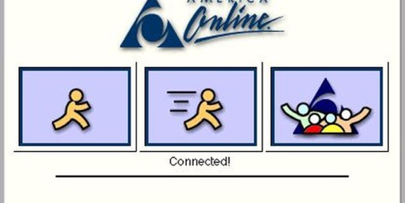
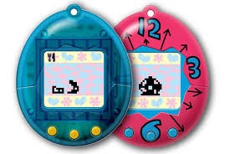

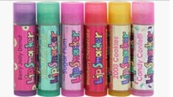

Slide 34
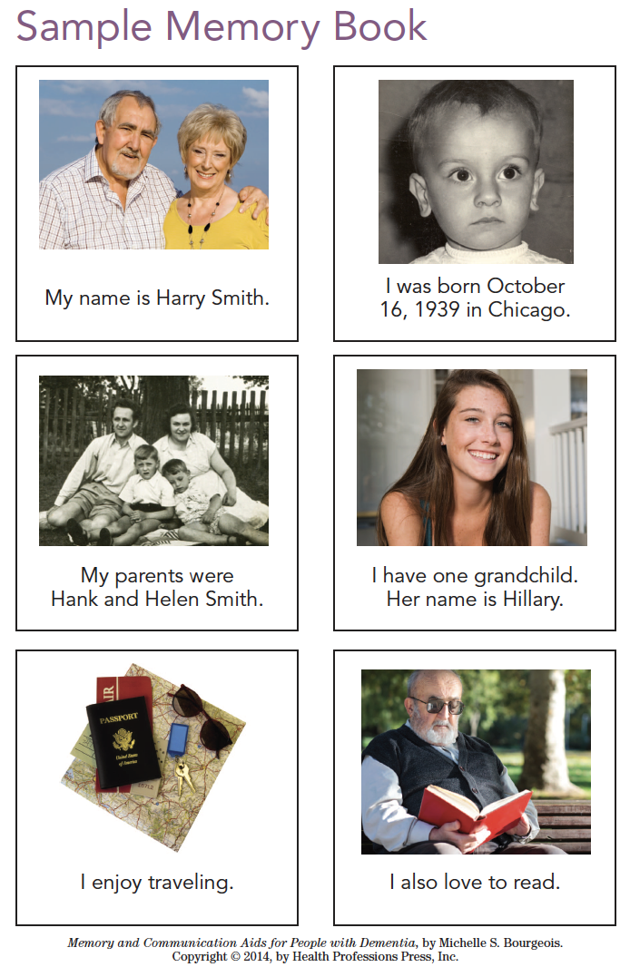
Reminisce + Communication Support: Memory Books
Helping people remember important information
Making conversation easier
Providing reassurance and comfort
(Bourgeois, 2014)

Slide 35
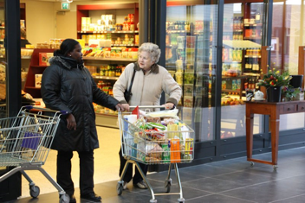
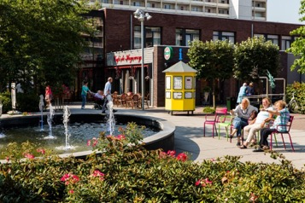
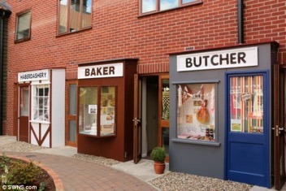
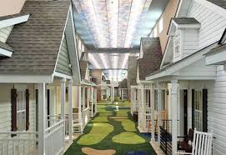
Dementia Villages: Reminiscence as a Lifestyle
https://www.dementiavillage.com/

Slide 36
In Practice
Focus on one topic/ object at a time
Make eye contact
Don’t correct
When in doubt, stick with pleasant memories

Slide 37
In Practice Continued
Do your research about the person
Stay at eye-level
Reduce background noise
Focus on their likes, not their dislikes
Follow their lead!

Slide 38

Reminiscence in the Time of COVID
Social Isolation & loneliness, particularly when living in a residential institution
Recent study of COVID19 on entertainment choices; half reported finding comfort in revisiting both TV & Music
(MRC Data Service, 2020)
(National Geographic, 2020)
Notes:
Researching a family tree can be rewarding, and you can share it online with older children or grandchildren. Perhaps you can use this time to record the person talking about their life history using a phone or tablet. As with all reminiscence, be mindful of sad memories that the person may not want to discuss.

Slide 39
Let’s Try it Out!

Slide 40


Questions?

Slide 41
References
Bademli K, Lök N, Selçuk‐Tosun A. The effect of reminiscence therapy on cognitive functions, depression, and quality of life in Alzheimer patients: Randomized controlled trial. Int J Geriatr Psychiatry. 2018;1–7. https://doi.org/10.1002/gps.4980
Bourgeois, M. S. (2014). Memory & communication aids for people with dementia. Baltimore, MD: Health Professions Press.
Siverová, J. and Bužgová, R. (2018), The effect of reminiscence therapy on quality of life, attitudes to ageing, and depressive symptoms in institutionalized elderly adults with cognitive impairment: A quasi‐experimental study. Int J Mental Health Nurs, 27: 1430-1439. doi:10.1111/inm.12442
Woods B, Spector AE, Jones CA, Orrell M, Davies SP. Reminiscence therapy for dementia. Cochrane Database of Systematic Reviews 2005, Issue 2. Art. No.: CD001120. DOI: 10.1002/14651858.CD001120.pub2.
https://static.billboard.com/files/2020/04/COVID-19-Entertainment-Tracker-Release-1-1586793733.pdf
https://www.nationalgeographic.com/science/2020/07/surprising-role-of-nostalgia-during-coronavirus-pandemic/#close
Notes:
Bademli K, Lök N, Selçuk‐Tosun A. The effect of reminiscence therapy on cognitive functions, depression, and quality of life in Alzheimer patients: Randomized controlled trial. Int J Geriatr Psychiatry. 2018;1–7. https://doi.org/10.1002/gps.4980

