Slide 1

Identification of Oropharyngeal Dysphagia in the Geriatric Patient
Alyson Zarzecki, M.A. CCC-SLP
Speech Language Pathologist
Durham VA Health Care System
Notes:
HI- My name is Alyson Zarzecki, and I am a Speech Pathologist here at the Durham VA, where I have proudly worked for 15 years. I am here this morning to talk to you about the Identification of Oropharyngeal Dysphagia in the Geriatric Population. Following my presentation. Susannah Dixon will be presenting on hearing loss. SO let’s get started ☺ …..

Slide 2
A few definitions….
Dysphagia: difficulty swallowing
        Oropharyngeal dysphagia: swallowing impairment resulting from difficulty in the mouth or pharynx (Speech Pathology)
        Esophageal dysphagia: swallowing impairment resulting from a problem involving the esophagus (Usually Gastroenterology)
        Odynaphagia: Pain with swallowing (Typically ENT or Gastroenterology)
Aspiration: the passage of material below the vocal cords into the trachea
“Silent” aspiration: No reflexive cough response with aspiration
Notes:
Helping individuals with swallowing disorders is a passion of mine. So that I can help YOU serve these patients well, I first have to give you a few definitions.
Notice different specialties address different complaints as they pertain to swallowing. Familiarizing yourself with this information will expedite getting patients to the specialty that can best address their particular complaints. (E.g., Globus sensation, regurgitation)

Slide 3
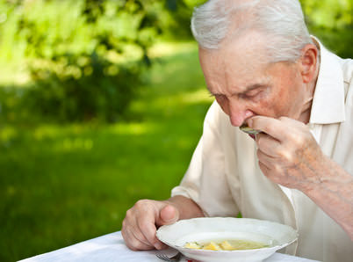
Dysphagia or No Dysphagia, that is the question…
https://www.caregiver-aid.com/wp-content/uploads/2014/11/difficulty-swallowing.jpg

Slide 4
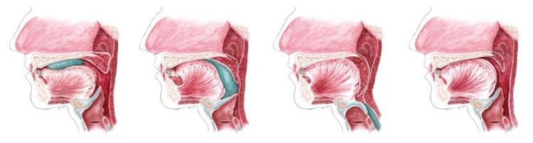
NORMAL SWALLOW
https://www.bing.com/images/search?view=detailV2&ccid=0oFX4JB5&id=A166CBDD1ED0A76F573A856F7B8CEA2289C98B32&thid=OIP.0oFX4JB5Ak2WktXcXixuTQHiCB&q=dysphagia+images&simid=607988962271234205&selectedindex=70&mode=overlay&first=1
Notes:
During description, point out large size of tongue (group of muscles), musculature of pharynx, palate, trachea, esophagus
Seal our lips and tongue gathers food/liquid into a cohesive bolus, the tongue then propels bolus posteriorly where the base of tongue retracts to meet the pharyngeal wall and the palate lifts to prevent nasal escape, the pharyngeal constrictor muscles continue to propel the bolus through pharynx as the hyoid bone lifts superiorly and anteriorly to invert the epiglottis and close off airway during the swallow, the UES relaxes and bolus continues through to esophagus

Slide 5
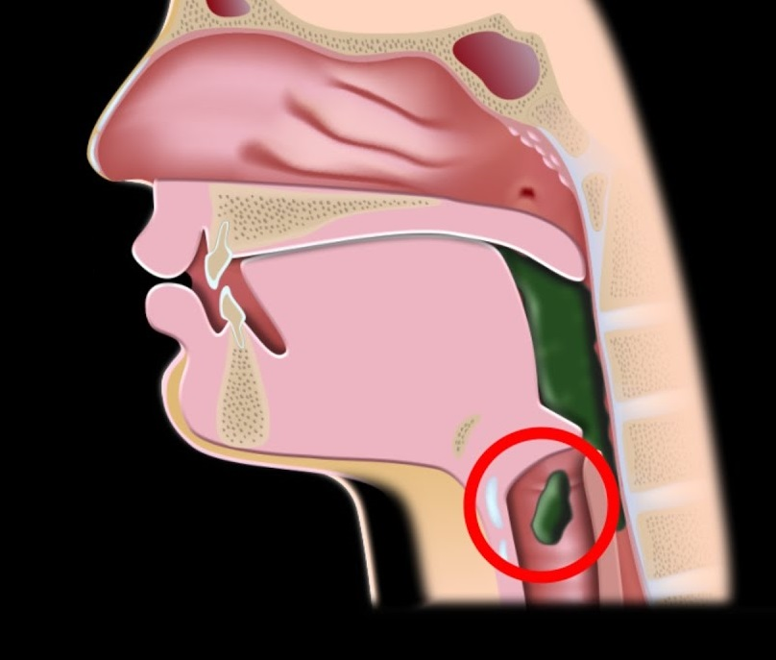
Aspiration
https://i.ytimg.com/vi/VoSMA2Anq3U/maxresdefault.jpg

Slide 6
Who’s at risk?
PATIENTS WITH NEURO INVOLVEMENT
Dysphagia is most prevalent in the Neuro population
The reported incidence of dysphagia in Stroke patients varies, generally ranging between 64%-78% when instrumental testing is utilized.
The most common cause of death in patients sustaining acute stroke is bacterial pneumonia believed to result from increased incidence of aspiration
High incidence of dysphagia also occurs in head injury and neurodegenerative disease such as Parkinson’s Disease, MS, and ALS
But neuro involvement is not necessary for an individual to be dysphagic….
Notes:
After bullet #4:
--food and liquid were not meant to be digested in the lungs. If not cleared adequately, it essentially stays there and rots. It draws bacteria and can result in a life-threatening pneumonia. It’s something we very much want to avoid and knowing who is high risk really helps.

Slide 7
Who’s at risk? (cont.)
Pt.s with difficulty coordinating respiration/swallowing (i.e. COPD)
Deconditioned patients (i.e. post-surgical, chronic conditions)
Tracheostomized and/or Ventilator-dependent patients
Head and Neck Cancer patients
Notes:
After 1st bullet:
--When we swallow normally, it involves a brief apneic period during the swallow (<1 second when we stop breathing) to protect our airway while food/liquid passes over it. People who have acute or chronic issues where the have a hjgh respiratory rate (usually >30 breaths/minute) or labored breathing, are at higher risk of aspiration. Chronic Obstructive Pulmonary Disease (COPD) is a good example of a respiratory disease that can put a person at high risk of aspiration, and one that is very common in the Veteran population due to the number of Veterans, particularly Vietnam Era and older, who smoke or have smoked.
What can happen is that the drive for O2 overrides the individual’s ability to maintain the necessary apneic period during the swallow, and instead take a breath, inhaling DURING the swallow.
After #2—think of the musculature (like the tongue) I showed you at the beginning that is involved in the normal swallow. Just like any other muscles in the body, when someone is very sick and becomes deconditioned (may after prolonged intubation, etc), this musculature can become weak, unable to adequately move food through the pharynx, and passed the airway, leaving food behind in the throat that can them move into the airway after the swallow.
After#3: One study show’s that that up to 80% of patients who have a tracheostomy tube in place and aspirate, do so silently (without coughing). Your larynx elevates as part of the protective mechanics of the swallow , and a cuffed tracheostomy tube can act as a weight to anchor the larynx down, placing the patient at risk for food/liquid entering the airway….even moreso when there is heavy vent-tubing attached to it.
After # 4: Patients who have tumors not yet treated, as well as those who are post-surgery or receiving radiation therapy can have significant difficulty swallowing. Radiation, although very helpful in treating cancer, can cause late-effect radiation fibrosis of the musculature of the pharynx and larynx, where the structures in the field of radiation simply don’t move well to protect the airway as well, thereafter.

Slide 8
Role of the Speech Pathology
Once consulted:
Performs thorough review of the medical record
Conducts Patient/Caregiver/Nursing interview whenever possible
Performs a Clinical Swallowing Evaluation (If does well, recommend diet)
If clinical signs of aspiration are observed, typically one of two instrumental swallowing evaluations are performed to evaluate swallowing function
        Videoflourographic Swallowing Evaluation (VSE) in Radiology
        Flexible Endoscopic Evaluation of Swallowing (FEES) at bedside
Results of instrumental evaluation (coupled with patient’s personalized needs/wishes) determine diet recommendation
Notes:
After final point
….and need for Tx if appropriate!!

Slide 9
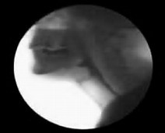
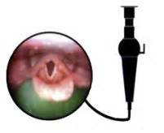
Instrumental Swallowing Evaluation
VIDEOFLUOROGRAPHIC SWALLOW EVALUATION (VSE)
FLEXIBLE ENDOSCOPI EVALUATION OF SWALLOWING (FEES)

Slide 10
Speech has to be involved to help
Nursing and other professionals are often our first line of defense in identification of geriatric patients with dysphagia
What can YOU look for?
  Coughing after administration of meds/during meals
  Throat clearing after administration of meds/during meals
  Wet voice at baseline and/or after eating/drinking
  Dysphonia/aphonia (very hoarse or breathy vocal quality)
  Pocketing of food/liquid in the oral cavity
  High respiratory rate (< 30 breaths/minute) during meals
  Inability to swallow saliva well without suctioning
  Tracheostomy
  Increased chest congestion after meals
  Complaints of difficulty swallowing by the patient

Slide 11
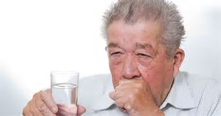
“He’s got a good cough!”
https://www.bing.com/images/search?view=detailV2&ccid=LJyJUwDV&id=C88FFA04C364C7FF90FAD297A92A5ACC21E0A9C5&thid=OIP.LJyJUwDVKjkF_gmlqfE2pQEsCd&q=dysphagia+images&simid=607996010313419388&selectedIndex=47&ajaxhist=0
Notes:
Let’s talk about some common misconceptions

Slide 12
Common misconceptions
Consulting Speech for solid food dysphagia/feeling of food “getting stuck” (start with the esophagus. i.e. Barium Swallow study or GI consult)
Consulting when someone WON’T eat secondary motivation/lack of desire to eat
Consulting when someone cannot keep food down
Chin tuck will prevent aspiration in all situations (“He’s ok…I just have him tuck his chin”)
Thick liquid is always safer
Straw use is always less safe
Coughing when taking meds/eating is ok as long as it’s a “good cough”
If a patient has difficulty swallowing, ALL meds should be crushed/ground
Notes:
*(the last point is because of the KOP-Q test question #22 that asks true/false “In the case of swallowing difficulty, all medicines must be ground to ensure that patients ingest them) The correct answer should be FALSE.

Slide 13
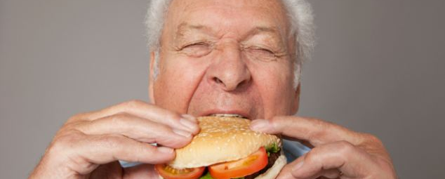
It takes a village….
https://www.bing.com/images/search?view=detailV2&ccid=7mlN4hqp&id=087D6BE9DF4E977CC6FE3388DC2CA82A77E690DE&thid=OIP.7mlN4hqpKtyo875n4uDp9QEsC6&q=old+man+smiling+while+eating&simid=608045836210667543&selectedIndex=14&ajaxhist=0
Notes:
I hope you now have some new or enhanced knowledge about:
dysphagia in the geriatric population
Who is most at risk
Some signs to look for to see if Speech (or other specialties) need to be involved
A few of the many things Speech can do once involved
And now know a few of the common misconceptions related to oropharyngeal dysphagia
Before we move on the Hearing Loss portion of our talk, does anyone have any questions related to dysphagia that I can help answer?

Slide 14
Hearing Loss:
What You Need To Know
Susannah Dixon
Audiology Extern
Durham VA Health Care System
Notes:
Special thanks to Melanie Frost, Au.D. and Emma Gibbings, Au.D., and Brettlyn Little, whose slides I adapted today’s presentation

Slide 15
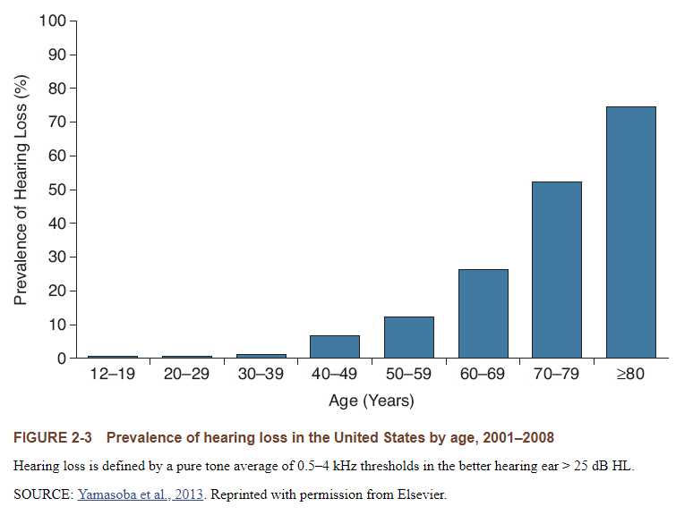
Statistics
  More than 37.5 million adults have hearing loss.
    About 15% of the US population
  Age is the strongest predictor of hearing loss.
Less than 30% of those who would benefit from hearing aids, are actually using them.
Notes:
While there are many causes to hearing loss, age is the strongest predictor.

Slide 16
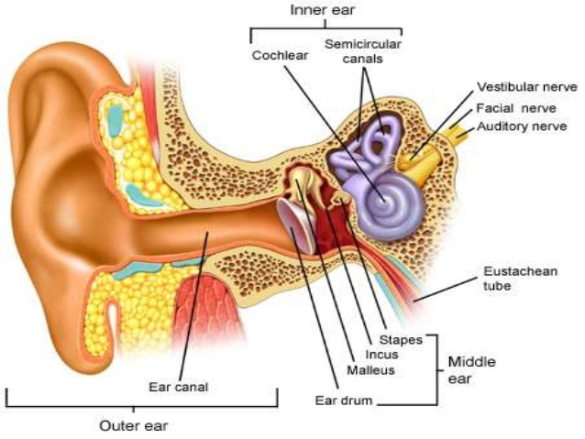
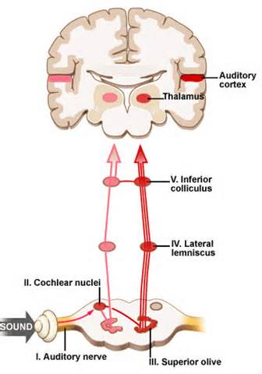
Auditory Pathway: How we hear
SOUND
Notes:
It helps to have an understanding of how we hear and how hearing loss affects communication before we get into the details of how to interact with these patients.
The site of lesion along this pathway impacts the severity of the hearing loss and determines the type and treatment of the hearing loss.

Slide 17
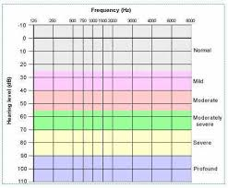
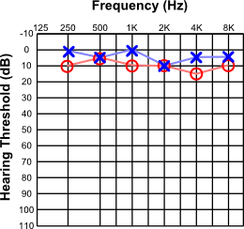
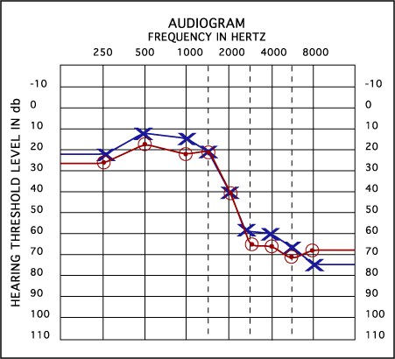
How to Interpret an Audiogram
We measure hearing by pitch and by volume.
The blue line or “X” represents the L ear.
The red line or “O” represents the R ear.
The lower the line, the more severe the hearing loss is.
Notes:
https://www.gptrove.net/wp-content/uploads/audiog1.png
https://encrypted-tbn0.gstatic.com/images?q=tbn:ANd9GcSidvN7CoDiTE6DiMcRXVKk-JRlX9ZnlLRiakiMYQOhxy3Z7xY3&s
We measure by pitch and by volume. With low pitch to high pitch, and soft sounds to loud sounds.
The blue line with “X” represents the left ear.
The red line with “O” represents the right ear.

Slide 18
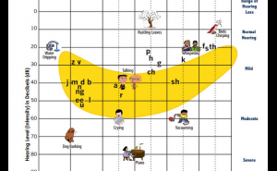
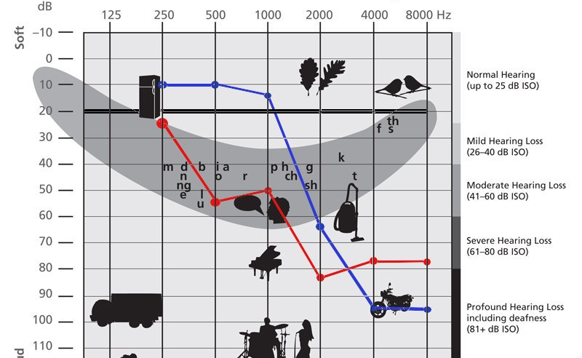
The Speech Banana
The “banana” is the volume and pitch range of speech at a normal conversational level.
The person is able to hear anything below their threshold line (blue and red lines).
With speech sounds, lower pitches provide volume, while higher pitches provide clarity.
Notes:
https://assets.classy.org/9486612/c864f6f0-4f33-11e9-a19a-0a97e5d08a74.png
https://pbs.twimg.com/media/DmynJB6UcAArWQT.jpg
“shoe” vs. “few”

Slide 19
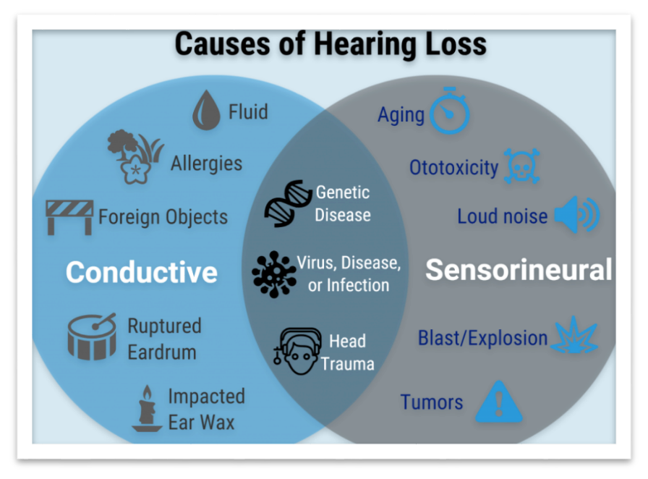
Notes:
Conductive hearing loss can usually be resolved, while sensorineural hearing loss is typically more permanent.
Most conductive hearing losses can be resolved with medical treatment.
Sensorineural hearing losses are usually treated with hearing devices, with the most popular hearing device being a hearing aid.

Slide 20


Sensorineural Hearing Loss
Sensory = cochlea AND/OR Neural = nerve pathway
Attenuation
Sounds must be louder in order to be heard (detected)
Distortion
Changes the way sound is encoded
Who is driving you to the VA?
He’s getting in the way?
Notes:
It is more common for us to see permanent or sensorineural hearing losses.
-sensory meaning damage occurred in the cochlea, and/or
-neural meaning the damage occurred in the neural pathway
This creates 2 major problems in the auditory system, which are attenuation and distortion
-Attenuation: the reduction of a signal, this means a sound has to be louder for the patient to even tell that it’s there
-Distortion: changes the way sound is coded (remember if the sound isn’t coded properly our understanding suffers)- for example
The important piece here is that even if the sound gets louder, it can still be distorted and unclear to your patients

Slide 21

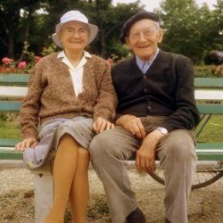
Louder does not always equal clearer
Notes:
SO louder is not always clearer
* THIS slide emphasizes the answer to the strange KOP-Q question #20 that asks true/false “When speaking to hearing impaired older patients, it is best to speak at normal volume. “ The answer on the test is TRUE.

Slide 22

Hearing Loss Impact
Emotional
  Frustration, anxiety, depression
Social
  Desire to withdraw or become isolated
Health
  Contributions to cognitive decline and disease
    Processing, attention, memory
Hearing aids (or assistive listening devices) have been shown to improve quality of life in older adults
Notes:
Hearing loss affects everyone differently. Some people experience one of these forms of daily impact, while others experience multiple.
Some become frustrated when they have to constantly say “huh” or “what”.
Some stop attending gatherings with their friends and families that they once enjoyed because they cannot understand the conversations.
A hot topic in research for audiology right now is the relationship between cognitive decline and hearing loss. More research needs to be done to see if assistive devices can help with cognitive decline, however, hearing aids have been shown to improve quality of life in older adults.

Slide 23
What can you do?
Communication breakdowns in health care can lead to serious medical errors.
Utilize available technology
Practice good communication strategies
Refer for diagnostic audiologic evaluation
Notes:
When communication breaks down, it can lead to serious and dangerous medical errors, so what can you do? the three big ones are :
1. Use assistive listening technology whenever available
2. Practice good communication strategies
And 3. refer for further diagnostic testing if you have concerns

Slide 24
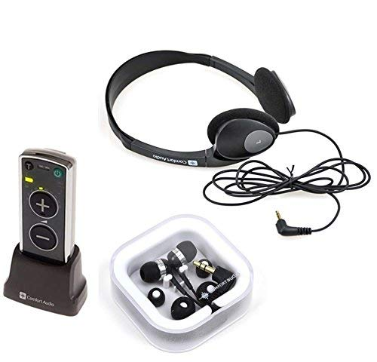
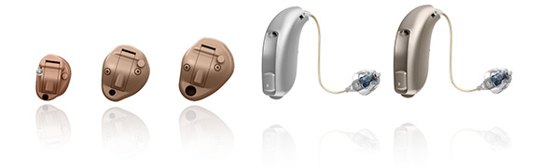
Hearing Aids and Listening Devices
Hearing aids amplify sound and are programmed based on their hearing loss.
    If your patient has hearing aids, encourage them to use them!
    These are helpful, however do not return hearing to normal!
Pocket talkers also amplify sound.
    These are less fine-tuned than hearing aids.
    Good for emergency situations for people without hearing aids!
Notes:
Hearing aids are still delivering sound to damaged system. If your patient has a hearing aid, please don’t expect them to hear everything you say. It is still important to use effective communication strategies.
With a pocket talker, the patient wears the headphones, you talk into a microphone, and what you are saying is played through the headphones or directly in their ears.

Slide 25
Communication Strategies
Be patient!
Get their attention before speaking.
Make sure the listener can see you and your face.
Speak at a normal rate or a little slower.
If needed, speak louder- but DO NOT shout.
If asked, wear a microphone.
DO NOT exclude the patient from the conversation!
Ask them to confirm what you said.
Rephrase the message in less words.
Provide visual cues or written information.

Slide 26
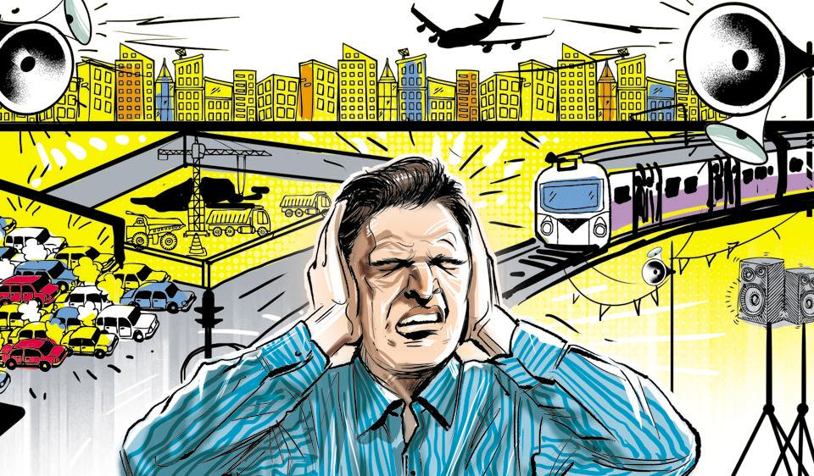
Remember Our Friend DEAN
Distance
  Stand within 3-6 feet of them
Echoes
  Adjust the room to eliminate an echo.
Angles
  Do not stand behind or directly on their side.
Noise
  Reduce the noise in the room

Slide 27
Audiology Services Offered Here
Services offered
  Hearing evaluations
  Hearing aid selections/fitting
  Assistive listening devices (can be used for inpatients)
  Vestibular evaluations
  Tinnitus evaluations and counseling
  Aural rehabilitation
  Cochlear implant evaluations and services
For inpatients who have significant difficulty communicating but do NOT have hearing aids, please contact Audiology. We have assistive listening devices that may be able to assist with communication.
Notes:
We provide a variety of diagnostic and rehabilitative services, including vestibular/dizzy evaluations and cochlear implant evaluations- we also have pocket talkers available for loan for inpatients who are in need and do not have hearing aids- please contact the clinic if you think a patient needs help, we are more than happy to work with you and the patient

Slide 28
Referrals
Inpatient referrals
  Ototoxic monitoring (oncology patients especially)
  Inpatients often have other, more concerning issues at hand. Hearing may not take priority at this time.
  Accommodations: we can support patients who are mobile and in wheel chairs, however our testing booths cannot fit stretchers
If a patient is interested in seeing Audiology but is unable to be seen as an inpatient, we are a DIRECT ACCESS clinic. Patients are able to contact us directly and schedule routine appointments (for a hearing test, if interested in hearing aids, etc.)
Please perform otoscopy prior to referring patients to Audiology – ears should be free of cerumen in order to perform accurate testing
  If patient is on blood thinners please have ears cleaned by physician (PCP, or ENT)
Notes:
Lastly, please refer a patient to audiology if they need further hearing testing or if they are at risk for developing hearing loss due to an ongoing treatment, such as oncology patients starting chemotherapy
If they are an inpatient, just keep in mind, that a hearing test may not be the more pressing concern for this patient- if you think they need help hearing we are happy to get them set up with a pocket talker, and schedule a hearing test when their condition is stable
-please look in their ears first, as ears need to be free of wax before testing
- we do offer cerumen management for wax buildups but we only have 2 providers with the training, and we cannot remove wax from patients who take prescription blood thinner medication (that needs to be done by a physician or ENT)
If they cannot be seen as an inpatient, We are a DIRECT ACCESS clinic, so patients can contact us directly to schedule an appointment

Slide 29
Questions?

Slide 30
References- Oropharyngeal Dysphagia
Konstantin Prass, Johann S. Braun, Ulrich Dirnagl, Christian Meisel and Andreas Meisel. Stroke Propagates Bacterial Aspiration to Pneumonia in a Model of Cerebral Ischemia. Stroke. 2006;37:2607-2612, originally published September 25, 2006
Martino, Rosemary & Foley, Norine & Bhogal, Sanjit & Diamant, Nicholas & Speechley, Mark & Teasell, Robert. (2006). Dysphagia After Stroke: Incidence, Diagnosis, and Pulmonary Complications. Stroke; a journal of cerebral circulation. 36. 2756-63. 10.1161/01.STR.0000190056.76543.eb.
Pictures:
https://www.bing.com/images/search?view=detailV2&ccid=0oFX4JB5&id=A166CBDD1ED0A76F573A856F7B8CEA2289C98B32&thid=OIP.0oFX4JB5Ak2WktXcXixuTQHiCB&q=dysphagia+images&simid=607988962271234205&selectedindex=70&mode=overlay&first=1 Normal Swallowing
https://i.ytimg.com/vi/VoSMA2Anq3U/maxresdefault.jpg Aspiration
https://www.bing.com/images/search?view=detailV2&ccid=VZho15wS&id=E0DE24FCBA82BE760C396E8B673123CD996B0AA5&thid=OIP.VZho15wS4tufGPXtmuaGyAEWDg&q=videofluoroscopic+swallow+study&simid=607987501991266485&selectedIndex=7&ajaxhist=0 Videofluorographic Swallowing Evaluation
https://www.bing.com/images/search?view=detailV2&ccid=H2yix6Mm&id=1A4A58CCE0EA468690A69E8E41C39C252502FBB2&thid=OIP.H2yix6Mmuh-AtpbvrezbrADJCk&q=fiberoptic+endoscopic+swallow&simid=608015883128144619&selectedindex=24&mode=overlay&first=1 Flexible Endoscopic Evaluation of Swallowing
https://www.bing.com/images/search?view=detailV2&ccid=7mlN4hqp&id=087D6BE9DF4E977CC6FE3388DC2CA82A77E690DE&thid=OIP.7mlN4hqpKtyo875n4uDp9QEsC6&q=old+man+smiling+while+eating&simid=608045836210667543&selectedIndex=14&ajaxhist=0 Eating hamburger

Slide 31
References- Hearing Loss
Ciorba, A., Bianchini, C., Pelucchi, S., & Pastore, A. (2012). The impact of hearing loss on the quality of life of elderly adults. Clinical Interventions in Aging, 7, 159–163. http://doi.org/10.2147/CIA.S26059
Harada, C. N., Natelson Love, M. C., & Triebel, K. (2013). Normal Cognitive Aging. Clinics in Geriatric Medicine, 29(4), 737–752. http://doi.org/10.1016/j.cger.2013.07.002
  Healthy Hearing. (2014). Communciation strategies when talking to individuals with hearing loss. Retrieved from https://www.healthyhearing.com/report/51744-Communication-strategies-when-talking-to-individuals-with-hearing-loss
Hoffman HJ, Dobie RA, Losonczy KG, Themann CL, Flamme GA. Declining Prevalence of Hearing Loss in US Adults Aged 20 to 69 Years(link is external). JAMA Otolaryngology – Head & Neck Surgery. December 2016 online.
Newton, V. & Shah, S. (2013). Improving communication with patients with hearing impairment. Community Eye Health Journal, 26(81), 6-7.
UCSF. (n.d.). Communicating with people with hearing loss. Retreived from https://www.ucsfhealth.org/education/communicating_with
_people_with_hearing_loss/
Pichora-Fuller, K. (2016). Hearing, cognition, and healthy aging: Social and public health implications of the links between age-related declines in hearing and cognition. Retrieved from http://www.audiologyonline.com/audiology-ceus/course/hearing-cognition-and-healthy-aging-27181
Yamasoba T, Lin FR, Someya S, Kashio A, Sakamoto T, Kondo K. Current concepts in age-related hearing loss: Epidemiology and mechanistic pathways. Hearing Research. 2013;303:30–38.
Pictures:
Microsoft Clip Art
https://www.tehrantimes.com/news/421181/Noise-pollution-in-Iran-s-megacities-20-times-above-standards
https://www.harriscomm.com/comfort-audio-duett-new-personal-listener-with-earphone-headphone.html
http://clarityhear.net/oticon-hearing-aids-grove-city-oh
https://www.pinterest.com/pin/224054150185051275/
https://www.myvmc.com/anatomy/ear/
http://www.cochlea.eu/en/audiometry/objective-methods/voies-et-centres
https://www.gptrove.net/wp-content/uploads/audiog1.png
https://encrypted-tbn0.gstatic.com/images?q=tbn:ANd9GcSidvN7CoDiTE6DiMcRXVKk-JRlX9ZnlLRiakiMYQOhxy3Z7xY3&s
https://assets.classy.org/9486612/c864f6f0-4f33-11e9-a19a-0a97e5d08a74.png

